Slide 1
REAL LIFE CLINICAL PRACTICE

Slide 2
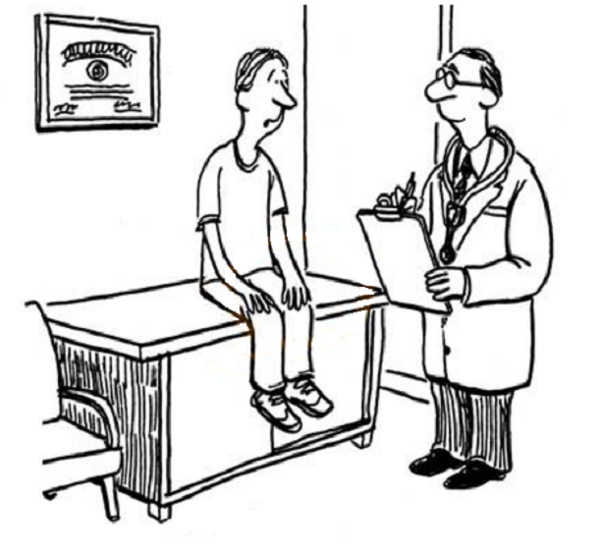
My whole life is affected…
Congratulations! The test were negative!
Everything is perfectly alright!
I cannot sleep…
I cannot bend over or exercise
I cannot eat or drink whatever I like

Slide 3
Paradox
Improvements
Greater understanding of pathogenesis and prevention of Allergy, Asthma and COPD
More therapies and delivery systems
Widespread dissemination of evidence-based guidelines
More knowledgeable patients, care givers, and general public
Birthe Hellquist Dahl 2009
Notes:
There appears to be a paradox in the world of asthma management.
Today, we have:
Better knowledge of the pathogenesis of the disease
Improved pharmacological interventions
National and international guidelines
More opportunities than ever before for education of both health professionals and patients, especially with wide use of the internet

Slide 4
Paradox
But yet…
Allergy & Asthma continues to be poorly controlled
Birthe Hellquist Dahl 2009
Notes:
And yet, asthma still continues to be poorly controlled with unacceptable levels of morbidity and mortality. As a result, patients continue to seek emergency care and require hospitalization.
With so many advancements in asthma management, why can’t we get this disease under control? The problem is complex; possible reasons stem from our patients, health professionals, and health systems.

Slide 5

Patient Reported Outcomes
“any report coming from patients about a health
condition and its treatment “.
Patrick et al, 2007
Notes:
any report coming from patients, without involvment and interpretation by physician or others, about how they function or feel in relation to a health condition and its treatment

Slide 6

PROs to support medical product labelling claims:
FDA perspective
PROs provide a unique perspective on medical therapy, because some effects of a health condition and its therapy are known only to patients
FDA, Food and Drug Administration
Patrick et al. Value Health 2007; 10 (Suppl 2): S125-S137
Notes:
And because pros are now taken into account in the regulatory process

Slide 7


Physician’s and Patient’s viewpoint
Limits
Emotions
Knowledge
Satisfaction
Fear
Sleep
School
Relationships
Diagnosis
Drugs
Follow-up
Guidelines
Severity
Comorbidity
Costs
Clinical parameters
Functional parameters
Physician
Patient
Notes:
Because physicans and patients, have different views of the same disease.
It’s obvious: one is the expert of the disease, and one has a personal experience of the disease
But qol provides an objective assessment of subjective aspects. So we can traslate patient’s perscetive into numbers, scores, indicators

Slide 8
Real Life Observational Studies
Patient
Reported
Outcomes
Disease
Phenotype
Therapy
Disease
Control
Measures
Aetiology
Severity
Comorbidities
Drugs
Schedule
Symptoms Score
Composite Score
Function
Biology
Clinical parameters
Resource utilisation
Preference
Awareness
Satisfaction
Behavior
Coping
Adherence
Stress
Anxiety/depression
Quality of life
Alexithymia
Mood
Etiology
Severity
Comorbidities
Drugs
Schedule
Symptoms Score
Composite Score
Function
Biology
Clin. Parameters
Resources utiliz.

Slide 9
Patient’s point of view
An option?

Slide 10

PROs have been used
as a
“make up – outcome”
Notes:
10
It has been used mainly as secondary outcome
It has been emphasized when the results of primary outcomes were not satisfaying
It has been evaluated with an uncorrect metodology: simple lists of items, unvalidated tool or validated tools in a wrong way

Slide 11


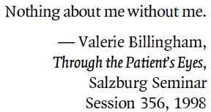
MARCH 2012

Slide 12
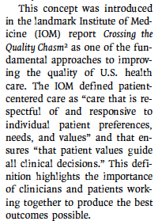
Barry & Edgman-Levitan
MARCH 2012

Slide 13

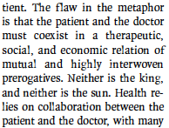
MARCH 2012

Slide 14

HRQoL and other PROs in the European centralised drug regulatory process:
a review of guidance documents and performed authorisations of medicinal products 1995 to 2003
There was a trend toward increasing HRQoL and other PRO claims in regulatory documents of pharmaceutical products in recent years, with the proportion exceeding 30% from 1999 to 2003
HRQoL, health-related quality of life
PRO, patient reported outcomes
Szende et al. Value Health 2005; 8: 534-548
Notes:
And because pros are now taken into account in the regulatory process

Slide 15
GUIDELINES
METHODOLOGY
to reach
Real Life Patients

Slide 16
From EBM to recommendation
Evidence-based medicine
Clinical recommendations
on efficacy for an intervention

Slide 17

Notes:
Il tentativo di risposta a questo quesito sembra rappresentare un vero e proprio punto di svolta. Esso è rappresentato dal progetto GRADE, dove l’acronio sta per…..

Slide 18

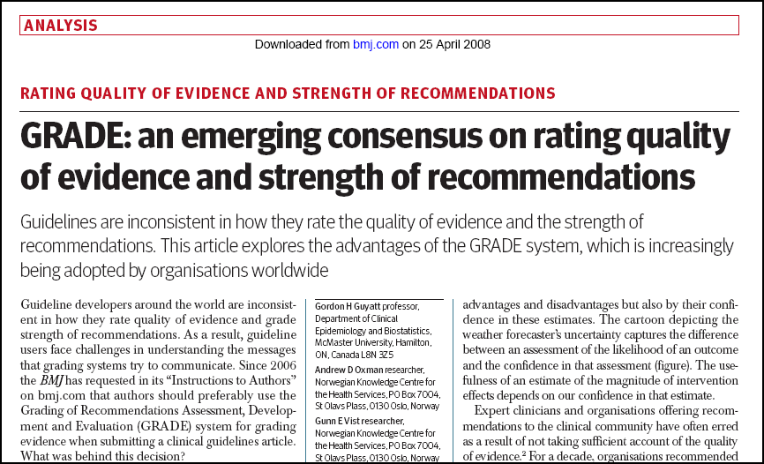
Guyatt et al. BMJ 2008; 336: 924-926

Slide 19






Factors that influence the strengths of a recommendation
Balance between desirable and undesirable effects
Quality of evidence
Patients’values and preferences
Costs
Notes:
Quindi riassumendo, i fattori che influenzano la forza di una raccomandazione sono rappresentati principalmente da:
Il bilancio tra effetti desiderabili ed indesiderabili
La qualità dell’evidenza
Le valutazioni e preferenze dei pazienti
I costi

Slide 20


Two Examples
DRUG A:
Effective
Safe
Cheap
Administration : 18 shots a day
DRUG B:
Effective
Safe
Fast Dissolving Tablet with a good taste
Cost: 300.000 € /year

Slide 21

From EBM to recommendation
Evidence-based medicine
Clinical recommendations
on efficacy for an intervention
Safety
including
post-marketing
surveillance
Health
economics
Patient’s views
recommendations
for an intervention

Slide 22


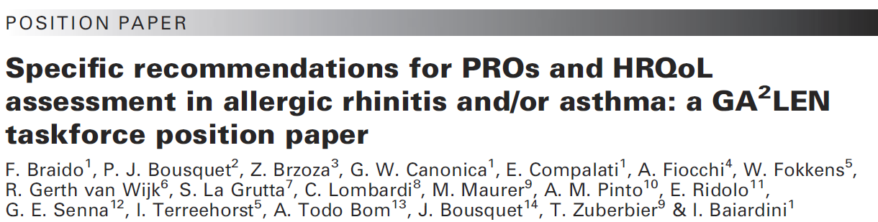

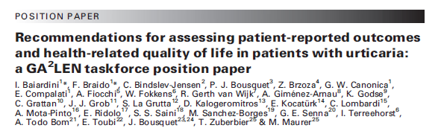
Notes:
In the contest of Ga2len network of excellence, activity supported by the European Union, we have developed specific recommendations for assessing PROS and Quality of life in allergic rhinitis and asthma in clinical trials. In these position papers published on Allergy you can find the criteria for development, use and interpretation of PROs in clinical Research.

Slide 23
PROS
Asking is sufficient?

Slide 24
The patient’s viewpoint, must be measured
directly from the patient
by mean of validated tools
PROs questionnaires must adhere to conventional standards of
validity, reliability, responsiveness

Slide 25
ITEM SELECTION
REDUCTION of ITEM
NUMBER
PRE TESTING
QUESTIONNAIRE
FORMAT
INSTRUMENT
REPRODUCIBILITY
RESPONSIVENESS
VALIDITY
Guyatt GH, JACM

Slide 26
PROS
Are they a paradox?

Slide 27
QOL in a population-based study (ECRHS)
Leynaert et al, Am J Respir Crit Care Med 2000
60
p<0.001
p<0.001
p<0.001
p<0.001
controls (N=448)
50
allergic rhinitis (N=297)
asthma + AR (N=76)
40
Mean score
30
20
10
0
Physical Summary
Mental Summary
Score
Score

Slide 28

Comparison of the NHP (part I) scores in patients
with Chronic Urticaria and Ischemic Hearth Disease
100
90
CU patients n= 134
IHD patients n= 98
80
70
60
50
40
30
20
10
0
mobility
pain
sleep
energy
social
isolation
emotions
gw1652000
O’Donnel et al 1997

Slide 29
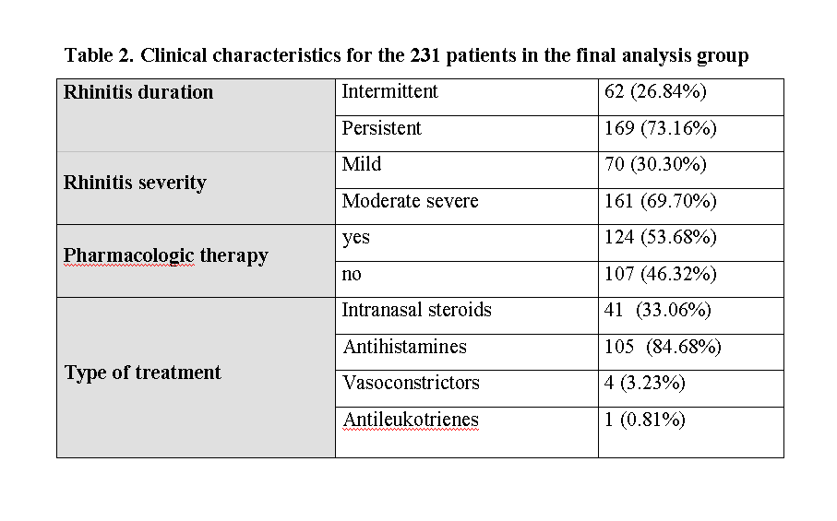

Illness perception, mood and coping strategies in allergic rhinitis:
which differences among ARIA classes of severity?
Fulvio Braido¹, Ilaria Baiardini¹, Nicola Scichilone², Antonino Musarra³, Stefania Menoni⁴, Giorgio W. Canonica¹ on behalf of PROs Research Italian Group⁵
⁵ PROs Research Italian Group:
Ridolo E.; Gani F; Pravettoni V; Colombo G.; Crivellaro M; Senna G.; Fumagalli F; Rossi O.
Braido et al.,Rhinology, 2014

Slide 30
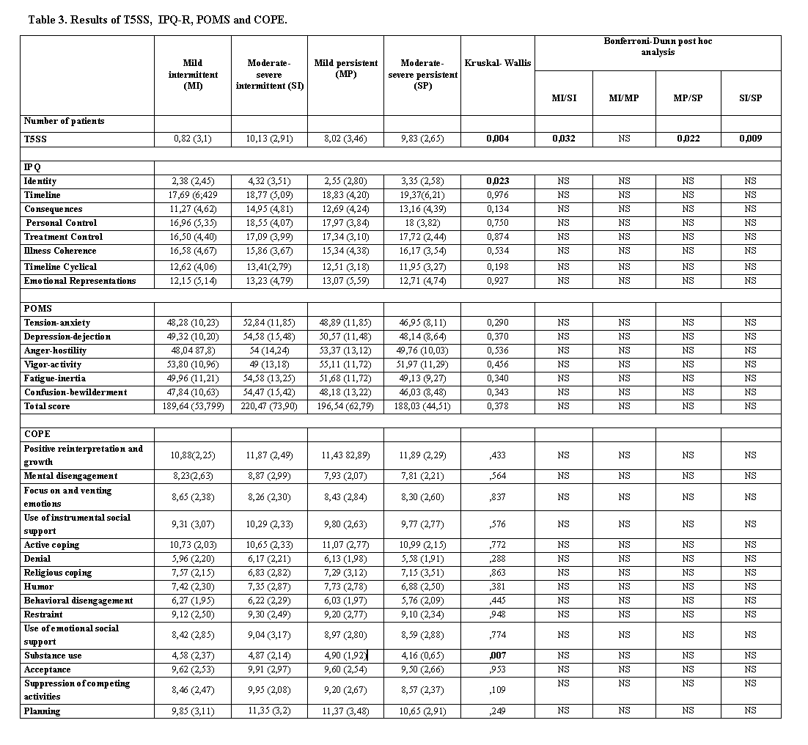
Symptoms
Illness
perception
Mood
Coping

Slide 31
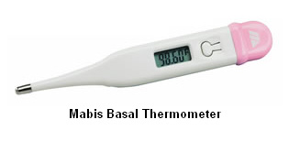
PROs evaluation is
not like
a thermometer …
......but..........

Slide 32
PROS
Can the PROs help us with
difficult patients?

Slide 33

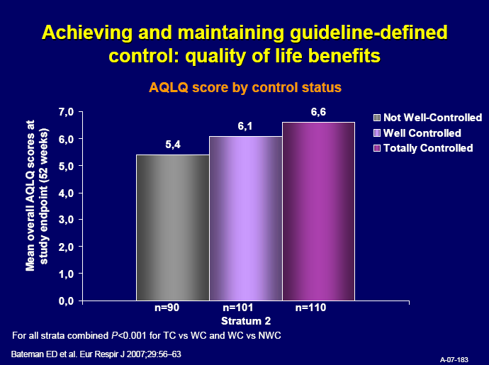
QoL
Notes:
33

Slide 34

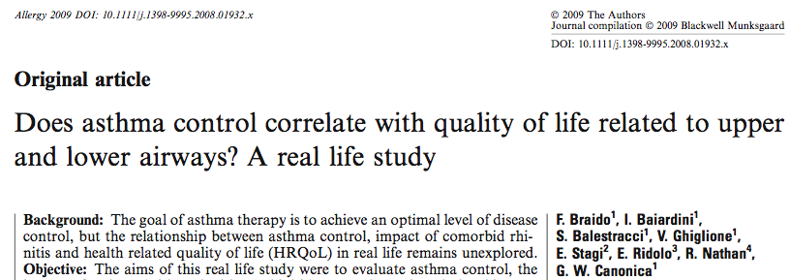
Braido et al. Allergy 2009

Slide 35
ACT vs Rhinasthma Global Summary
ACT vs GS
30
25
20
ACT
15
10
5
0
100
80
60
40
20
0
0
20
40
60
80
100
120
1- GS
Braido F et al.Allergy 2009

Slide 36
Asthma Control vs QoL related to Asthma & Rhinitis
Optimal control – Optimal QoL
30
25
20
ACT
15
10
5
0
100
80
60
40
20
0
0
20
40
60
80
100
120
1- GS
Monitoring control and/or QoL
Braido F et al.Allergy 2009

Slide 37
Asthma Control vs QoL related to Asthma & Rhinitis
No control – Non optimal QoL
30
25
20
ACT
15
10
5
0
100
80
60
40
20
0
0
20
40
60
80
100
120
1- GS
1° to improve control: diagnosis/ treatment plan
adherence/BEHAVIOUR
comorbidities
Braido F et al.Allergy 2009

Slide 38
Asthma Control vs QoL related to Asthma & Rhinitis
Control – non optimal QoL
30
25
20
ACT
15
10
5
0
100
80
60
40
20
0
0
20
40
60
80
100
120
1- GS
1° Check rhinitis (and other comorbidities)
Braido F et al.Allergy 2009

Slide 39
Asthma Control vs QoL related to Asthma & Rhinitis
No control – Optimal QoL
30
25
20
ACT
15
10
5
0
100
80
60
40
20
0
0
20
40
60
80
100
120
1- GS
Check: coping, illness perception, alexithymia (unusable PROs tools)
Disease follow up with medical parameters
Braido F et al.Allergy 2009

Slide 40
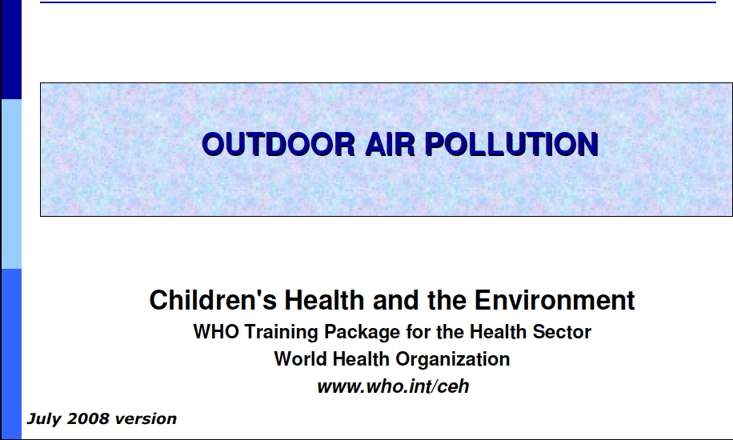


Slide 41
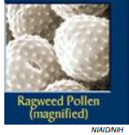

Outdoor air pollution
Pollens
Penetrate into home
  Air-conditioning
  Air-filtration systems: HEPA filter
High grass pollen levels linked
to asthma admissions, epidemics
WHO
Avoid outside play on high pollen days
Antihistamine use

Slide 42
Outdoor air pollution
AIR POLLUTION SOURCES
Outdoor air quality is affected by:
Industrial or agricultural activities
Treatment of industrial effluents and domestic residues
Traffic
Solid waste management
Cottage industries
Chemical incidents and spills

Slide 43

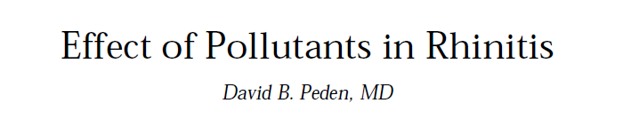
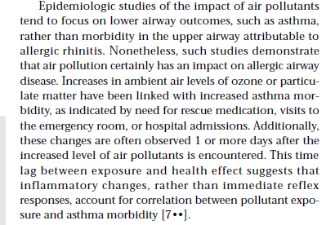
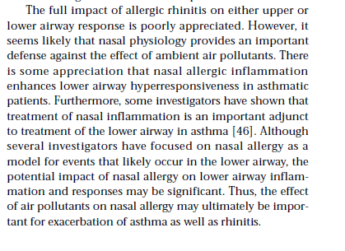


Slide 44


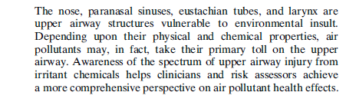

Slide 45
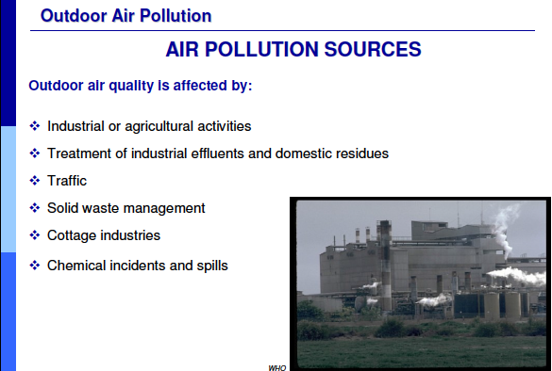

Slide 46
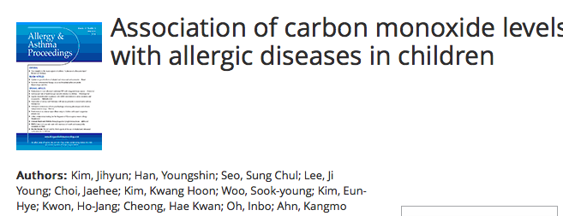
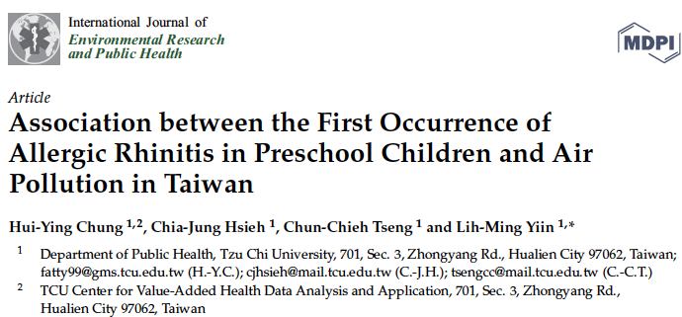

Slide 47
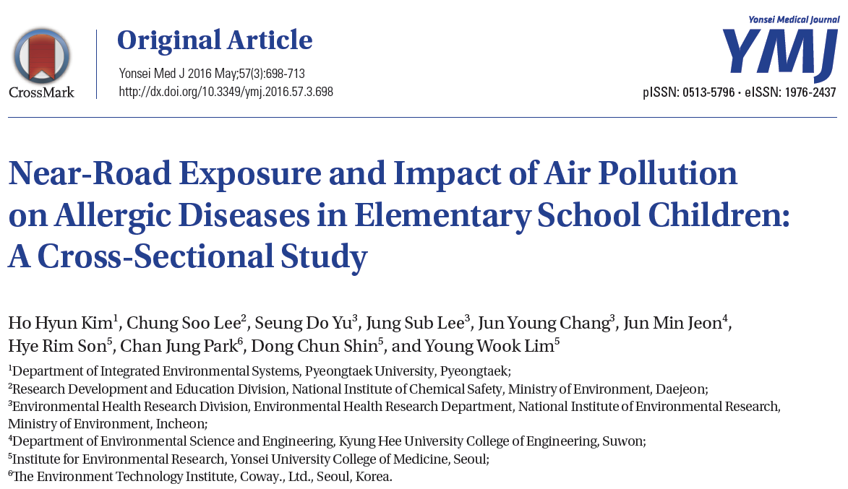

Slide 48

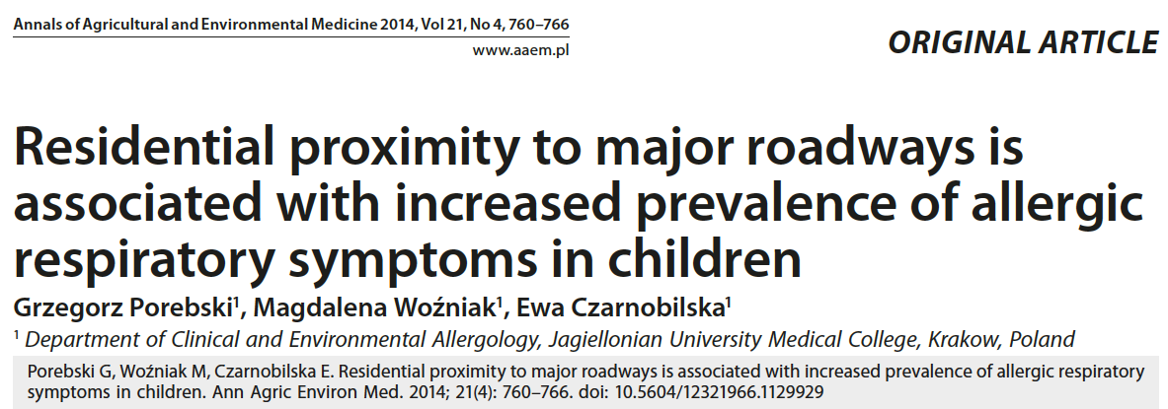
Porebski et al. 2014

Slide 49
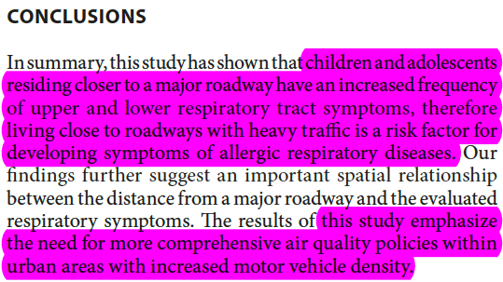
Porebski et al. 2014

Slide 50
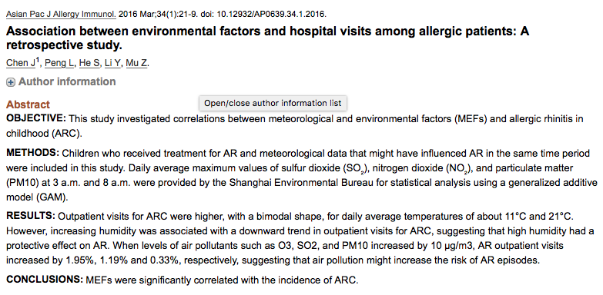

Slide 51
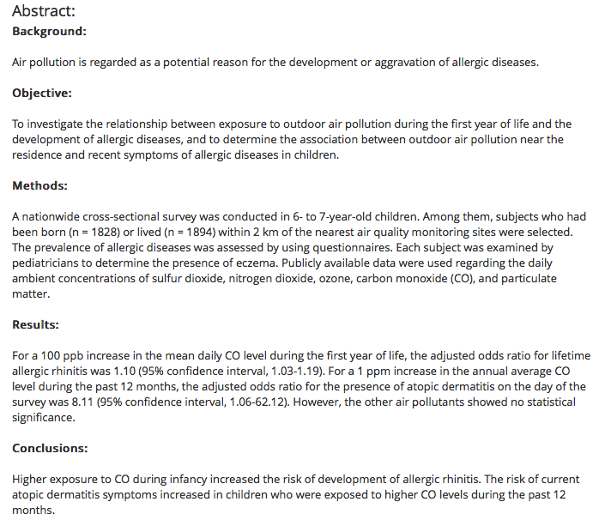

Slide 52
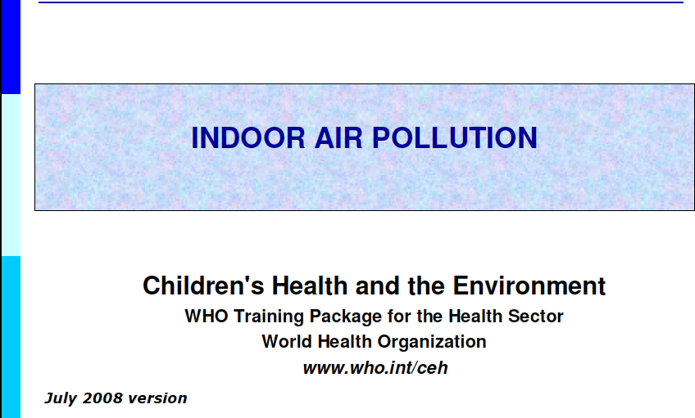

Slide 53
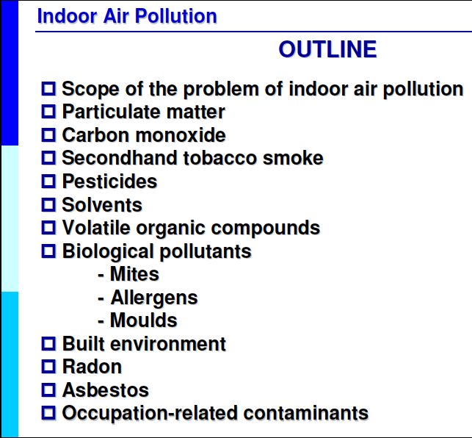
The invisible
culprit

Slide 54
Scope of the problem of indoor air pollution
Particulate matter
Carbon monoxide
Second hand tobacco smoke
Pesticides
Solvents
Volatile organic compounds
Biological pollutants
  - Mites
  - Allergens
  - Molds
Built environment
Radon
Asbestos
Occupation-related contaminants
The invisible
culprit
Adapted from WHO

Slide 55
SOLVENTS AND VOLATILE ORGANIC COMPOUNDS
Alkanes, aromatic hydrocarbons, alcohols, aldehydes, ketones
Sources:
Solvents, fabric softeners, deodorizers and cleaning products
Paints, glues, resins, waxes and polishing materials
Spray propellants, dry cleaning fluids
Pens and markers
Binders and plasticizers
Cosmetics: hair sprays, parfumes
VOLATILE ORGANIC COMPOUNDS: HEALTH EFFECTS
Acute:
Irritation of eyes and respiratory tract
General
  headache, dizziness, loss of coordination, nausea, visual disorders
Allergic reactions, including asthma and rhinitis
Chronic:
Damage to liver, kidney, blood system and central nervous system (CNS)
Some may cause cancer in humans (formaldehyde)

Slide 56


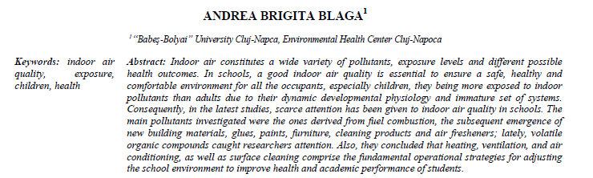

Slide 57
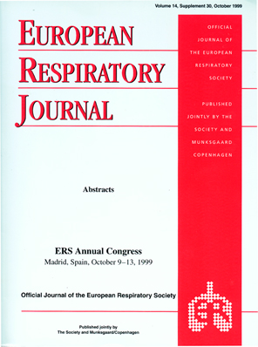
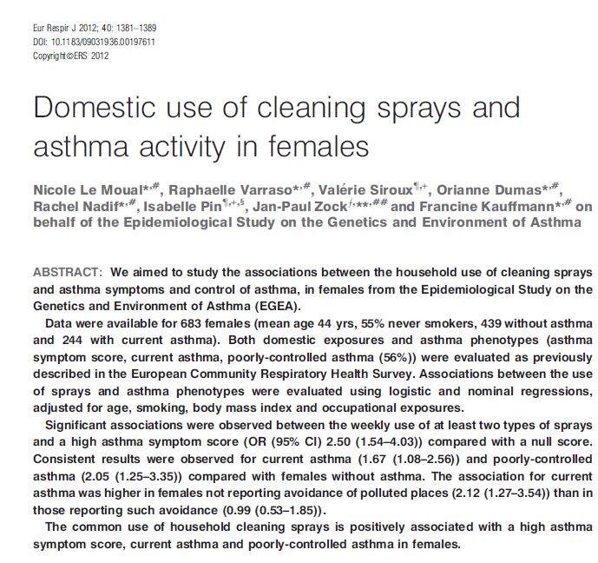

Slide 58
APPROACHES TO REDUCE INDOOR AIR POLLUTION
1. Eliminate or control the sources of pollution
Improved stoves
Clean fuels (kerosene, gas)
Venting stoves for cooking and heating
Regular maintenance of cooking, heating and cooling systems
Choose non-volatile, non-toxic building materials
Maintaining dry homes and schools
2. Ventilation – building design
Dilute and remove pollutants through ventilation with outdoor air
3. Air cleaning – NOT air fresheners!
Air filters and ionizers may remove some airborne particles
Gas adsorbing material is used to remove gaseous contaminants

Slide 59
EDUCATION AND ADVOCACY
Education off:
    Children
    Family and community
    Health care providers
    Environment policy-making
Framework Convention on Tobacco Control
Clean indoor air regulations
Community actions
Research
    A multi-level approach to prevention of indoor air-related illness is required. Education, policy-making and research

Slide 60
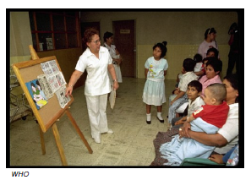
CRITICAL ROLES OF HEALTH & ENVIRONMENT PROFESSIONALS
Diagnose and treat
Do research and publish
  • Detect sentinel cases
  • Inspire community-based
  interventions
Educate
  • Patients and families
  • Colleagues and students
Advocate
Provide good role model

Slide 62

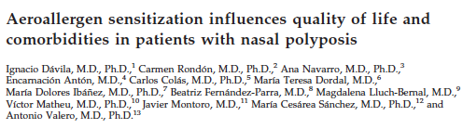
Davila et al. Am.J. Rhin.All. 2012

Slide 63
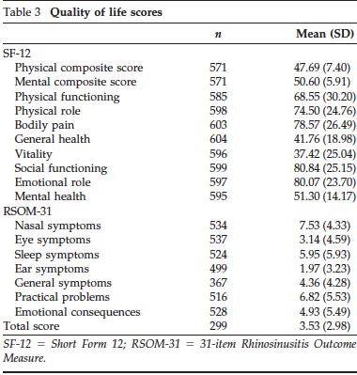
Davila et al. Am.J. Rhin.All. 2012

Slide 64
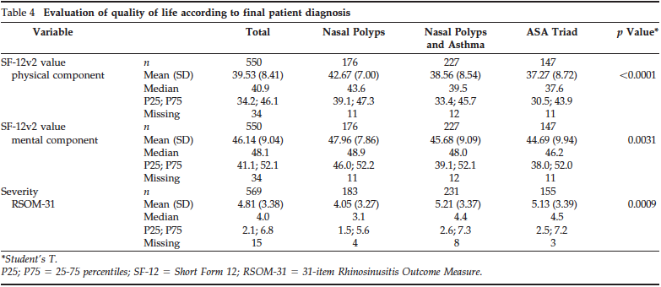
Davila et al. Am.J. Rhin.All. 2012

Slide 65
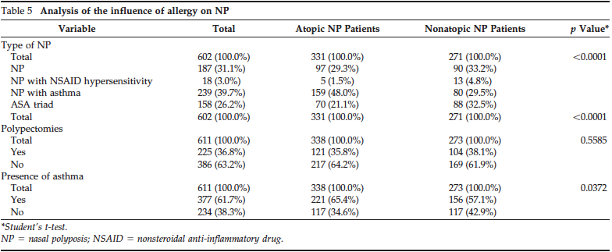
Davila et al. Am.J. Rhin.All. 2012

Slide 66
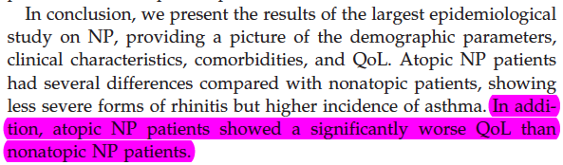
CONCLUSIONS
Davila et al. Am.J. Rhin.All. 2012

Slide 67

ARIA Guidelines: Recommendations for Management of Allergic Rhinitis
E.B.M
Check for asthma
Moderate/
severe
persistent
Mild
persistent
Moderate/
severe
intermittent
Mild
intermittent
Intranasal corticosteroid
Local chromone
Leukotriene receptor antagonists
Second-generation nonsedating H₁-antihistamine
Intranasal decongestant (<10 days) or oral decongestant
Allergen and irritant avoidance
Consider immunotherapy
Bousquet et al. J Allergy Clin Immunol. 2001;108(5 suppl):S147.
At: http://www.whiar.org.

Slide 68


AIT- Allergen ImmunoTherapy

Slide 69
REAL LIFE
HOW IS A.R.
TREATED???

Slide 70
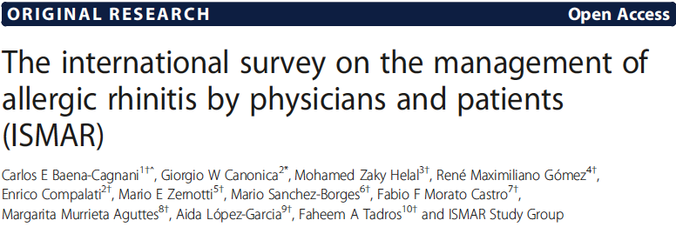
Baena Cagnani et al. WAOJ 2015

Slide 71
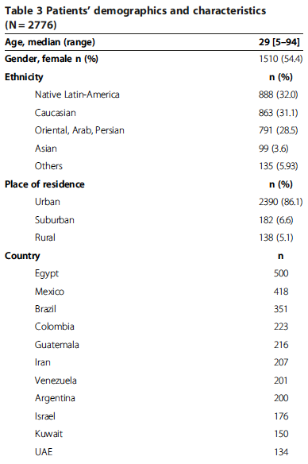
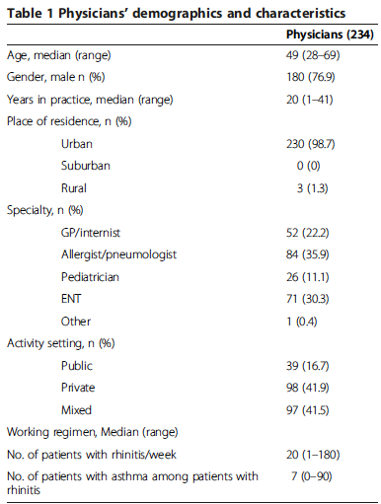
Baena Cagnani et al. WAOJ 2015
Baena Cagnani et al. WAOJ 2015

Slide 72
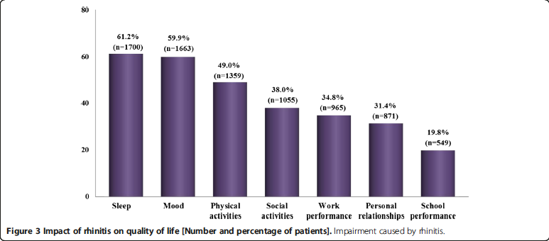
Impact on QoL
Baena Cagnani et al. WAOJ 2015

Slide 73

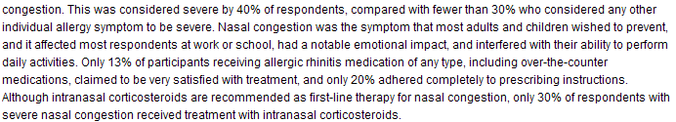
Shedden A et al, Treat Respir Med 2OO5
- 2355 individuals
- 85% Nasal Congestion
Notes:
2355 individui. 85% congestione nasale, severa nel 40%. Sintomo da prevenire

Slide 74
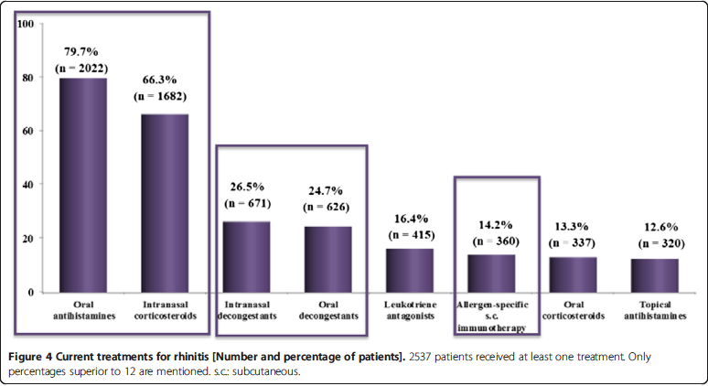
Current Treatments
Baena Cagnani et al. WAOJ 2015

Slide 75
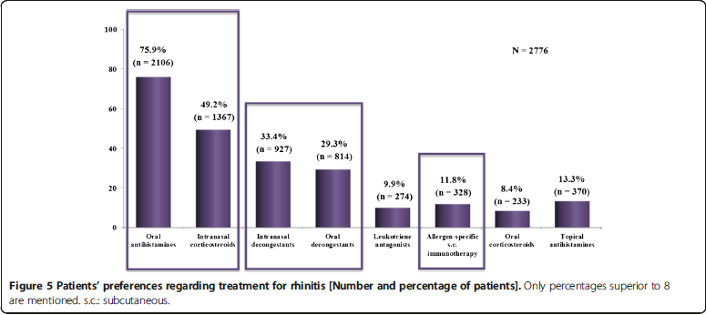
PATIENTS’ PREFERENCE
Baena Cagnani et al. WAOJ 2015

Slide 76
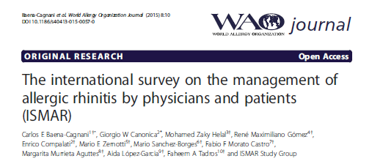
Main Comorbidities
Sinusitis
1384 (49.9%)
Conjunctivitis
1005 (36.2%)
Allergic Rhinitis
N=2776
Asthma
907(32.7%)
Nasal polyps
310 (11.2%)
Otitis media
363 (13.1%)
76
Notes:
76

Slide 77

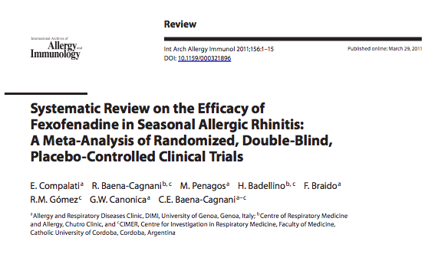
Compalati e al. Int.Arch.All.Immunol 2011

Slide 78
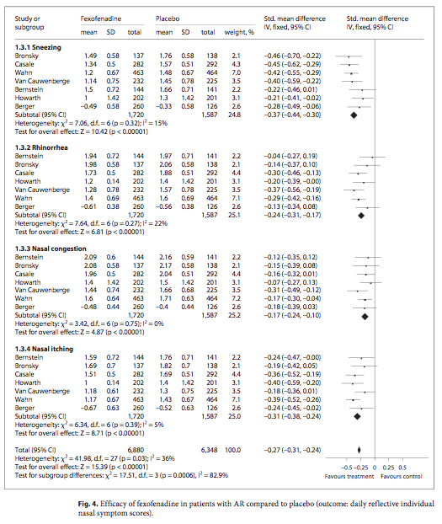
Efficacy of Fexofenadine in Allergic Rhinitis
Compalati E et al. Int Arch Allergy Immunol 2011, 156:1-15

Slide 79
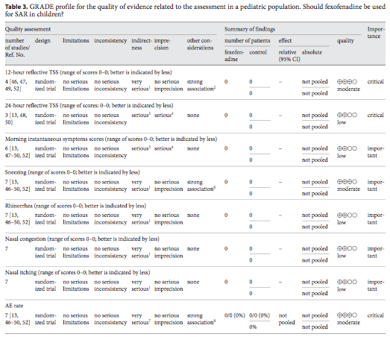
The efficacy and the good safety profile of fexofenadine
was confirmed.
All of these values, together with the
absence of important limitations, encourage the use of
this antihistamine for the treatment of AR.
Compalati E et al. Int Arch Allergy Immunol 2011, 156:1-15

Slide 80
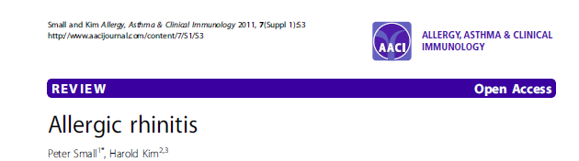
Intranasal corticosteroids are also first-line therapeutic options for patients with mild persistent or moderate/ severe symptoms and they can be used alone or in combination with oral antihistamines
Small & Kim 2011

Slide 81
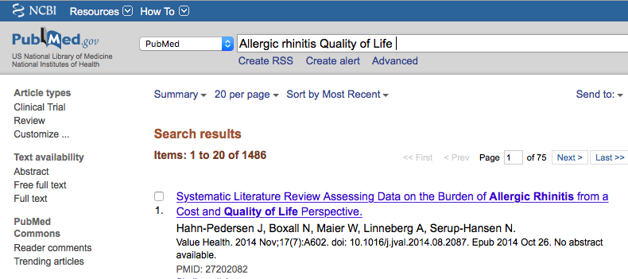

Slide 82
Allergic Rhinitis QoL in Clinical Practice
1

Slide 83


Meltzer E.O. Immunol. All.N.Am.2016

Slide 84


Quality of Life
Meltzer E.O. Immunol. All.N.Am.2016

Slide 85


Okubo et al Int.Arch.All.Immunol. 2004

Slide 86


Okubo et al Int.Arch.All.Immunol. 2004

Slide 87



Okubo et al Int.Arch.All.Immunol. 2004

Slide 88


Okubo et al Int.Arch.All.Immunol. 2004

Slide 89
Allergic Rhinitis QoL in Clinical Practice
2

Slide 90
Barriers to the use of current questionnaires
in daily practice
size
complexity
scoring systems
Notes:
the psychometric properties of the available questionnaires have been evaluated in patients’ populations, but not in the single patient [1]. For a questionnaire to be clinically useful, not only it must be valid, reliable and responsive in the single patient, but also simple, quick to complete, easy to score and interpret, and it has to provide useful information for disease management
Barriers to the use of current questionnaires in daily practice:

Slide 91

Baiardini et al. Allergy 2003
30 items
5 points Likert response scale
3 factors
Lower Airways
Upper Airways
Respiratory Allergy Impact
1 composite
score
Global Summary
A higher score indicates worse QoL in a 0-100 scale.
Notes:
91

Slide 92

RHINASTHMA scoring
Numeric values for responses to the CU-Q2oL items have to be converted to 0-100 point scores by using the following formula for each factor and for the Global:
[ (Σ items – minΣ items / maxΣ items – minΣ items)] x 100
where:
Σ items= sum of all items included in the factor
minΣ items = minimum possible score for the factor
maxΣ items = maximum possible score for the factor
Baiardini et al. Allergy 2003

Slide 93
Baiardini et al. Allergy 2003
Questionnaires for clinical practice must be
valid
reliable
responsive
simple
quick to complete
easy to score and interpret
it has to provide useful information for disease management

Slide 94
RAPP:
Rhinitis & Asthma Patient Perspective
Braido et al. Allergy, 2012
Notes:
94

Slide 95
Optimal HRQoL
ROC analyses, using RHINASTHMA GS score < 20 or >20 as criterion measure, to determine the RAPP score that indicates optimal HRQoL.
A cut-off point of 15 demonstrated the best sensitivity (88.3%) and specificity (84.6%) in discriminating the achievement of an optimal HRQoL, with a percentage of correctly classified patients of 87.3%
Braido et al. Allergy, 2012

Slide 96
Clinical significance (MID)
ROC analysis of different cut-offs of the global rating of change
A 2-point difference or change in RAPP maximizes sensitivity, specificity and number of individuals correctly classified.
Braido et al. Allergy, 2012
Notes:
It indicates the score perceived as significant for the patients, non only for the statisical analysis
96

Slide 97


Braido et al. Allergy, 2012
Optimal QoL

Slide 98

Braido et al. Allergy, 2012
FIRST QoL Tool
to be used in daily
Clinical Practice

Slide 99




RAPP-APP
Smartphone App
for QoL measure in
Respiratory Allergy
patients

Slide 100
Take Home Messages

Slide 101



Slide 102
A.R. TREATMENT REQUIREMENTS
Prevention of Indoor & Outdoor Pollution

Slide 103


Slide 104


Slide 105


Slide 106


Slide 107
A.R. TREATMENT REQUIREMENTS
Prevention of Indoor & Outdoor Pollution
Drug & AIT Treatments according to Guidelines

Slide 108

Concluding Remarks

Slide 109
The role of air pollution in the severity of rhinitis
Bibliographic analysis
Proposal for a study using telemonitoring
        New thinking
        MASK
        First unexpected MASK results
        Proposal

Slide 110
Proposal
To have a new thinking strategy
To use new methods to assess AR severity
To combine ICT technology with validated measures of outdoor air pollution
  To demonstrate the role of air pollution in aggravation of AR symptoms during allergen exposure
  To suggest the effect of some medications

Slide 111
The role of air pollution in the severity of rhinitis
Proposal for a study using telemonitoring
        New thinking
        MASK
        First unexpected MASK results
        Proposal

Slide 112

EIP on AHA

Slide 113





AIRWAYS ICPs (Eur Respir J 2014)

Slide 114
Airways - ICP launch
Dr Mike Bewick
Deputy Medical Director
NHS England
17 Feb 2014

Slide 115


My allergy diary
On first use, users see a welcome screen, accept terms and conditions of use and are given the opportunity to register and create an account.

Slide 116



Slide 117


My Allergy Diary: Symptom Control
? Indicates a response is required
Users touch the line to indicate response and a ‘marker’ appears in that location
The marker can be moved with a finger to mark the line where intended.
Once the mark is placed the user then touches ‘next’ to move on to the next VAS
Each VAS is completed once daily

Slide 118

My Allergy Diary: control assessment
In case of continued high scores the feedback message will display an appropriate message in red type and a warning icon will mark the graph
  Prompts users to discuss their diary data with their health care provider
  Aim: get to ‘green’ and stay there

Slide 119


EQ-5D & WPAI-AS

Slide 120

Availability of the MASK App
Initial version
July 2015
December 2015

Slide 121


ICP in allergic rhinitis

Slide 122


Clinical decision support system
J Allergy Clin Immunol, 2016, in press

Slide 123



Michael Bewick
Jean Bousquet
Olivier VandenPlas
Peter Hellings

Slide 124
The role of air pollution in the severity of rhinitis
Proposal for a study using telemonitoring
          New thinking
          MASK
          First unexpected MASK results
          Proposal

Slide 125
Aims
On February 29, 2016, information on baseline characteristics was made available for the first 730 participants of the MASK survey in Europe.
The aims of this cross-sectional pilot study were to assess whether
  Allergy Diary users were able to properly provide baseline characteristics,
  Simple phenotypic characteristics based upon data captured by Allergy Diary could be identified
  and information gathered by this pilot study could suggest novel concepts and research questions.

Slide 126



Slide 127
Clinical score
Group
Nasal symptoms
1
NO
YES
Non symptomatic
Rhinorrhea
Probably non-allergic
rhinitis
2
NO
YES
Number of other nasal/ocular symptoms
3
4
5
6
None
1-2
≥3
All
Most patients with allergic rhinitis should have 3-4 symptoms (including rhinorrhoea)

Slide 128
Repartition of symptomatic participants
% participants
Group

Slide 129

Impairment in different clinical groups
Chi2 test : P<0.01 group 4 vs 3*; group 5 vs 4$; group 6 vs 5£.

Slide 130

Impairment in participants with rhinorrhea

Slide 131
Validation in an observational study
EQUINOXE 2 (Devillier et al)
Adolescents (aged 12–17) and adults (aged 18–65) consulting specialist physicians for grass-pollen-induced AR in France
Four-week, multicentre, observational study. The management of AR was at the physicians’ discretion.
Participants regularly rate
  the impairments of classroom/work productivity and regular activities according to the WPAI,
  their symptoms (using the Rhino conjunctivitis Total Symptom Score (RTSS) score,
  and a visual analogue scale, (VAS)
  and quality of life (according to the Rhino conjunctivitis Quality of Life Questionnaire, RQLQ).

Slide 132

Validation in an observational study

Slide 133


Slide 134




Slide 135
VAS correlations
Global VAS score measured
Cumulative VAS score: mean of nasal + ocular + asthma/3
N= 2,267 days
Measured global VAS score
Calculated cumulative VAS score

Slide 136
The role of air pollution in the severity of rhinitis
Proposal for a study using telemonitoring
          New thinking
          MASK
          First unexpected MASK results
          Proposal

Slide 137
Interactions between air pollution and AR
1- MASK users have agreed for the analysis of their data
2- MASK users are geolocalized
3- MASK users measure daily
  VAS (global, nasal, ocular, asthma, work)
  Medications
4- VAS users measure weekly
  WPAI-AS
  EQ-5D
5- Measurement of pollution
6- Comparison between « polluted » and « non-polluted » days
  Daily VAS including work productivity
  Possibility to assess treatment effect
  Possibility to have an economic evaluation

Slide 138
Key messages
Allergy & Air Pollution Training meeting
Air pollution is considered as a major global threat for respiratory and non-respiratory diseases causing over 3 million deaths a year
There are many studies supporting the impact of air pollution in the onset and severity of rhinitis and asthma
However, more studies are needed
  To better understand the links between allergy and pollution
  To better define the role of indoor and outdoor pollution
  To estimate the interaction between allergens and pollutants across the life cycle
  To understand the impact of pollution in the prevention and control of allergic diseases
A political agenda should be proposed to appropriately prevent and manage air pollution in allergic diseases (including Cop 21)

Slide 139
THANK YOU

Slide 140
The content of this slide deck does not necessarily reflect the views of Sanofi.
Any product mentioned in these slides may be marketed or not in their country and doses may vary.
Before prescribing, always refer to the prescribing information.
Sanofi does not recommend the use of its products in a manner inconsistent with that described in the full Prescribing Information.
Reproduction is prohibited in whole or in part in any means graphic, electronic or print, without the consent of Sanofi.
SAGLB.CFEX.16.06.0420

