Slide 1
Role of Air Pollution in the Aggravation of Allergic symptoms: The Indian situation

Slide 2
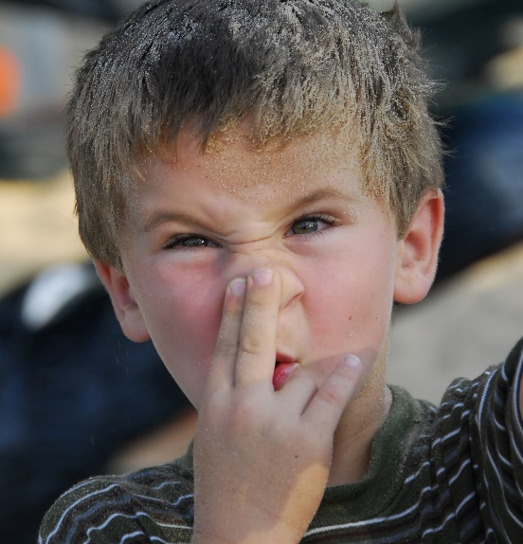
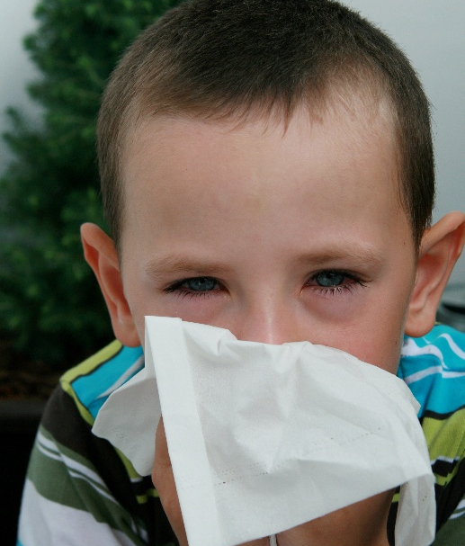
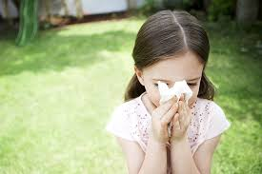
Prevalence of AR in India: The International Study for Asthma and Allergies in Childhood (ISAAC): Indian data²
Only nasal symptoms
Allergic rhino conjunctivitis
 | ISSAC Phase 1 | ISSAC Phase 3
 | ISSAC Phase 1 | ISSAC Phase 3
Age group | 1998 | 2009
6-7 years | 12.5% | 12.9%
13-14 years | 18.6% | 23.6%
Age group | 1998 | 2009
6-7 years | 3.2% | 3.9%
13-14 years | 6.3% | 10.4%
Asia Pac Allergy. 2012;2(2):93-100
Notes:
The phase I of the International Study for Asthma and Allergies in Childhood (ISAAC) in India exhibited that 12.5% and 18.6% of children have only nasal symptoms in the 6-7 year age-group and 13-14 year age-group, respectively. It was reported that allergic rhinoconjunctivitis was seen in 3.2% and 6.3% of children in the 6-7 year age-group and 13-14 year age-group, respectively. The phase III of ISAAC exhibited that the prevalence of current nose symptoms increased to 12.9% in the 6-7 age-group and 23.6% in the 13-14 year age-group, while the prevalence of allergic rhinoconjunctivitis increased to 3.9% and 10.4% respectively.

Slide 3
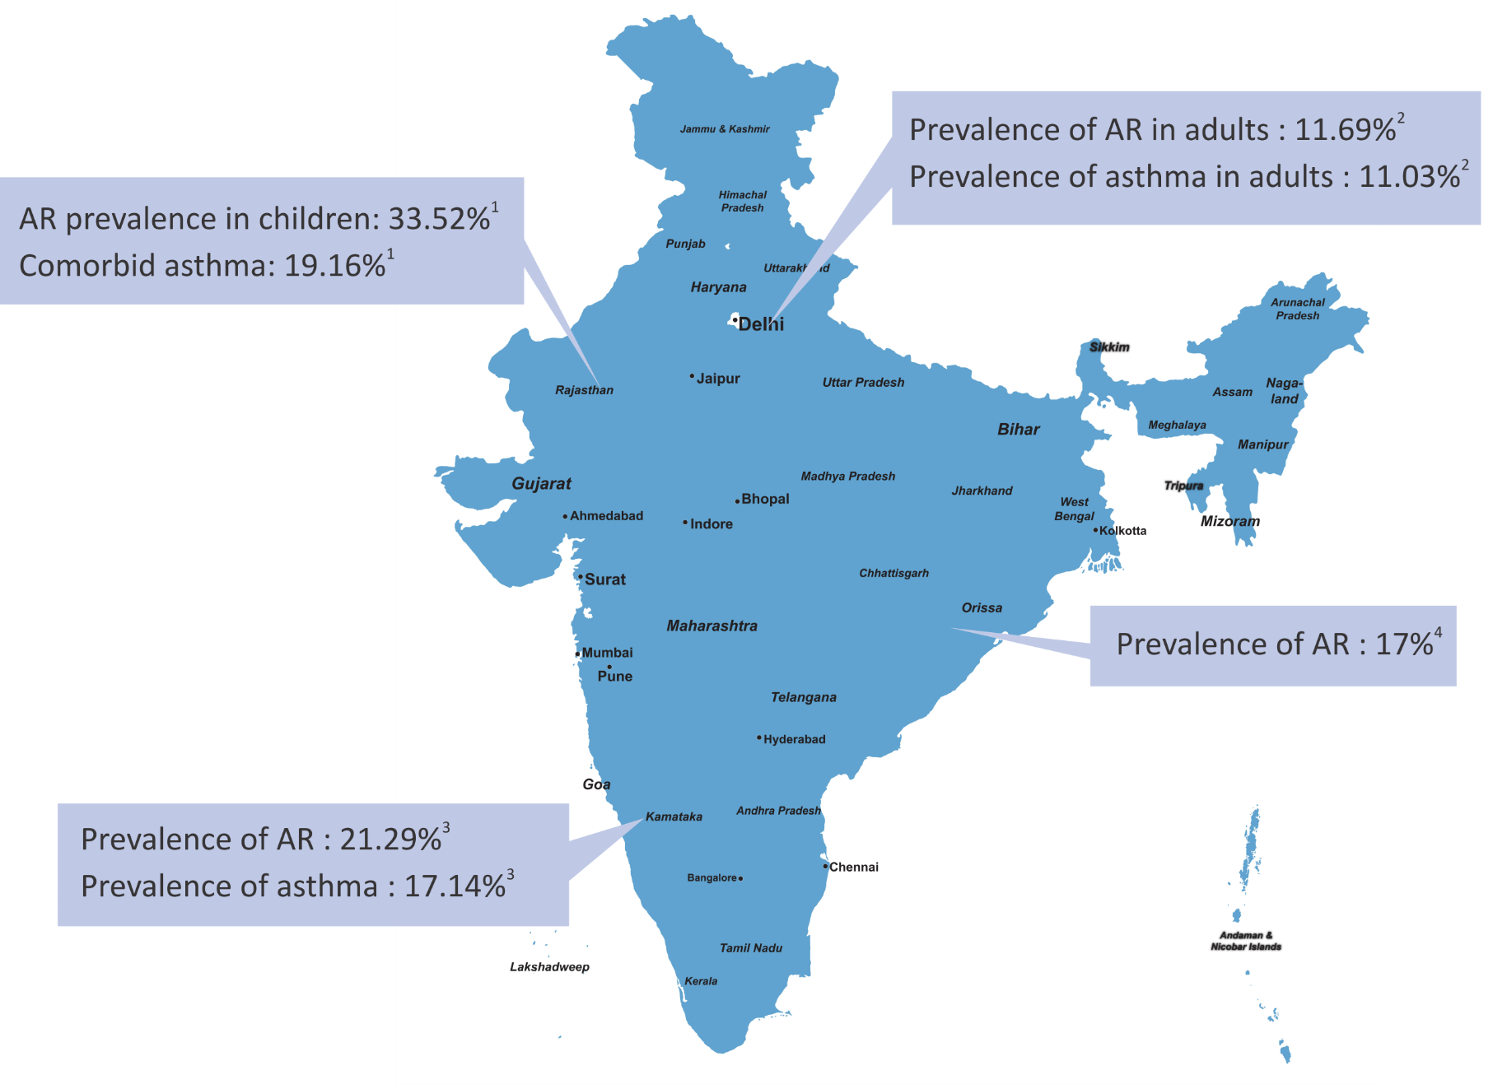
Studies with prevalence of AR and asthma from various regions of India
World Allergy Organ J. 2013;6(Suppl 1):P164; 2. Indian J Allergy Asthma Immunol. 2006;20(2):90-97; 3. ERJ. 2014;44(Suppl 58):1187; 4. IOSR Journal of Dental and Medical Sciences (IOSR-JDMS). 2014;13(11):16-20.

Slide 4
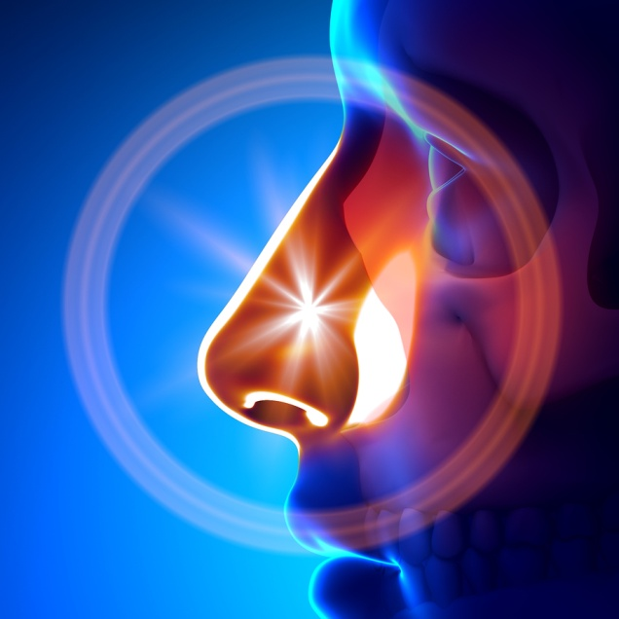
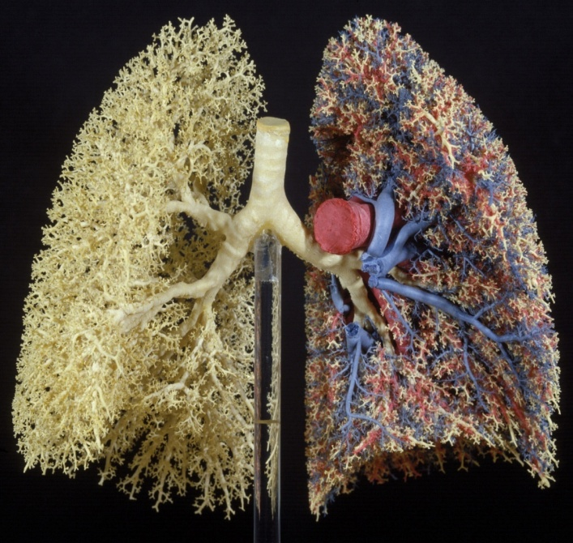
NOSE: FILTER, SMELL and CONDITION
LUNGS: THE ORGAN OF RESPIRATION
In an adult, about 18,000 liters of air pass through the nose each day.
Lungs–surface area 100m²
Lungs - 10,000+ Lts air pass in and out every 24 hours
Lungs - 10,000 Lts blood pass every 24 hours
420 Lts of oxygen required every day
350 Lts of CO2 excreted every day
Lung health and Diseases, American Lung Association_www.lung.org

Slide 5
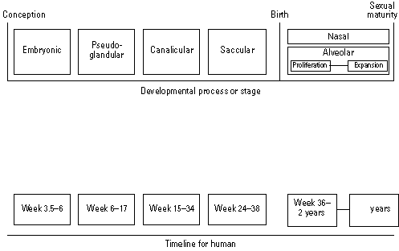
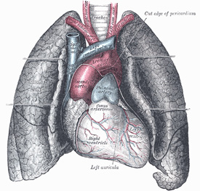
RESPIRATORY DEVELOPMENT: CONTINUES THROUGH LINEAR GROWTH
External Influences on
Growth/structure
Second-hand tobacco smoke
Particulates
Ozone
Function
Indoor air quality
Ambient ozone
10 X 10⁶ Alveoli
300 X 10⁶ Alveoli
(age 8)
2 to 8
Dieter T , Developmental and Reproductive Toxicology 2000
Notes:
Like the nervous system, the respiratory system continues to grow and develop through linear growth. The upper section of the diagram depicts the different developmental phases of the lungs corresponding to the age of the embryo/fetus. It may be seen that at birth, a baby has about 10 million alveoli, but at age 8 years, the lungs have grown and the number of alveoli has reached 300 million. Exposures during this growth period are known to have adverse consequences on both structure (growth of the lungs, as illustrated in the diagram) and function (which is affected by indoor air quality and ozone exposure).
Figure: Dietert RR et al. Workshop to identify critical windows of exposure for children's health: immune and respiratory systems – work group summary. Environmental Health Perspectives, 2000, 108:483-90. Reproduced with permission from Environmental Health Perspectives

Slide 6
Few Risk Factors for Allergic Disease
Family History
(Genetics)
Season of Birth
Male Gender during Childhood
Increase in pollution
Dietary Changes
Obesity
Viral Infections
STRESS
WAO. White Book on Allergy: Update 2013.
Accessed May 2016
Lockett GA et al. Allergy 2016; DOI:
10.1111/all.12882.

Slide 7
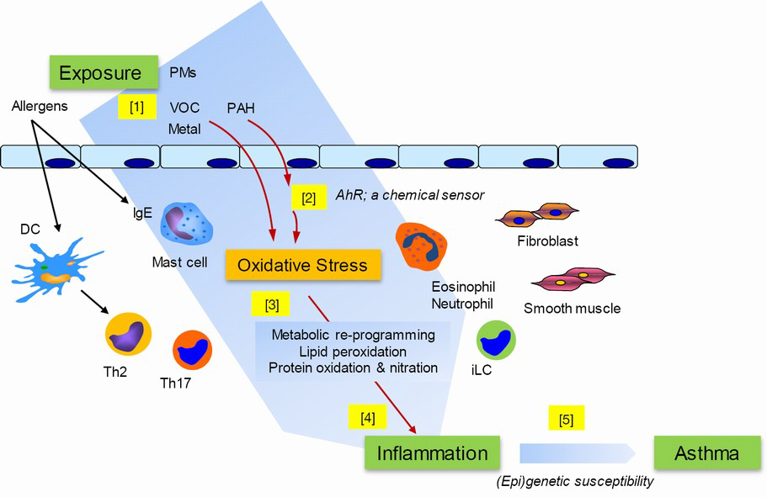
Pollution – Allergy Mechanistic Links
Allergy
From Huang SK et al. J Thorac Dis; 2015, 7(1):22-33.doi:10.3978/j.issn.2072-1439.2014.12.13:

Slide 8
India – Scope of the Problem of Air Pollution
The World Health Organization (WHO) estimates that of the 67 risk factors studied in their Global Burden of Disease project, outdoor air pollution was ranked fifth in mortality and seventh in health burden in India, contributing to over 627,000 deaths and 17.7 million healthy years of life lost in 2010.
Lim SS et al. 2012.. Lancet 380:2224–60.

Slide 9
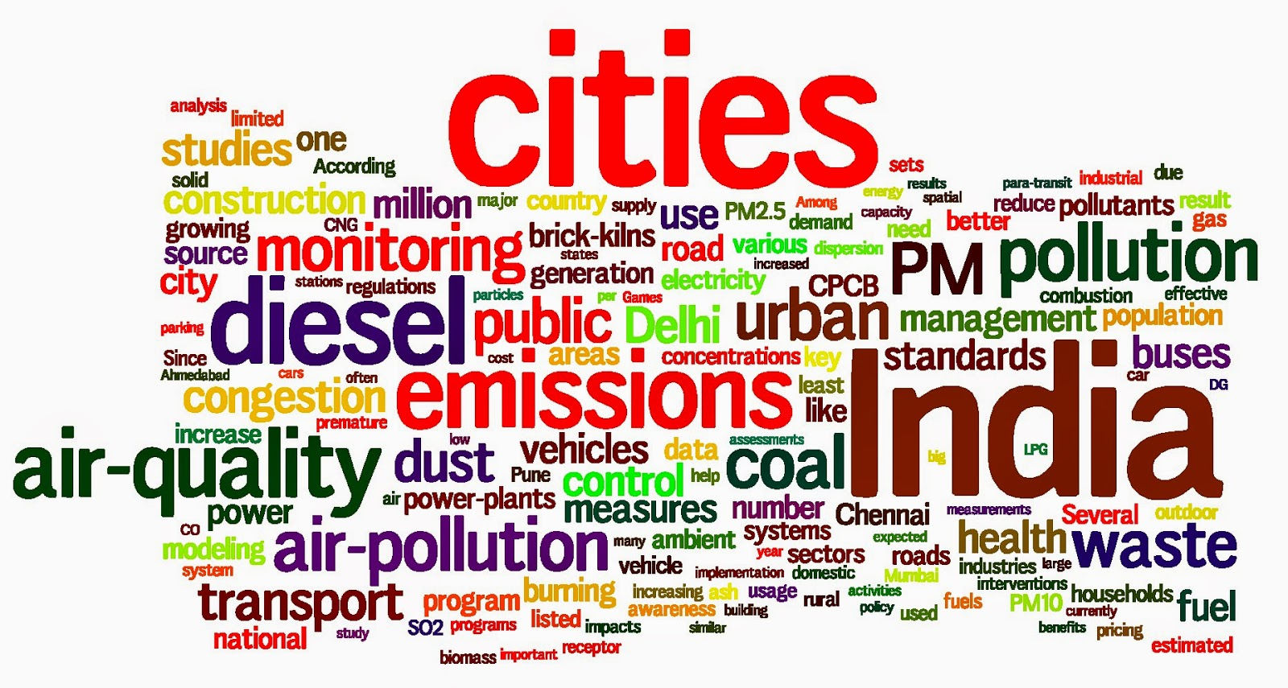
13 out of 20 most polluted cities in world are from India
- WHO Report December 2014

Slide 10
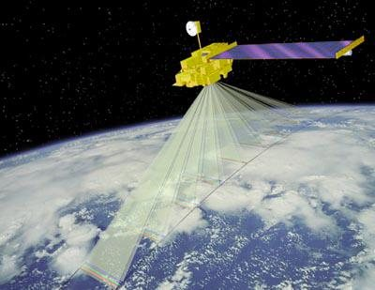
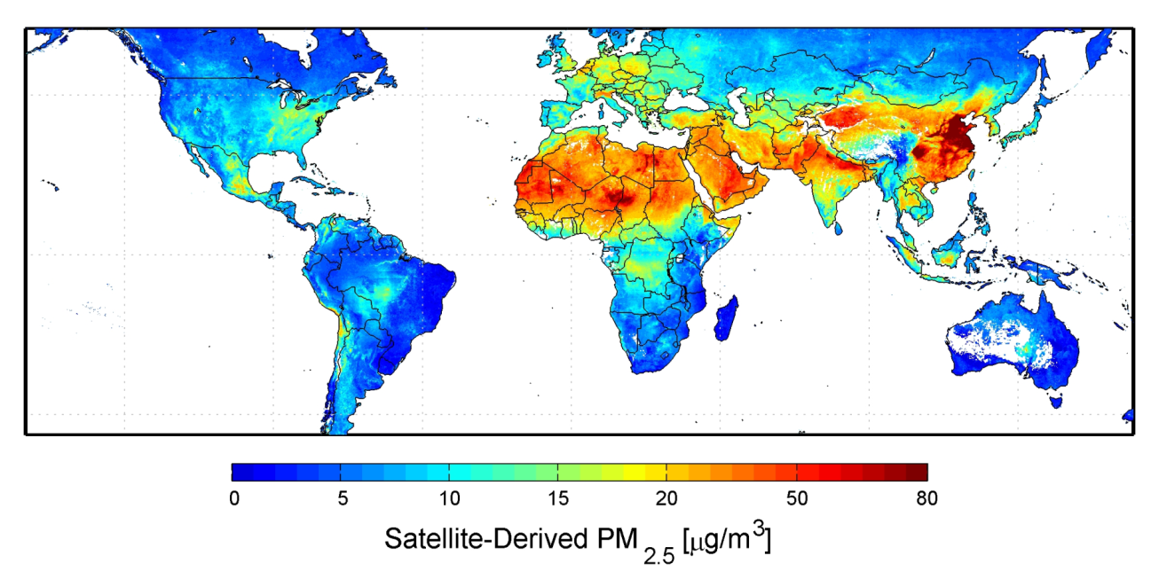
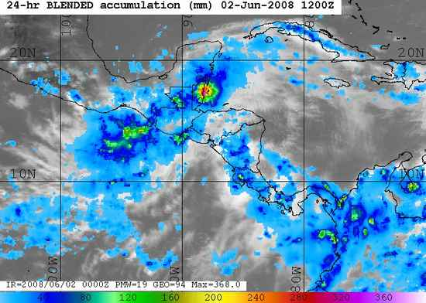
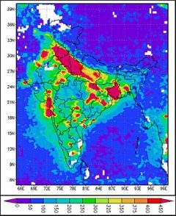
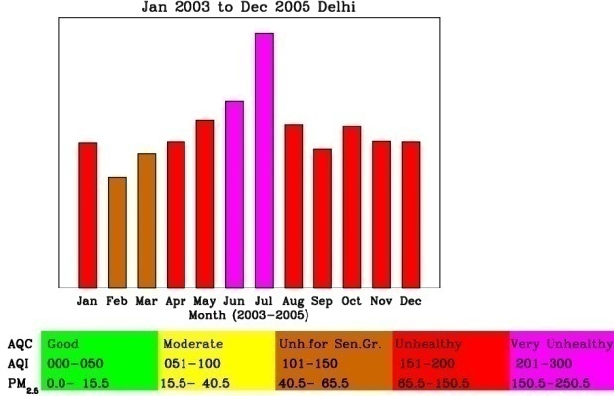
Remote sensing of air pollution from space
(Indian Inst. of Tropical Meteorology)
(Van Donkelaar et al. Environ Health Perspect 2010; 118(6): 847 DOI: 10.1289/ehp.0901623)

Slide 11
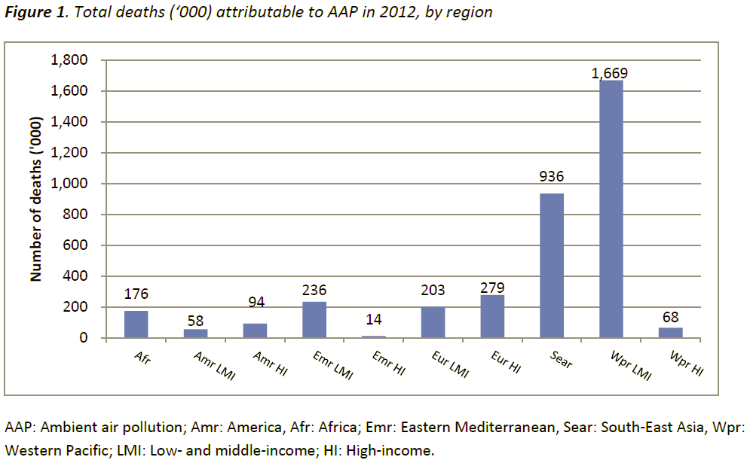
Burden from Ambient Air Pollution
Globally, 3.7 million deaths were attributable to ambient air pollution (AAP) in 2012. About 88% of these deaths occur in low- and middle-income (LMI) countries, which represent 82% of the world population. The Western Pacific and South East Asian regions bear most of the burden with 1.67 million and 936’000 deaths, respectively.

Slide 12
Contribution of various sectors to ambient air pollution in India
% age
Ministry of Environment & Forests, 2005

Slide 13
Vehicular Exhaust Rising – The Indian Scenario
WORLD SCENARIO
INDIAN SCENARIO
Motor vehicle fleet
No. of Motor vehicles in India
1951 0.3 million
1997 37.2 million
Urban population
Total population
(In 2014 will reached 70 million vehicles)
Consumption of petrol in India
1981 1.3 x 10⁵ tonnes
1999 5.17 x 10⁵ tonnes
Growth rate
Consumption of diesel in India
1981 3.77 lac tonnes
1999 11.9 lac tonnes
1950
1970
1990
2000
2020
(World Bank, 1990)
(Panwar TS et al, World Bank, 2002)

Slide 14
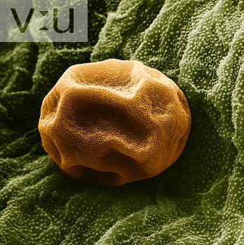
↑ ↑ IgE
↑ ↑ ↑ ↑ IgE
Diesel exhaust particles increase allergen-specific IgE levels by up to 50-fold
New sensitizations have been shown to be developed by DEPs
Pollen become more allergenic when these trees grow in an urban environment
(Knox et al, Clin Exp Allergy 1997
Takenaka et al, J Allergy Clin Immunol 1995; 95: 103-115)
(Bryce M et al., Int Arch Alergy Immunol 2010; 151: 45-65)

Slide 15
Climate Change Impacts on Pollen
How climate change impacts pollen:
Temperature
Increased pollen production, longer pollen season, increased potency of airborne allergens
Proliferation of weedy plants/grass species that are known producers of highly allergenic pollen
Introduction of new allergen-producing plant species
Carbon dioxide
Precipitation
Notes:
Climate change is expected to increase pollen production, lengthen the pollen season and increase the potency of airborne allergens
Higher levels of CO2 in the atmosphere act as a fertilizer for plant growth
Warmer temperatures and increased precipitation cause some plants to grow faster, bloom earlier, and produce more pollen
Both increased temperatures and increased carbon dioxide concentrations are expected to increase plant production of pollens, and may also increase fungal growth and spore release.
“Pollen and mold spores are allergens; they can induce and/or aggravate allergic rhinitis, asthma (already the most common childhood chronic illness), and COPD. Some experts have suggested that the global rise in asthma rates is an early health effect of climate change.”
Increased allergenicity: Recent scientific studies also suggest that climate-related temperature changes are expected to increase the potency of airborne allergens. Such changes increase the concentration of pollen in the air, the length of the allergy season and the strength of airborne allergens, and associated increases in allergy symptoms.
Longer growing season: Temperature changes are expected to alter allergy seasons to begin earlier and last longer and the distribution of allergenic plant varieties to change over time. In one study, allowing spring to arrive 30 days earlier resulted in a 54.8% increase in ragweed pollen production
Climate change will allow certain allergen-producing plant species to move into new areas, and wind blown dust, carrying pollens and molds from outside of the United States, could expose people to allergens they had not previously contacted. Exposure to more potent concentrations of pollen and mold may make current non-sufferers more likely to develop allergic symptoms.
Sources:
(Bernard et al, 2001; CDC, 2012; U.S. EPA, 2008; Rogers et al, 2006)

Slide 16
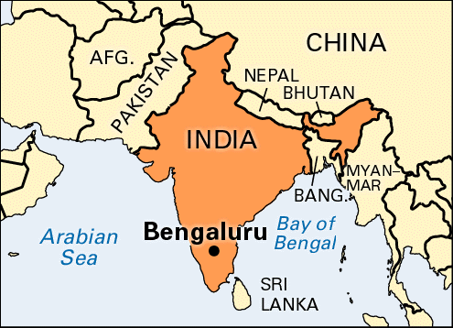
Tropical Country with Lots of Flora...
2 years of pollen counts revealed 74 different types of outdoor pollen and 113 species of fungal spores
Weeds most common followed by grasses and tress
Grass, Tree and Weed pollen present almost all year round
Tree season April-June and October – December
Weed pollen peaked in June and July
Grass pollen peaked in September and October
Highest overall pollen in July and lowest in January
Cladosporium abundant April-July, Alternaria in May-June and Aspergillus all year round.
Parmeshvara V, Annual API conference, Bangalore, 1985

Slide 17
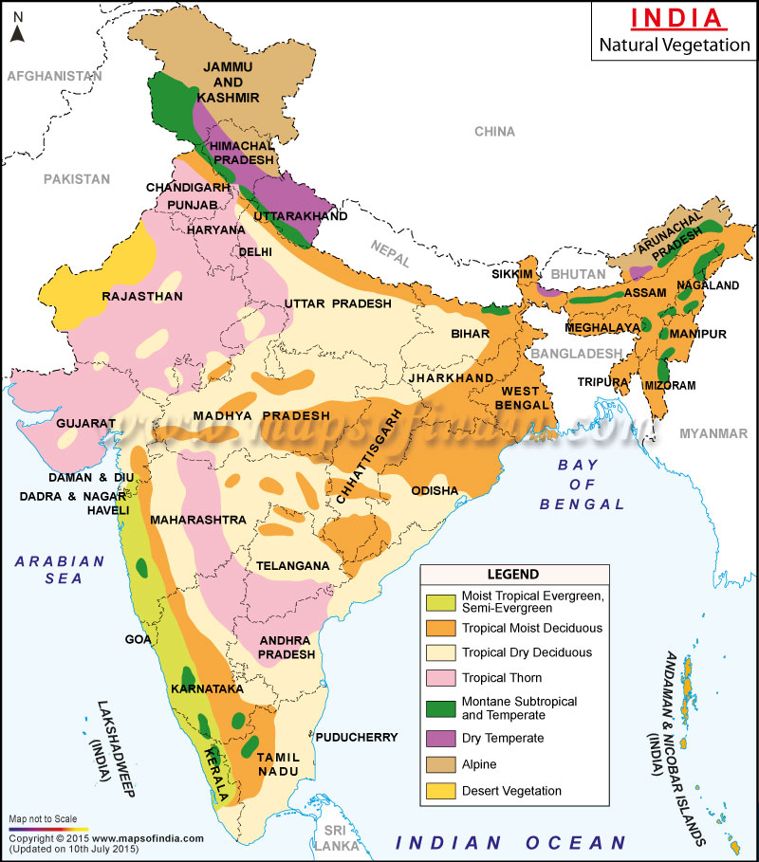

Slide 18
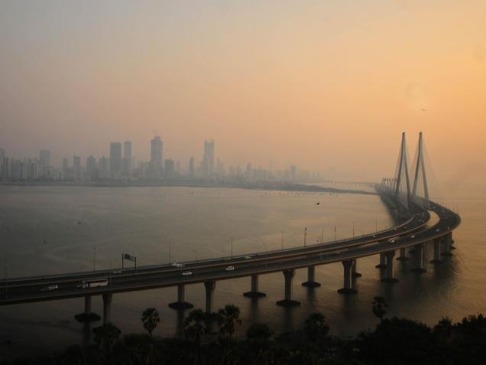
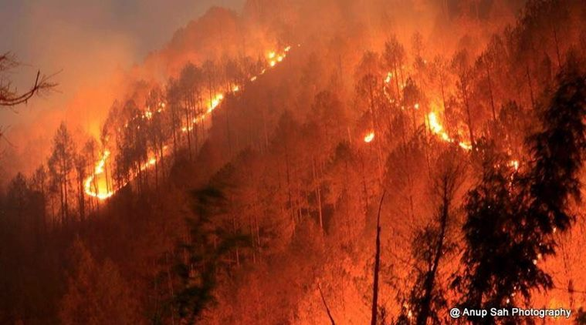
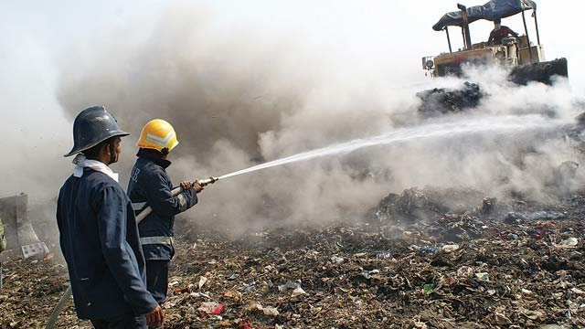
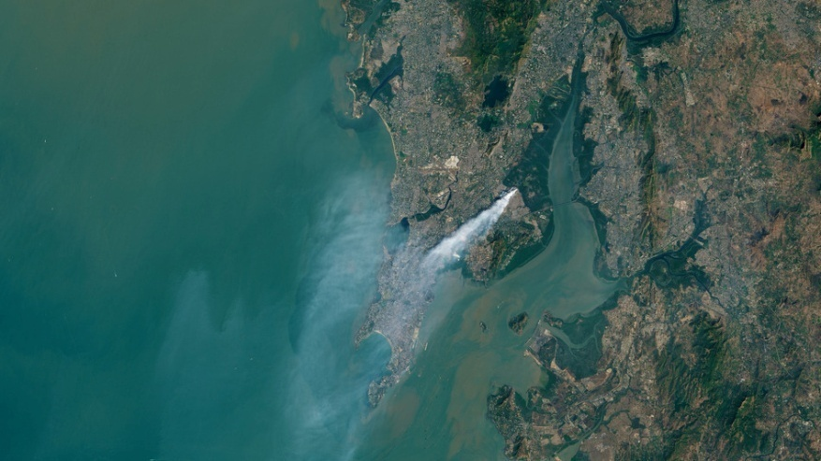
Outdoor Air Pollution Worsening Allergies
Forest Fire Uttarakhand, India
SMOG – Mumbai City
Fire at Deonar Dump, Mumbai

Slide 19
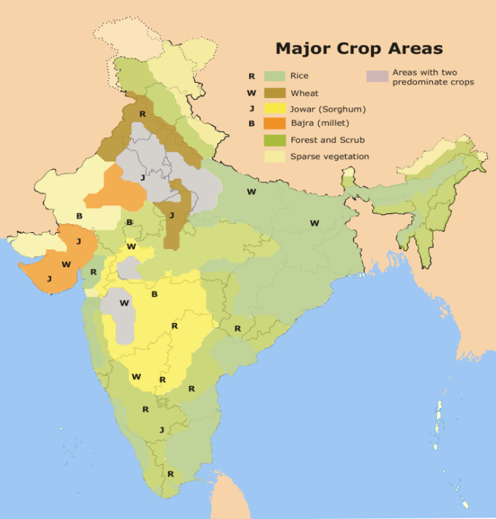
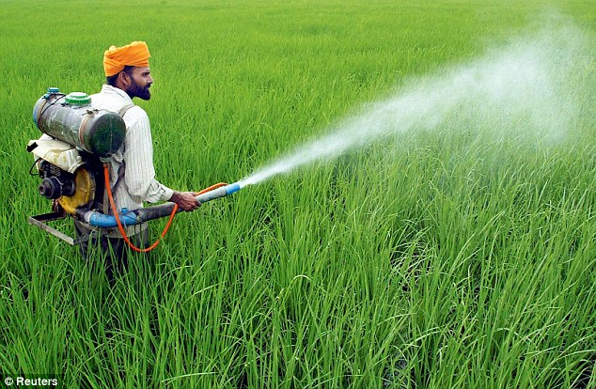
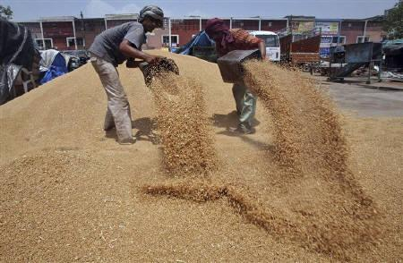
India – A Rich Agricultural Land
Cow Dung Cakes
Used as Bio-fuel
Grain dusts
Insecticide and Pesticide Sprays

Slide 20
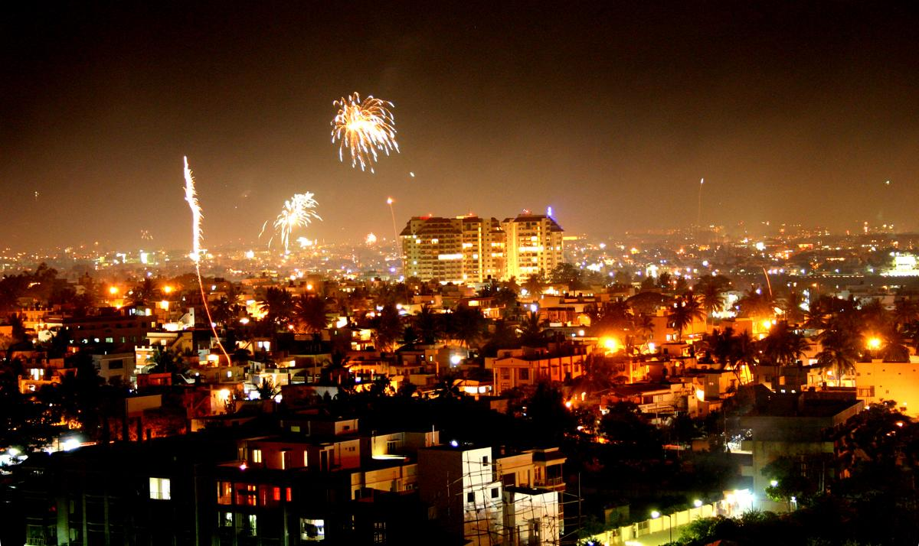
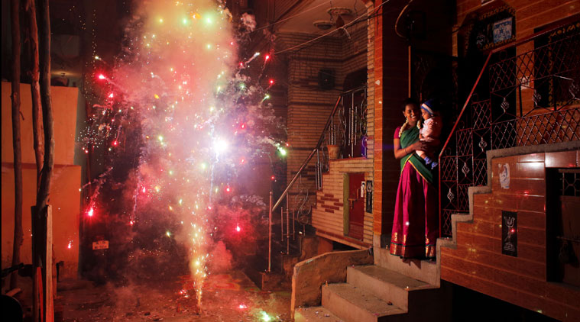
Land of Festivals and Celebrations...
DIWALI –The Festival of Lights

Slide 21
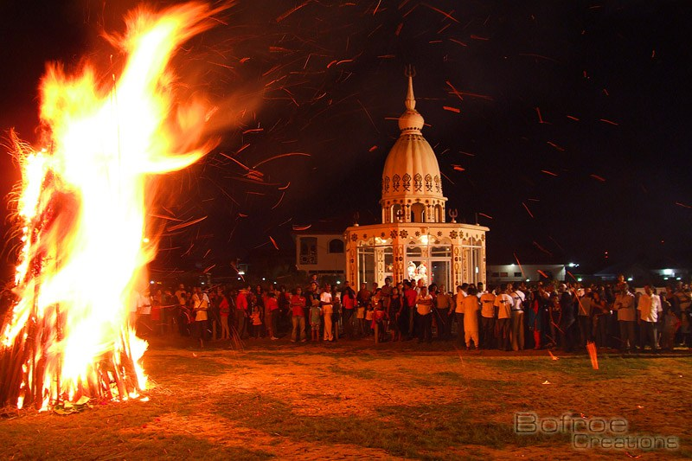
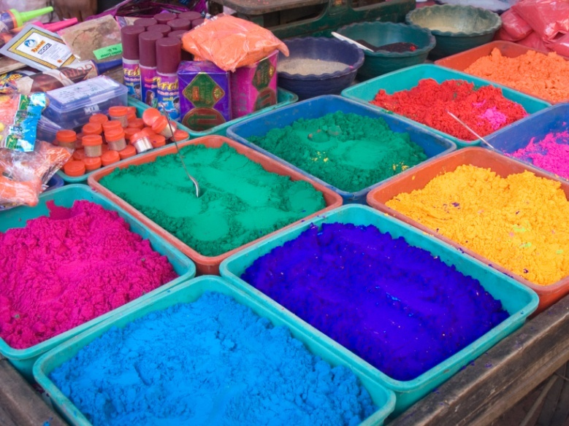
Holi – Festival of Colours – Celebrating Spring and A Good Harvest - March
MICRODUST,
INORGANIC
CHEMICALS,
IRRITANTS
India
SMOKE, FUMES, DUST
SAFER,
ORGANIC
OPTIONS
DO EXIST!
UTAH

Slide 22
AND then there were Pests...

Slide 23
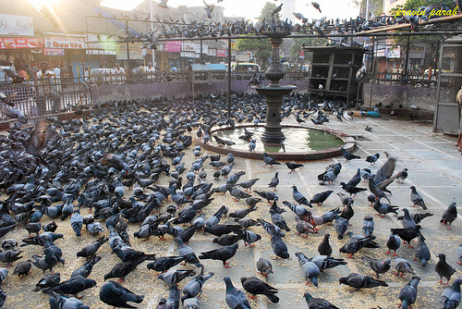
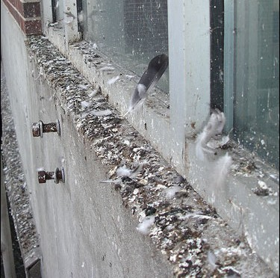
Pigeons – Triggers for Allergic sensitization and reactions
Aspergillus sp. shown to grow in abundance on pigeon droppings can be an additional source of airborne allergies and Fungal hypersensitivity reactions
Source: BMC, Mumbai, and NEERI

Slide 24
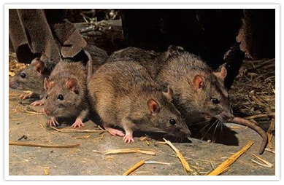
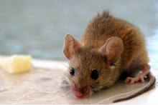
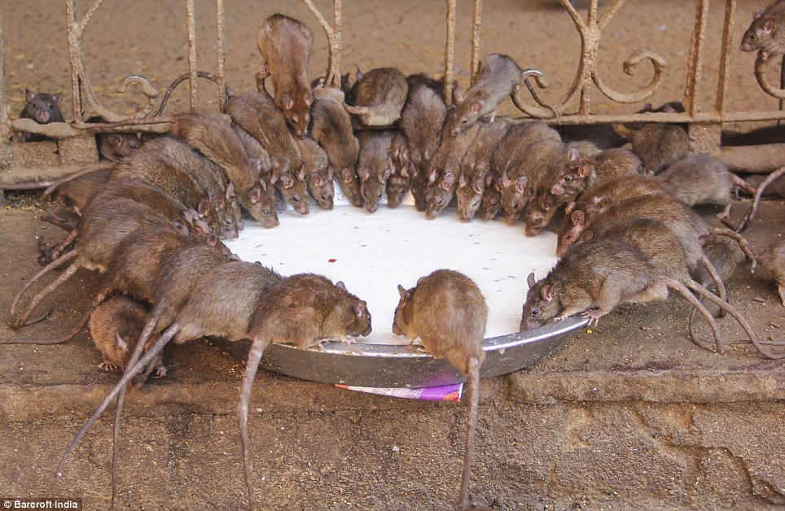
Rats and Mice...

Slide 25
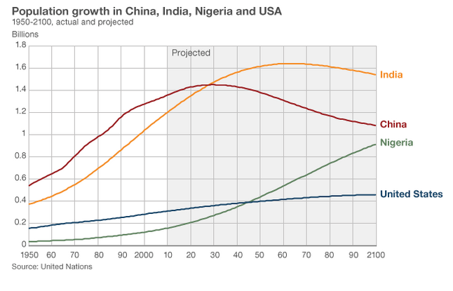
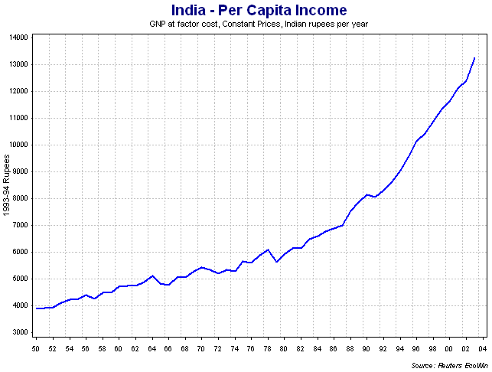
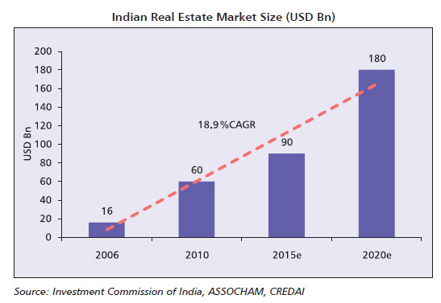
A Re-Newed India – Economic and Infrastructure Boom

Slide 26
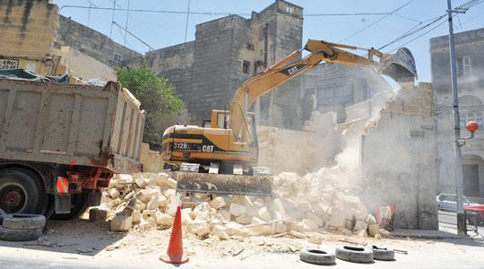
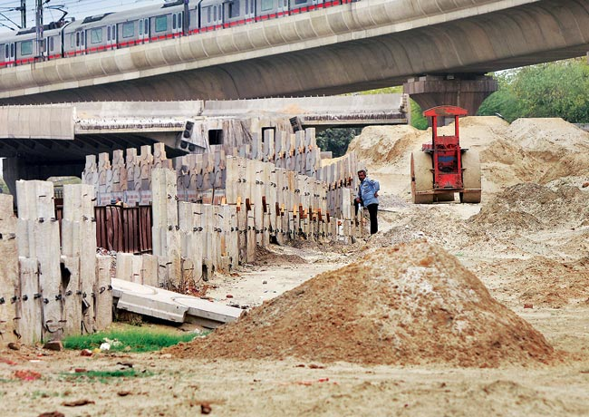
Construction...Dust...Pollution
India will become the world's third
largest construction market by 2025,
adding 11.5 million homes a year to
become a $1 trillion a year market,
finds a new study by Global construction perspectives and Oxford Economics
India has the 3rd Largest Road Network
in the World and it is Growing and
Expanding day by day
2.1 million miles and increasing...

Slide 27
Shifting gears… Now Lets go inside… INDOOR AIR POLLUTION (IAP)
www.niramultiversity.org

Slide 28
Most people spend up to 90% of their time indoors¹.
Indoor Air Pollutants can reach much higher levels than outdoor ones…¹
The WHO Report-2002 “Indoor air pollution from solid fuels is the fourth most important health risk factor in the less developed regions of countries, where 40% of the world’s population lives.”
Indoor Air Pollution is one of the Top 5 Health Environmental risks for Public Health as per US EPA²
.
1. Hulin M et al. Eur Respir J 2012; 40: 1033–1045
DOI: 10.1183/09031936.00159011
2. Targeting Indoor Air Pollution EPA's Approach and Progress
nepis.epa.gov/Exe/ZyPURL.cgi?Dockey=000001PR.TXT . Accessed May 2016

Slide 29
Outdoor - Indoor equalization
Suspended particulate matter | 70 –80 % of outdoor levels + indoor sources (indoor - much higher than outdoor levels)
Sulfur dioxide | Indoor levels – lower than outdoors
Nitric oxides | Indoor – lower than outdoor
Photo-oxidants | O₃ (product in reaction of HC and NOx)– lower than outdoor
Volatile organic compounds | Usually higher than outdoor levels
Carbon monoxide | Indoor levels – close to outdoor levels
Notes:
Influence on indoor contamination by outdoor one might be listed as follows:
Suspended particulate matter: Small particulates efficiently penetrate indoors, where levels are typically 70% to 80% of outdoor levels in the absence of indoor sources. And with indoor sources (cooking or tobacco smoke) indoors levels may be much higher than outdoors.
Sulphur dioxide: Indoor levels are usually lower than outdoor levels, owing to the reactivity of SO₂ with indoor surface.
Nitric oxides:In indoor environments without combustion sources, indoor levels of NO₂ are lower than outdoor levels. Homes with combustion devices have higher NO₂ levels than outdoors, during cooking.
Photo-oxidants: Photo-oxidants are produced by photochemical reactions in air containing oxides of nitrogen and reactive hydrocarbons. O₃ is highly reactive and indoor concentrations are lower than outdoors.
Volatile organic compounds (VOCs): VOCs are alkanes, alkenes, alkynes, aromatics, aldehydes, ketones, alcohols, esters, benzene, and some chlorinated hydrocarbons. The major sources of VOCs come from the burning of fossil fuels. Benzene is emitted from motor vehicles exhaust and /or from evaporated petrol. Indoor levels of VOCs are usually higher than outdoors levels, because VOCs are present in all building materials, such as paints and adhesives. VOCs are also released from laser printers and photocopiers. Indoor exposure of VOCs may result in headache and irritation of eyes and nose. Some VOCs have been shown to be carcinogenic.
Carbon monoxide (CO): CO is a product of incomplete combustion of fossil fuels. Concentration in urban areas depends on traffic density and weather conditions (cold temperatures cause combustion and it causes inversions that trap CO low to the ground and concentrations are higher). In the absence of indoor combustion devices, indoor levels may be close to outdoor levels. Invented combustion devices may produce additional CO indoors.

Slide 30
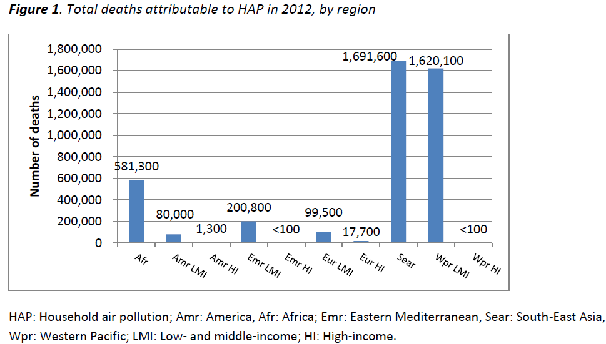
Burden of Indoor Air Pollution
Globally, 4.3 million deaths were attributable to household air pollution (HAP) in 2012, almost all in low and middle income (LMI) countries. The South East Asian and Western Pacific regions bear most of the burden with 1.69 and 1.62 million deaths, respectively.

Slide 31
Sources of Indoor Air Pollution in a Typical Office Building

Slide 32
Sources of Indoor Air Pollution in a Typical Household

Slide 33
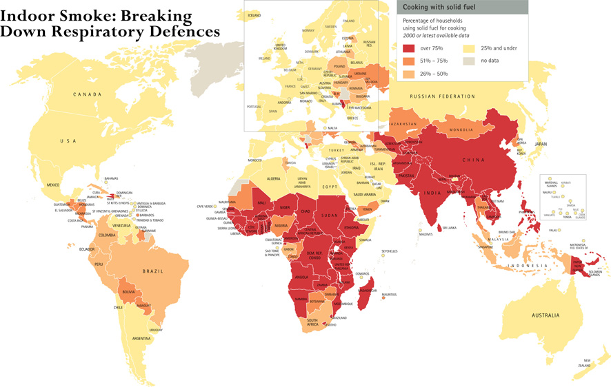
Gordon, WHO, 2004
Notes:
Cooking is central to our lives, yet the very act of cooking is a threat to children’s health and well-being. Half of the world’s population relies on solid fuels, such as dung, wood, crop waste or coal to meet their most basic energy needs. In most developing countries, these fuels are burned in open fires or rudimentary stoves that give off black smoke. Children, often carried on their mother’s back during cooking, are most exposed. The indoor smoke inhaled leads to pneumonia and other respiratory infections – the biggest killer of children under 5 years of age. Indoor air pollution is responsible for nearly half of the more than 2 million deaths each year that are caused by acute respiratory infections. Good ventilation and improved cooking stoves can dramatically reduce children’s exposure to smoke. Ultimately, making the transition to gas and electricity will save lives and reduce the physical toll on women and children from gathering wood, freeing time for education and development. This problem has been largely ignored by policy-makers.
Ref:
Gordon B et al. Inheriting the world, the Atlas on Children's Health and the Environment. Geneva, World Health Organization, 2004

Slide 34
COMBUSTION PRODUCTS USED IN INDIA
Sources
Gas stoves and appliances
Wood and coal stoves
Biofuels
Fireplaces
Tobacco smoke
Candles and incense
Mosquito coils
Combustion products
Carbon monoxide (CO)
Nitrogen dioxide (NO₂)
Sulfur dioxide (SO₂)
Nitrogenated compounds (NO_{x})
Particulate matter (PM)
Notes:
A large number of combustion products originate from various different sources. The main ones are listed here.
<<READ SLIDE.>>

Slide 35
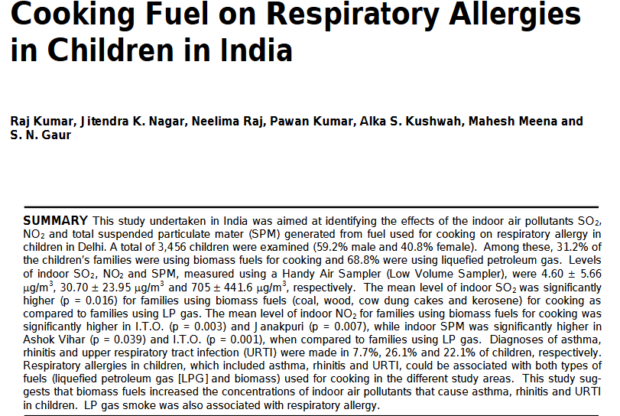

Slide 36
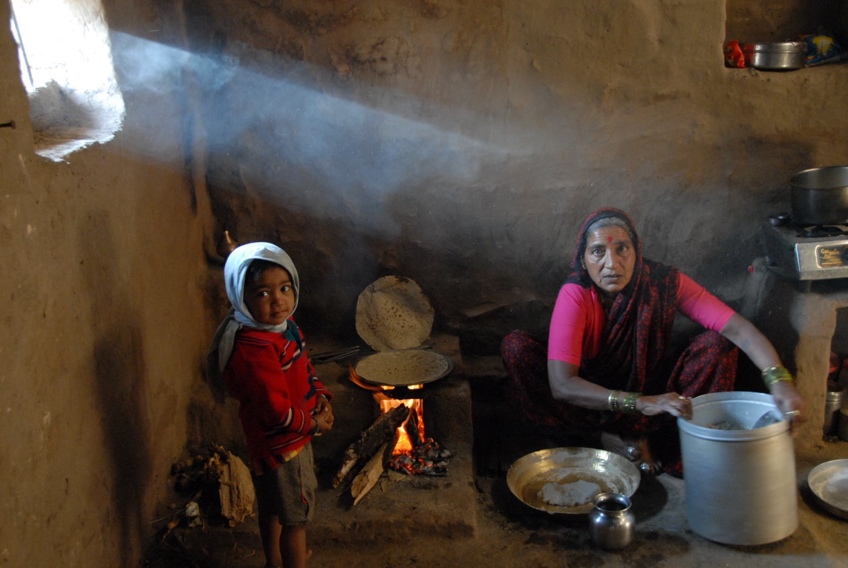
EXPOSURE TO BIOMASS SMOKE AND THE RISK OF CHRONIC RESPIRATORY DISEASES
2 billion Kg of biomass burnt every day world-wide
Asthma, COPD
Respiratory tract infections
Lung Cancer
Poor lung growth
Respiratory tract infections
Asthma
3
billion
1.1
billion
Smokers
BMF-exposed
(Salvi S et al, Lancet 2009; 374: 733-743
Salvi S et al, Chest 2010; 138: 3-6)

Slide 37
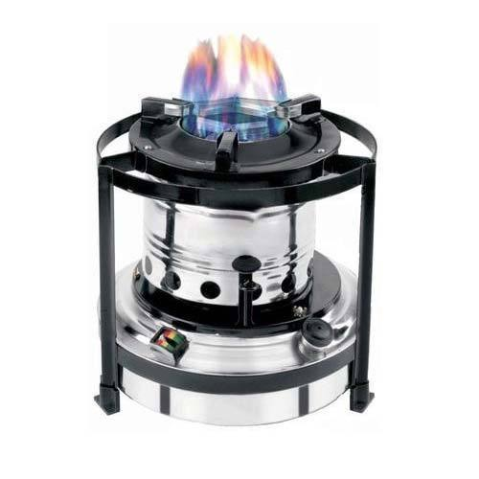
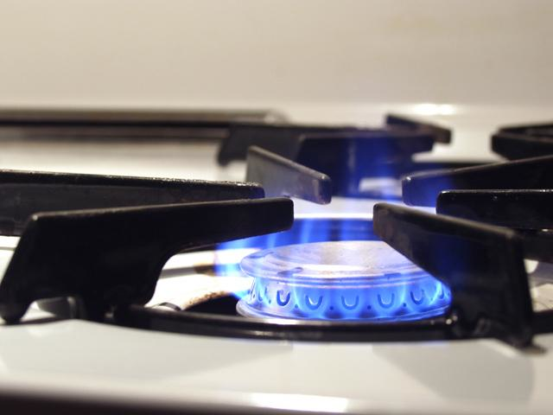
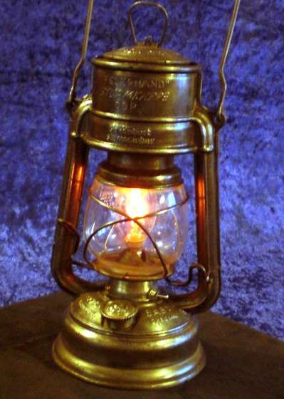
Few more Sources of Indoor Air Pollution
Gas stove
Kerosene Stove
Kerosene Lamp

Slide 38
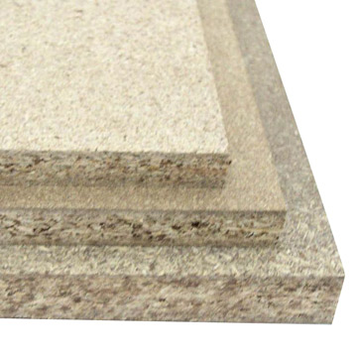
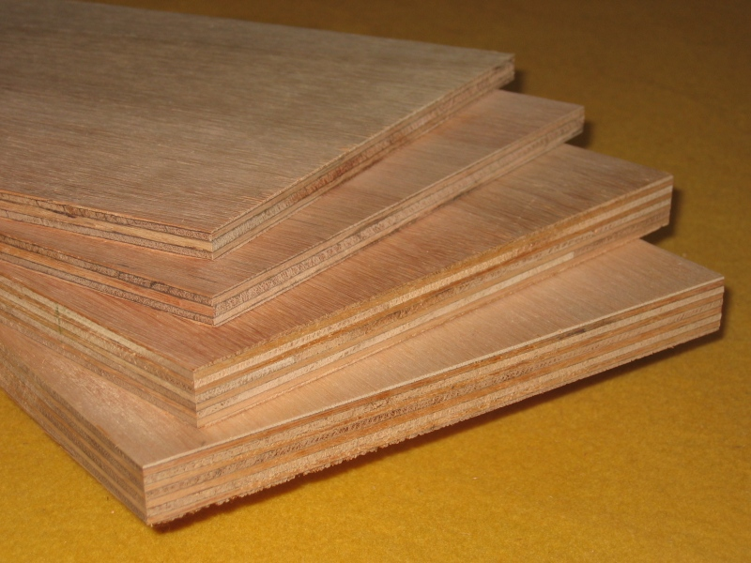
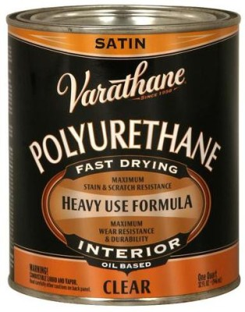
Additional Sources of Indoor Air Pollution
Plywood
Wooden Panels
Particle board

Slide 39
Cultural practices in India that add to Indoor Air Pollution
Incense can produce up to PM of 45 mg/gm
Particulate matter (PM)
Carbon monoxide (CO)
Sulfur dioxide (SO₂) and nitrogen dioxide (NO₂)
Volatile organic compounds
Aldehydes
Acrolein
Polycyclic aromatic hydrocarbons
Diethylphthalate (DEP)
Lin et al, Incense smoke: clinical, structural and molecular effects on airway disease
Clin Mol Allergy 2008

Slide 40
Avoidable Evils causing IAP
There were 75 million malaria cases annually in 1947, 4.1 million cases in 1995 and 1.8 million cases in 2014 in India
India has over 100 million smokers
Cigarettes
Bidis
20,000 reported cases of dengue in 2015

Slide 41
Heavy Monsoon’s in India – High Humidity and its related effects

Slide 42
BIOLOGICAL POLLUTANTS
Biological pollutants are/were living organisms:
House dust mites, Cockroach, Animal dander, Molds etc
Respiratory allergy caused by house dust mites: What do we really know? JACI 2015
Gupta S, et al. Role of animal dander as inhalant allergens in bronchial asthma in India. J Asthma 1996;33(5):339-48
Notes:
Dust mites, fungi and bacteria require moisture to proliferate. Permeation of rain or groundwater into a building and condensation on cold interior surfaces can promote proliferation of microbes. Water vapour is produced by people and pets, cooking and showering and requires sufficient air exchange to prevent moisture problems. Mattresses, upholstered furniture and carpets are reservoirs for dust mites.
Moulds have been associated with three types of effects: infections, allergic reactions and toxic effects. Toxic effects may be caused by inhalation of mycotoxins.
These notes are taken from the US EPA website www.epa.gov/iaq/pubs/bio_1.html

Slide 43
Rural - Urban Migration and Farm Life
Allergy 2005: 60: 1357–1360
The discovery of the central role played by microbial diversity in the asthma-protective and allergy-protective effects of farming warrants metagenomic studies that concertedly and longitudinally investigate the microbiome, the genome, and the immune system of farmers and the farms they live on.
Science 04 Sep 2015

Slide 44
FROM AIR POLLUTION TO MIND POLLUTION (STRESS)
www.niramultiversity.org

Slide 45
STRESS And ALLERGIC DISEASE
FAST-PACED, MODERN LIFESTYLE - DISTRESS

Slide 46
INTERVENTIONS & ACTIONS

Slide 47
INDIA at COP 21 Paris...reducing our Carbon Footprint
The country had committed to reducing its emissions intensity by 33-35 per cent by 2030, compared with 2005 levels. Since it seems to have achieved about 12-15 per cent efficiency improvements in the last decade, India is on target to easily achieve its target and could even exceed it.
INCREASE SOLAR POWER
INCREASE WIND POWER
Renewable Sustainable “E”

Slide 48
Odd - Even Principle

Slide 50
APPROACHES TO REDUCE INDOOR AIR POLLUTION
Eliminate or control the sources of pollution
Improved stoves
Clean fuels (kerosene, gas)
Venting stoves for cooking and heating
Regular maintenance of cooking, heating and cooling systems
Choose non-volatile, non-toxic building materials
Maintaining dry homes and schools
Ventilation – building design
Dilute and remove pollutants through ventilation with outdoor air
Air cleaning – NOT air fresheners!
Air filters and ionizers may remove some airborne particles
Gas adsorbing material is used to remove gaseous contaminants
Notes:
It is always better to prevent rather than treat illness. To avoid problems due to indoor air quality, the first approach is source reduction and elimination, and the second, proper ventilation and maintenance of gas, oil and solid fuel cooking, heating and cooling systems. Air cleaning is the least effective, and most expensive. Air fresheners, which contain untested potentially harmful volatile organic compounds (VOCs), should not be used to cover up stale air or unpleasant smells.
Ref:
www.epa.gov/iaq/pubs/ozonegen.html
For more information on indoor air pollution, you can obtain a guide (Indoor pollution: An introduction for health professionals) recently published by the US EPA at: www.epa.gov/iedweb00/pubs/hpguide.html
Ref:
Meklin T et al. Effects of moisture-damage repairs on microbial exposure and symptoms in schoolchildren. Indoor Air. 2005;15 Suppl 10:40-7.
Effects of renovation on symptom prevalence and microbial status were studied in two moisture-damaged schools and in two non-damaged schools with longitudinal cross-sectional surveys before and after repairs. Over 1300 schoolchildren aged 6-17 returned questionnaires before and after repairs. After full renovation in one of the damaged schools, elevated concentrations and increased frequencies of indoor air fungi normalized and a significant decrease in the prevalence of 10 symptoms of 12 studied was observed among schoolchildren. No change in microbial conditions was seen after partial repairs in the other damaged school, and only slight improvement was observed in symptom prevalence. The change in the prevalence of symptoms in the reference schools was minor. The results suggest that increased symptom prevalence among schoolchildren in moisture-damaged schools can be managed with proper repair of the moisture damage. PRACTICAL IMPLICATIONS: This longitudinal intervention study showed the positive effects of the moisture and mold damage repairs of a school building on children's health. The success necessitates however, a thorough renovation including appropriate ventilation. Monitoring of airborne viable microbes revealed the damage status of the building and thus could be used as a tool in evaluating the quality of repairs.

Slide 51
HAWA Mahal,
Jaipur, Rajashthan
Constructed 1799
Pearl Academy, Jaipur
Constructed 2008

Slide 52
GREEN BUILDINGS...LITERALLY

Slide 53
EDUCATION AND ADVOCACY
Education of:
Children
Family and community
Health care providers
Lawmakers
Environment policy-making
Framework Convention on Tobacco Control
Clean indoor air regulations
Community actions
Governmental regulations and enforcement
MORE Research…
Notes:
A multi-level approach to prevention of indoor air-related illness is required. Education, policy-making and research all have roles to play.
<<READ SLIDE>>
<<NOTE TO USER: Insert appropriate suggestions for tackling the specific indoor air problems in your area.>>
Refs:
Eriksen MP et al. The diffusion and impact of clean indoor air laws. Annu Rev Public Health. 2008;29:171-85.
Over the past quarter century, primarily as a result of scientific discovery, citizen advocacy, and legislative action, comprehensive clean indoor air laws have spread rapidly throughout the world. Laws that establish completely smoke-free indoor environments have many relative advantages including being low cost, safe, effective, and easy to implement. The diffusion of these laws has been associated with a dramatic and rapid reduction in population levels of serum cotinine among nonsmokers and has also contributed to a reduction in overall cigarette consumption among smokers, with no adverse economic impact, except to the tobacco industry. Currently, nearly half of the U.S. population lives in jurisdictions with some combination of completely smoke-free workplaces, restaurants, or bars. The diffusion of clean indoor air laws is spreading rapidly throughout the world, stimulated by the first global health treaty, the Framework Convention on Tobacco Control.

Slide 54
Conclusions
Allergic rhinitis is increasing rapidly in prevalence in India
Variety of indoor and outdoor pollutants some of known origins and some unique to the Indian scenario clearly contribute to the aggravation of allergic rhinitis
Greater awareness amongst physicians and public is necessary to reduce such exposures and impact

Slide 55
New Insights On Air Pollution & Allergy:
The Brazilian Reality

Slide 56
SANTA CASA DE SÃO PAULO MEDICAL SCHOOL

Slide 57
DEPARTMENT OF OTORHINOLARYNGOLOGY

Slide 58
BREATHING
10 to 15 thousand air liters per day
Millions of suspended particles
Organic and volatile compounds
Airway - Nose - Lungs
Particle retention
Allergic reactivity
AIR POLLUTION
Ganong’s Review of Medical Physiology - 24th ed. – Section VI – Respiratory Physiology

Slide 59
INDUSTRIAL REVOLUTION 18th CENTURY
Increase on air pollution
Mineral coal
Oil derivatives (gasoline and diesel)
“Progress” living with air pollutants
Are we able to leave fossil fuels aside?

Slide 60
AIR POLLUTION
World biggest cities
Among the most polluted in the world:
São Paulo
Tokyo
New York
Mexico City

Slide 61
4.3 million deaths occur each year from exposure to household (indoor) air pollution
3.7 million deaths each year are attributable to ambient (outdoor) air pollution
Exposure to air pollutants (including fine particulate matter) is a leading risk factor for noncommunicable diseases in adults:
Ischemic heart disease
Stroke
Chronic obstructive pulmonary disease
Asthma
Cancer
Air pollution poses a considerable health threat to current and future generations
World Health Organization - Sixty-eighth World Health Assembly – Agenda item 14.6 – 2015/05/26

Slide 62
ALLERGY IN BRAZIL
1970 – 96.06 million inhabitants
10% of allergic people = 9 million
Economic miracle
1990= 149.6 million inhabitants
20% of allergic people = 29 million
2016= 206 million inhabitants
30 to 35% of allergic people = 61.8 million
Brazil, Ministry of Health – Hospital Information System of the Unified Health System - DataSUS

Slide 63
AIR POLLUTION AND DEATH
Air pollution will cause 250,000 deaths in the next 15 years in the State of São Paulo
25% of them only in the city of São Paulo
Health and sustainability Institute - 2014 - Projection of mortality, hospital admissions in public and public spending on health as result of air pollution, in the State of São Paulo from 2010 to 2030

Slide 64
AIR POLLUTION AND DEATH
Particulate material in the air
90% from motor vehicles
It will bring 1 million people to hospitalizations
Will cause public spending over US$ 450 million
Correia-Deur JE, Claudio L, Imazawa AT, Eluf-Neto J. Variations in peak expiratory flow measurements associated to air pollution and allergic sensitization in children in Sao Paulo, Brazil. Am J Ind Med. 2012;55(12):1087-98

Slide 65
AIR POLLUTION AND DEATH
Rio de Janeiro
2006 to 2012
31,194 deaths
65,102 hospitalizations on public health system
The Brazilian Institute of Geography and Statistics (IBGE), Board of Research, Coordination of Work and Income
National Health Research – 2013

Slide 66
COMPARISON WITH AIR POLLUTION STANDARDS SET BY WHO AND BY THE UNITED STATES AND EUROPE
Comparison of the patterns of particulate matter PM10
 | WHO 2005 | São Paulo - 2013
Annual Average | 20 μg/m³ | 40 μg/m³
24 hours | 50 μg/m³ | 120 μg/m³
Comparison of the patterns of fine particulate material PM 2.5
 | WHO 2005 | São Paulo 2013 | USA | Europe
Annual Average | 10 μg/m³ | 20 μg/m³ | 15 μg/m³ | 25 μg/m³
Brazil, Institute of Energy and Environment - Air quality standards - Comparative experience of Brazil, USA and European Union - 2012

Slide 67
ALLERGY IN BRAZIL
25% of children between 6 and 14 years old have asthma
Brazil holds the 8th place in the world in Asthma
376,672 hospitalizations caused by asthma in the public health system
3rd cause of hospitalization
Pneumonia
Cancer
Asthma
Cost = US$ 64.5 million
56,000 deaths / year due to respiratory diseases
International Study on Asthma and Allergies in Childhood (ISAAC) - 1998 / 2003 / 2006

Slide 68
PREVALENCE OF DISEASES IN BRAZIL
ARTERIAL HYPERTENSION ….……. 21.4%
HIGH CHOLESTEROL ……….………. 12.5%
DIABETES MELLITUS …….…………... 6.2%
ASTHMA …………………….…………… 4.4%
CARDIOVASCULAR DISEASES .…….. 4.2%
CANCER ……………………….………… 1.8%
STROKE …………………………………. 1.5%
The Brazilian Institute of Geography and Statistics (IBGE), Board of Research, Coordination of Work and Income
National Health Research – 2013

Slide 69
ASTHMA IN BRAZIL NATIONAL HEALTH RESEARCH - 2013
Proportion of persons of 18 years of age or older who reported medical diagnosis of asthma, with indication of the confidence interval of 95%, according to the major regions-2013
The Brazilian Institute of Geography and Statistics (IBGE), Board of Research, Coordination of Work and Income
National Health Research – 2013

Slide 70
9 MILLION PEOPLE WITH ASTHMA IN BRAZIL
Over 18 years old
38.2% (34.7% to 41.6%) presented asthma symptoms in the last 12 months
15.7% - asthma with activities limitation
The Brazilian Institute of Geography and Statistics (IBGE), Board of Research, Coordination of Work and Income
National Health Research – 2013

Slide 71
ASTHMA
Symptoms related to active asthma
Average prevalence
19.0 % adolescents
24.3% school children
International Study on Asthma and Allergies in Childhood (ISAAC) - 1998 / 2003 / 2006

Slide 72
RISK FACTORS FOR WHEEZING
City of Salvador - BA
Tropical South American Region
Wheezing important cause of visits to emergency in childhood
1,534 children <4 years old
501 with wheezing episodes in the last 12 months
Average of 3 episodes
Maternal atopy more recurrent wheeze and asthma
Smoking at home more occasional wheezing
Reis GG, Miranda VM, Cardoso MR, Solé D, Barral A, Nascimento-Carvalho CM. Prevalence and risk factors for wheezing in Salvador, Brazil: a population-based study. QJM. 2015 Mar;108(3):213-8

Slide 73
ASTHMA AND AIR POLLUTANTS
São José dos Campos – SP
600,000 inhabitants (between SP and RJ cities)
Strong correlation between hospitalizations and the pollutants particulate matter and sulfur dioxide
Increases in the concentrations of these pollutants elevate the risk of hospitalization between 8% and 19%.
Amâncio CT, Nascimento LF. Asthma and ambient pollutants: a time series study. Rev Assoc Med Bras. 2012; 58(3):302-7

Slide 74
POLLUTANT VALUES (μg/m³) SÃO JOSÉ DOS CAMPOS – SP
Particulate matter
Sulfur dioxide
Ozone
2004 to 2005
841 hospitalizations

Slide 75
III BRAZILIAN CONSENSUS ON RHINITIS
Prevalence (%) of rhinitis and related symptoms among Brazilian school children, according to age group, participants in the International Study of Asthma and Allergies in Childhood (ISAAC)
Question | 6 to 7 y.o. |  | 13 to 14 y.o.
 | Phase 1 (1996) | Phase 3 (2012) | Phase 1 (1996) | Phase 3 (2012)
Nasal Symptoms in the last year without cold (rhinitis) | 26.6 | 25.7 | 34.2 | 29.6
 | (20.2 to 33.8) | (19.3 to 39.8) | (24.1 to 46.0) | (17.4 to 47.4)
Nasal symptoms associated with red eyes and tearing (allergic rhino conjunctivitis) | 12.8 | 12.6 | 18 | 15.6
 | (9.8 to 28.9) | (10.3 to 17.4) | (11.1 to 25.5) | (8.9 to 24.4)
Medical diagnosis of rhinitis | 19.9 | 19.3 | 25.7 | 21.4
 | (9.3 to 28.8) | (12.3 to 32.3) | (7.9 to 31.7) | (2.8 to 42.1)
Nasal problem interferes in daily activities | 17.3 | 17.1 | 19.3 | 18.5
 | (13.2 to 20.2) | (13.2 to 26.0) | (15.1 to 24.2) | (10.1 to 31.1)
Brazilian Association of E. N. T. and Cervicofacial Surgery - III Consenso Brasileiro sobre Rinites – Braz J Otorhinolaryngol. 2012, 75(6)

Slide 76
OTORHINOLARYNGOLOGY OFFICES
Over 50% of the patients complain of allergic rhinitis symptoms
20% of the patients with medical diagnosis of allergic rhinitis have asthma symptoms associated

Slide 77
PREVALENCE OF PERENNIAL AND SEASONAL ALLERGIC RHINITIS
Nasal symptoms without flu (once in lifetime)
56% in children
66% in adults
Last 12 months
47% in children
65% in adults
Medical diagnosis of allergic rhinitis
19% in children
42% in adults
Nasal and ocular symptoms in the last 12 months
28% in children
47% in adults
Esteves PC, Rosario Filho NA, Trippia SG, Caleffe LG.Prevalence of perennial and seasonal allergic rhinitis with atopic sensitization to Dermatophagoides pteronyssinus (Dp) and Lolium multiflorum (LOLIUM) in schoolchildren and adults in Curitiba. Rev Bras Alerg Imunopatol.2000, 23(6).

Slide 78
PREVALENCE OF ASTHMA AND ALLERGIC DISEASES IN ADOLESCENTS
20,099 adolescents (13 to 14 years old)
ISAAC Written Questionnaire
N / NE / S / SE of Brazil
Asthma= 17.5% (4.7% severe asthma)
Nasal symptoms of rhinitis / rhino conjunctivitis
Atopic eczema
Higher prevalence in regions closer to the Equator
Solé D, Rosário Filho NA, Sarinho ES, Camelo-Nunes IC, Barreto BA, Medeiros ML, et al. Prevalence of asthma and allergic diseases in adolescents: nine-year follow-up study (2003-2012). J Pediatr (Rio J). 2015;91:30---5.

Slide 79
PREVALENCE OF ASTHMA AND ALLERGIC DISEASES IN ADOLESCENTS

Slide 80
PREVALENCE OF RESPIRATORY DISEASES ASSOCIATED WITH AIR POLLUTION
Ribeirão Preto (NE of SP) - 650,000 inhabitants
Tropical wet climate / dry winter
Questionnaire based on ISAAC
Comparison of 2 schools (children 6 to 7 y.o.)
Asthma = 14.4%
Allergic Rhinitis = 43.2%
Allergic Eczema = 26.6%
Nicolussi FH, Santos AP, André SC, Veiga TB, Takayanagui AM, Air pollution and respiratory allergic diseases in schoolchildren. Rev Saúde Pública. 2014 Apr;48(2):326-30.

Slide 81
PREVALENCE OF RESPIRATORY DISEASES ASSOCIATED WITH AIR POLLUTION
 | Downtown school | Residential neighborhood school
Asthma | 17.9% | 9.8%
Wheezing 12 months | 33.3% | 29.5%
Allergic Rhinitis diagnosis | 48.7% | 36.1%
Sneezing and itching 12 months | 53.8% | 44.3%
Ocular symptoms | 39.7% | 23.0%

Slide 82
RESPIRATORY ALLERGY IN BRAZIL
Non-allergic parents = 15% risk for allergy
Allergic parents = 70% risk for allergy
Substitution of breast milk for cow's milk
higher production of IgE
greater risk of respiratory allergy

Slide 83
TRIGGERING FACTORS IN BRAZIL
Mites
Fungi
Cockroaches
Domestic animals (hair, saliva and urine)
Pollen
Cigarette smoke
Cooking gas
Organic solvents
Detergents
Perfumes
Food Dyes
Reis,A.P. Environmental control in allergic diseases what is yes and what is not . Rev. bras. alerg. imunopatol. 1998; 21(4):112-21.

Slide 84
HOUSEHOLD DUST MITES
Dermatophagoides pteronyssinus
Dermatophagoides farinae
Blomia tropicalis
Reis,A.P. Environmental control in allergic diseases what is yes and what is not . Rev. bras. alerg. imunopatol. 1998; 21(4):112-21.

Slide 85
HOUSEHOLD DUST MITES
Dark environments
Temperature between 21 and 28 ºC
Relative humidity around 70%
They feed on human skin flaking and domestic animals – fungi - food scraps
Reis,A.P. Environmental control in allergic diseases what is yes and what is not . Rev. bras. alerg. imunopatol. 1998; 21(4):112-21.

Slide 86
HOUSEHOLD DUST MITES
Mattresses and pillows
1 double bed has about 5,000 mites / dust gram or about 2,000,000 mites and 60,000,000 fecal acorns
Movement leads to dispersion in the indoor air
Inhalation
Reis,A.P. Environmental control in allergic diseases what is yes and what is not . Rev. bras. alerg. imunopatol. 1998; 21(4):112-21.

Slide 87
HOUSEHOLD FUNGI
Cladosporium sp
Aspergillus sp
Alternaria sp
Penicillium notatum
Reis,A.P. Environmental control in allergic diseases what is yes and what is not . Rev. bras. alerg. imunopatol. 1998; 21(4):112-21.

Slide 88
MOLD
Excessive moisture (walls / floors / ceilings)
Hydraulic leaks
Indoor plants
Low Socio-Economic Level
Poor quality of some
residences
Reis,A.P. Environmental control in allergic diseases what is yes and what is not . Rev. bras. alerg. imunopatol. 1998; 21(4):112-21.

Slide 89
COCKROACHES
Less-favored social classes
Proteins of flaking and body decomposition
Fecal material
Accumulation of garbage - large cities
Areas without sanitation
Packaging
Reis,A.P. Environmental control in allergic diseases what is yes and what is not . Rev. bras. alerg. imunopatol. 1998; 21(4):112-21.

Slide 90
MITES - MOLD - COCKROACHES
Allergen material dispersion in the air
Moving objects
Curtains
Carpets / Rugs
Clothes stored for long times
Cleaning with feather duster
Reis,A.P. Environmental control in allergic diseases what is yes and what is not . Rev. bras. alerg. imunopatol. 1998; 21(4):112-21.

Slide 91
POLLEN
The southern region of Brazil
Well defined weather stations
October to December
Allergenic plants cultivation
Lolium multiflorum
Common association of allergic rhinitis and allergic conjunctivitis
Esteves PC, Rosario Filho NA, Trippia SG, Caleffe LG.Prevalence of perennial and seasonal allergic rhinitis with atopic sensitization to Dermatophagoides pteronyssinus (Dp) and Lolium multiflorum (LOLIUM) in schoolchildren and adults in Curitiba. Rev Bras Alerg Imunopatol.2000, 23(6).

Slide 92
SICK BUILDING SYNDROME
Estimated 20 to 30% of workers in office buildings to have symptoms attributable to bad indoor air quality
Estimated cost of 22 billion dollars annually
In the city of São Paulo, 34.7% of symptoms related to Sick Building Syndrome
Boechat JL, Rios JL. Indoor pollution. Rev.Bras Alerg Imunopatol. 2011, 34(3): 83-9

Slide 93
TOBACCO SMOKE
SMOKING IN BRAZIL
15% (31.9 million people)
19.2% men
11.2% women
40 to 59 years old
The Brazilian Institute of Geography and Statistics (IBGE), Board of Research, Coordination of Work and Income
National Health Research – 2013

Slide 94
EXPOSURE TO TOBACCO SMOKE
At home = 10.7%
Men - 9.5%
Women - 11.7%
18 to 24 years old
At work = 13.5%
Men - 16.9%
Women - 10.4%

Slide 95
PARENTAL SMOKING PATTERNS AND THEIR ASSOCIATION WITH WHEEZING IN CHILDREN
Children - 6 to 23 months of age
Exposure to tobacco smoke leads to increased risk of wheezing syndrome
The greater the number of cigarettes smoked at home, the greater the risk of respiratory allergy symptoms
Schvartsman C, Farhat SC, Schvartsman S, Saldiva PH. Parental smoking patterns and their association with wheezing in children. Clinic (São Paulo). 2013 Jul;68(7):934-9

Slide 96
POLLUTION FROM MOTOR VEHICLES
Brazil (march-2016) | 91,485,547
Cars | 50,175,060
Trucks | 2,655,707
Motorcycles | 20,406,898
Brazil - National Department of Transit - DENATRAN

Slide 97
POLLUTION FROM MOTOR VEHICLES
State | Number of motor vehicles
São Paulo | 26,789,393
Minas Gerais | 9,963,552
Paraná | 7,004,769
Rio Grande do Sul | 6,504,174
Rio de Janeiro | 6,235,976
Bahia | 3,681,292
Goiás | 3,575,464
Brazil - National Department of Transit - DENATRAN

Slide 98
POLLUTION FROM MOTOR VEHICLES
Smoke from exhausts:
Ozone, Nitrogen oxides and Sulphur dioxide
Induces higher formation of IgE
Greater adherence of allergens to the respiratory epithelium

Slide 99
POLLUTION FROM MOTOR VEHICLES
As an attempt to reduce air pollution by motor vehicles, the city of São Paulo adopted the road space rationing
Every week day, a different group of vehicles may not circulate in the expanded city center between 7:00 AM and 10:00 AM and between 5:00 PM and 8:00 PM

Slide 100
AIR QUALITY
2011 survey by the World Health Organization
91 countries
quantity of particulate material present in the air
Mainly produced by the burning of fossil fuels
gasoline and diesel oil
WHO Recommendation - less than 10 µg/m³
Levels above 20 µg/m³ can cause serious health problems in the population, mainly the respiratory diseases
Brazil
48th place
Average 40 µg/m³ of particulate matter suspended in the air
World Health Organization - Global Health Observatory data repository – Exposure - City level 2011

Slide 101
NATIONAL AIR QUALITY STANDARDS
Brazil, National Council for the Environment (CONAMA) Resolution no. 03 - 1990/06/28

Slide 102
Air Quality Standards – State of São Paulo
Quality | Index | PM₁₀ | PM_{2,5} | O₃ | CO | NO₂ | SO₂ | Smoke | Meaning
 |  | mg/m³ | mg/m³ | mg/m³ | mg/m³ | mg/m³ | mg/m³ | mg/m³
 |  | 24h | 24h | 8h | 8h | 1h | 24h | 24h
N1 - GOOD | 0-40 | 0-50 | 0-25 | 0-100 | 0-9 | 0-200 | 0-20 | 0-50
N2- MODERATE | 41-80 | >50-100 | >25-50 | >100-130 | >9-11 | >200-240 | >20-40 | >50-100 | People in sensitive groups (children, the elderly and people with respiratory and heart diseases) can present symptoms such as dry cough and tiredness. The population, in general, is not affected.
N3- BAD | 81-120 | >100-150 | >50-75 | >130-160 | >11-13 | >240-320 | >40-365 | >100-150 | All the population can presentt symptoms such as dry cough, tiredness, burning eyes, nose and throat. People in sensitive groups (children, the elderly and people with respiratory and heart diseases) may have more serious effects on health.
N4- VERY BAD | 121-200 | >150-250 | >75-125 | >160-200 | >13-15 | >320-1130 | >365-800 | >150-250 | All the population can present worsening of symptoms such as dry cough, fatigue, burning eyes, nose and throat and even shortness of breath and wheezing. Even more serious effects to the health of sensitive groups (children, the elderly and people with respiratory and heart diseases).
N5- TERRIBLE | >200 | >250 | >125 | >200 | >15 | >1130 | >800 | >250 | All the population can present serious risks of respiratory and cardiovascular events. Increase of premature deaths in people sensitive groups
Government of the State of São Paulo - Environmental Company of the State of São Paulo, CETESB - 2015

Slide 103
POLLUTION CAUSES STATE OF SÃO PAULO
Category |  |  | Fuel | Pollutants (%)
 |  |  |  | CO | HC | NO_{X} | PM₁₀ | SO_{X}
MOBILE | Automobiles |  | C Gasoline | 41.39 | 32.22 | 10.93 | 0.99 | 2.69
 |  |  | Hydrated Ethanol | 8.39 | 5.94 | 1.40 | - | -
 |  |  | Flex - C Gasoline | 5.74 | 8.91 | 1.30 | 0.50 | 1.52
 |  |  | Flex - Hydrated Ethanol | 6.64 | 8.02 | 1.18 | - | -
 | light commercial vehicles |  | C Gasoline | 7.90 | 5.35 | 1.62 | 0.19 | 0.62
 |  |  | Hydrated Ethanol | 0.53 | 0.38 | 0.10 | - | -
 |  |  | Flex - C Gasoline | 0.83 | 1.59 | 0.22 | 0.08 | 0.30
 |  |  | Flex - Hydrated Ethanol | 1.18 | 1.30 | 0.26 | - | -
 |  |  | Diesel | 0.63 | 0.61 | 5.41 | 4.91 | 4.48
 | Trucks | Semi-Lights | Diesel | 0.14 | 0.16 | 1.56 | 1.57 | 0.48
 |  | Lights |  | 0.60 | 0.69 | 7.12 | 6.40 | 2.48
 |  | Medium |  | 0.39 | 0.49 | 4.77 | 5.05 | 1.42
 |  | Semi-heavy |  | 0.49 | 0.43 | 5.77 | 3.67 | 2.44
 |  | Heavy |  | 0.44 | 0.46 | 5.72 | 3.71 | 2.52
 | Buses | Urbans | Diesel | 1.46 | 1.24 | 15.81 | 9.87 | 0.16
 |  | Micro-buses |  | 0.10 | 0.09 | 1.14 | 0.63 | 0.01
 |  | Highway buses |  | 0.14 | 0.16 | 1.84 | 0.58 | 0.78
 | Motorcycles |  | C Gasoline | 20.06 | 10.60 | 1.34 | 1.79 | 1.78
 |  |  | Flex - C Gasoline | 0.32 | 0.20 | 0.05 | 0.07 | 0.14
 |  |  | Flex - Hydrated Ethanol | 0.13 | 0.10 | 0.02 | - | -
FIXED | Operation of Industrial process |  |  | 2.50 | 12.70 | 32.45 | 10.00 | 78.16
 | Fuel Stations |  |  | - | 8.34 | - | - | -
 | Resuspension of particles |  |  | - | - | - | 25.00 | -
 | Secondary Aerosols |  |  | - | - | - | 25.00 | -
TOTAL |  |  |  | 100.00 | 100.00 | 100.00 | 100.00 | 100.00
Government of the State of São Paulo – Decree No. 59,113 – 2013/04/23 - CETESB

Slide 104
GREENHOUSE GASES
1 - GWP= Global Warming Potential.
2 - Only the greenhouse gases family defined in the Kyoto Protocol were considered.
3 - Gg (Gigagram). 1 Gg is equivalent to 10³ tons of pollutant gas
Brazil - Ministry of Environment - 2009/10/02

Slide 105
GREENHOUSE GASES IN BRAZIL
Instituted by law No. 12187, of 2009, the National Policy on Climate Changes formalized the voluntary commitment of Brazil before the United Nations to reduce greenhouse gas emissions
The goal is to cut between 36.1% and 38.9% of greenhouse gas emissions until 2020
Brazil. Ministry of Environment. Greenhouse gas emissions. www.mma.gov.br/mma-em-numeros/emissoes-de-gee

Slide 106
GREENHOUSE GASES IN BRAZIL
Brazil. Ministry of Environment. Greenhouse gas emissions. www.mma.gov.br/mma-em-numeros/emissoes-de-gee

Slide 107
SUGAR CANE BURNING POLLUTION AND RESPIRATORY SYMPTOMS IN SCHOOLCHILDREN IN MONTE APRAZÍVEL, SOUTHEASTERN BRAZIL
Questionnaires containing the asthma and rhinitis components of ISAAC
Asthma = 11%
Allergic Rhinitis = 33.2%
Wheezing (12 months) = 10.6%
Rhinitis symptoms were more frequent from June to October
sugarcane harvest season
cane trash burn
Riguera D, André PA, Zanetta DM. Sugar cane burning pollution and respiratory symptoms in schoolchildren in Monte Aprazível, Southeastern Brazil. Rev Saúde Pública. 2011;45(5):878-86

Slide 108
PEAK EXPIRATORY FLOW MEASUREMENTS AND AIR POLLUTION AND ALLERGIC SENSITIZATION IN CHILDREN IN SAO PAULO, BRAZIL
Decrements in PEF were observed with previous 24-h average exposure to air pollution
(associated mainly with PM₁₀, NO₂ and O₃)
Allergic sensitized children tended to present larger decrements in the PEF measurements
(not statistically different from the non-allergic sensitized)
Daily exposure to air pollution can be responsible for a chronic inflammatory process that might impair their lung growth and later their lung function in adulthood
Correia-Deur JE, Claudio L, Imazawa AT, Eluf-Neto J. Variations in peak expiratory flow measurements associated to air pollution and allergic sensitization in children in Sao Paulo, Brazil. Am J Ind Med. 2012;55(12):1087-98

Slide 109
FACTORS INFLUENCING ATMOSPHERIC POLLUTION
Weather
Temperature
Winds
Rain
Topographical Conditions

Slide 110
TEMPERATURE
Highest Altitude lowest temperature
Greater dispersion of pollutants
Hot air between two layers of cold air
Stagnation of pollutants
Thermal inversion more allergy symptoms

Slide 111
THERMAL INVERSION

Slide 112
RAIN
Retention of pollutants
Formation of the raindrops
Washing the pollutants to soil
Easy disposal of large particles

Slide 113
WINDS AND TOPOGRAPHY
Greater dispersion of pollutants
Winds carry the pollution away
Topography can influence the movement of air masses
Sea Breeze

Slide 114
BRAZIL COAST
9198 Km of coastline
273 coastal cities
Best dispersion of pollutants?

Slide 115
HOWEVER…
Rio de Janeiro - 64 micrograms/m³
Cubatão - 48 micrograms/m³
http://www.who.int/entity/phe/health_topics/outdoorair/databases/OAP_database.xls?ua=1

Slide 116
HOWEVER…
São Paulo - 38 micrograms/m³
Curitiba – 29 micrograms/m³
Betim – 22 micrograms/m³
Belo Horizonte - 20 micrograms/m³
http://www.who.int/entity/phe/health_topics/outdoorair/databases/OAP_database.xls?ua=1

Slide 117
INFLUENCE OF ENVIRONMENT ON RHINITIS AND ASTHMA
Populations in the interior of the Amazon and many rural or less densely populated areas feature less Asthma or Rhinitis symptoms
When they move to large urban centers they frequently develop symptoms of rhinitis and asthma
Individuals who spend more time outdoor have less tendency to present allergy symptoms
- Boechat JL, Rios JL. Indoor pollution. Rev.Bras Alerg Imunopatol. 2011, 34(3): 83-9
- Solé D, Camelo-Nunes IC, Wandalsen GF, Pastorino AC, Jacob CM, Gonzalez C, et al. Prevalence of symptoms of asthma, rhinitis, and atopic eczema in Brazilian adolescents related to exposure to gaseous air pollutants and socioeconomic status. J Investig Allergol Clin Immunol. 2007;17(1):6-13.

Slide 118
INDOOR ENVIRONMENTS - BRAZIL
Air conditioning
Dry air
Lack of cleaning/maintenance of equipment
Cleaning products
Chlorine
Ammonia
Household dust
Rugs/carpets/curtains/blankets
Cosmetics
Perfumes / aerosols / shampoos / soaps
Domestic animals
Especially in the bedrooms

Slide 119
AIR POLLUTION AND ALLERGY
Air pollution is a challenge for the Government and for the population
Treatments with long lasting effects and appropriate control of allergies by air pollution, especially allergic rhinitis and asthma, are challenges for doctors and for the pharmaceutical industry

Slide 120
Improving Quality of Life in Allergic Rhinitis Aggravated by Pollution

