Slide 1
Clinical Case

Slide 2

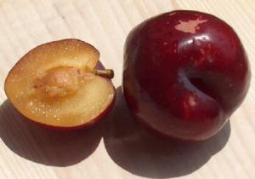




A. M. (football player )
Diagnosis: Atopic ocular and nasal symptoms, oral allergic syndrome and asthma (sensitization to grasses).
Notes:
2

Slide 3

During spring rhino-conjunctivitis & episodes of exercise-induced asthma.
Treated in adolescence with SLIT with good results for four years .

Slide 4


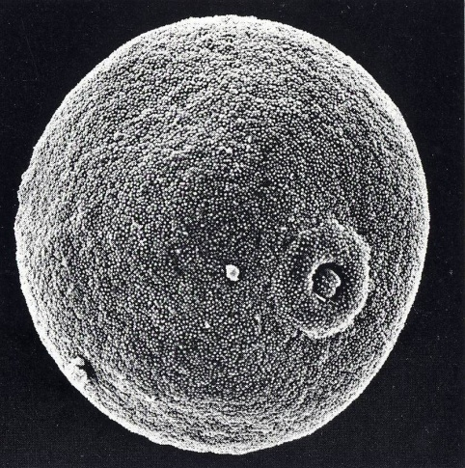
Pollen distribution
J F M A M J J A S O N D
Northern
Central
Southern
Grasses
low
moderate
Very high

Slide 5


Air Pollution
When A.M. lives in urban areas and there is high atmospheric pressure with increase of Particulate Matters (PM), there is deterioration of nasal and bronchial symptomatology with rhinorrhoea, cough and dyspnoea.

Slide 6



Subjects living in urban areas tend to be more affected by plant-derived respiratory disorders compared to rural areas
Notes:
Air pollutants can affect both the respiratory and cardiac systems. The health effects of AP can be seen as a pyramid, with the mildest but not common effects at the bottom of the pyramid, and the least common but more severe at the top of the pyramid. The pyramid demonstrates that as severity decreases the number of people affected increases.
THE EFFECTS OF AIR POLLUTION ON HEALTH ARE OFTEN CONVENIENTLY CLASSIFIED: short-term vs. long-term effects
although there is probably a continuum of effects in the time scale, which are not yet fully understood

Slide 7
The Possible Ways by which Atmospheric Pollution may Increase Nasal Allergy and Asthma
Genetic Predisposition
Enhancement of
Sensitization
Allergic Sensitisation
Enhancement of Organ
Hyper-responsiveness
Enhanced Pollen
Production
and Antigenicity
Organ Hyper-responsiveness
Triggering Episodes
of Disease
Disease
Notes:
7

Slide 8
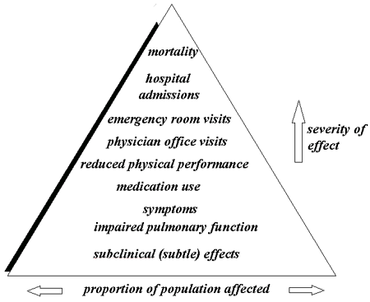
Pyramid of respiratory effects (nasal and bronchial) of air pollution
Short-term
vs
long-term effects
D'Amato G, Holgate ST, Pawankar R, et al
World Allergy Organ J. 2015 Jul 14;8(1):25. doi: 10.1186/s40413-015-0073-0. eCollection 2015.
Notes:
Air pollutants can affect both the respiratory and cardiac systems. The health effects of AP can be seen as a pyramid, with the mildest but not common effects at the bottom of the pyramid, and the least common but more severe at the top of the pyramid. The pyramid demonstrates that as severity decreases the number of people affected increases.
THE EFFECTS OF AIR POLLUTION ON HEALTH ARE OFTEN CONVENIENTLY CLASSIFIED: short-term vs. long-term effects
although there is probably a continuum of effects in the time scale, which are not yet fully understood

Slide 9



Factors in Rhinitis and Asthma Variability
Interaction between climate change, air pollution & aeroallergens
Genetic
Disease Variability
Environment,
Including aeroallergens
such as pollens
Phenotype
Variability
“Phenotypes”: The visible effects of the interaction between Genetic Makeup and the Environment
D'Amato G, et al, .Multidiscip Respir Med. 2015 Dec 22;10:39. doi: 10.1186/s40248-015-0036-x. eCollection 2015. Review.
Notes:
Slide 4: Factors Contributing to the Systemic Manifestations of Inflammation in the Respiratory System: A Working Hypothesis
Continued…
The immune-response hypothesis gives importance to the route of exposure, which could be via inhaled air, via postnasal drip, or by way of circulating inflammatory mediators newly formed in response to environmental factors. The inflammatory effectors would be delivered through the systemic circulation to target tissues. The specific type and degree of immune response determine or modulate the systemic manifestation of the allergy as an IgE response or as a non-IgE, primary T-cell response. Other factors, such as T-cell homing, play a role in the manifestation of the allergic inflammation in specific target organs, such as the lower airway, the nose, or other tissues (eg, the skin).1,3,4
References: 1. Sicherer SH. Determinants of systemic manifestations of food allergy. J Allergy Clin Immunol. 2000;106(5):S251– S257.
2. Busse WW, Lemanske RF Jr. Asthma. N Engl J Med. 2001;344:350–362.
3. Kay AB. Allergy and allergic diseases. First of two parts. N Engl J Med. 2001;344:30–37.
4. Ainslie MP, McNulty CA, Huynh T, Symon FA, Wardlaw AJ. Characterisation of adhesion receptors mediating lymphocyte adhesion to bronchial endothelium provides evidence for a distinct lung homing pathway. Thorax. Dec 2002;57:1054–1059.

Slide 10


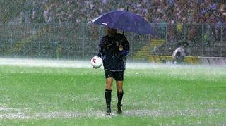

25 March 2015
Atlanta-Bologna 2-0
Thunderstorm just at the end of the first time….and in A.M appeared rhinitis and asthma crisis

Slide 11

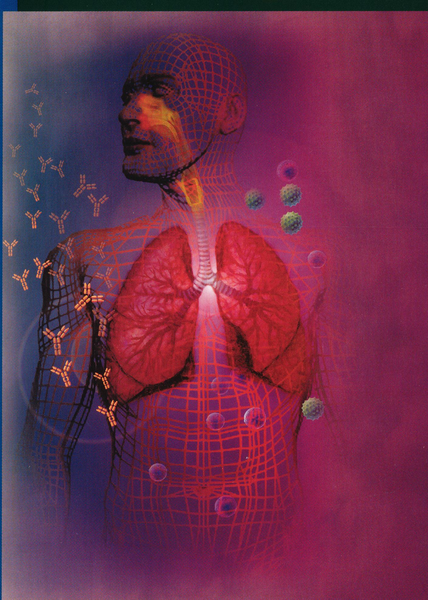
The thunderstorm
rhinitis and asthma
: D’Amato G et al .Thunderstorm related asthma: what happens and why.
Clin Exp Allergy 2016 ;(46) :390–396.

Slide 12
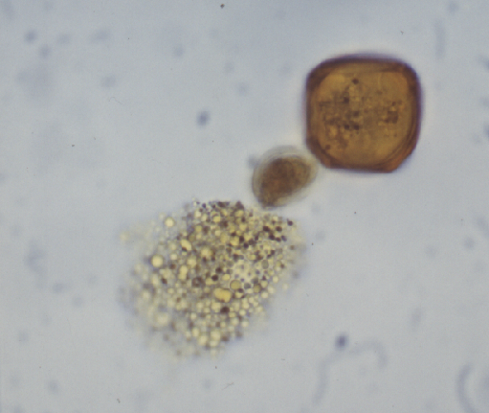
Hydrated pollen on a wet surface
proteins
lipid drops
starch

Slide 13
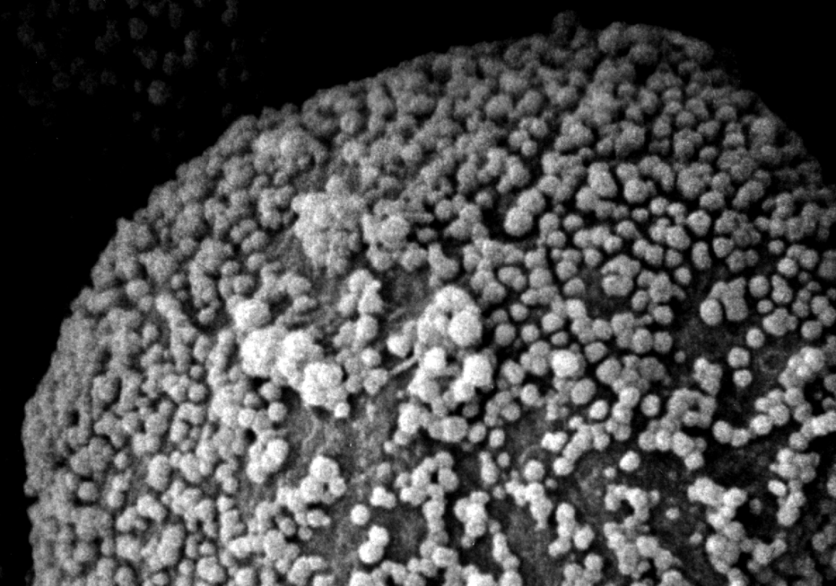
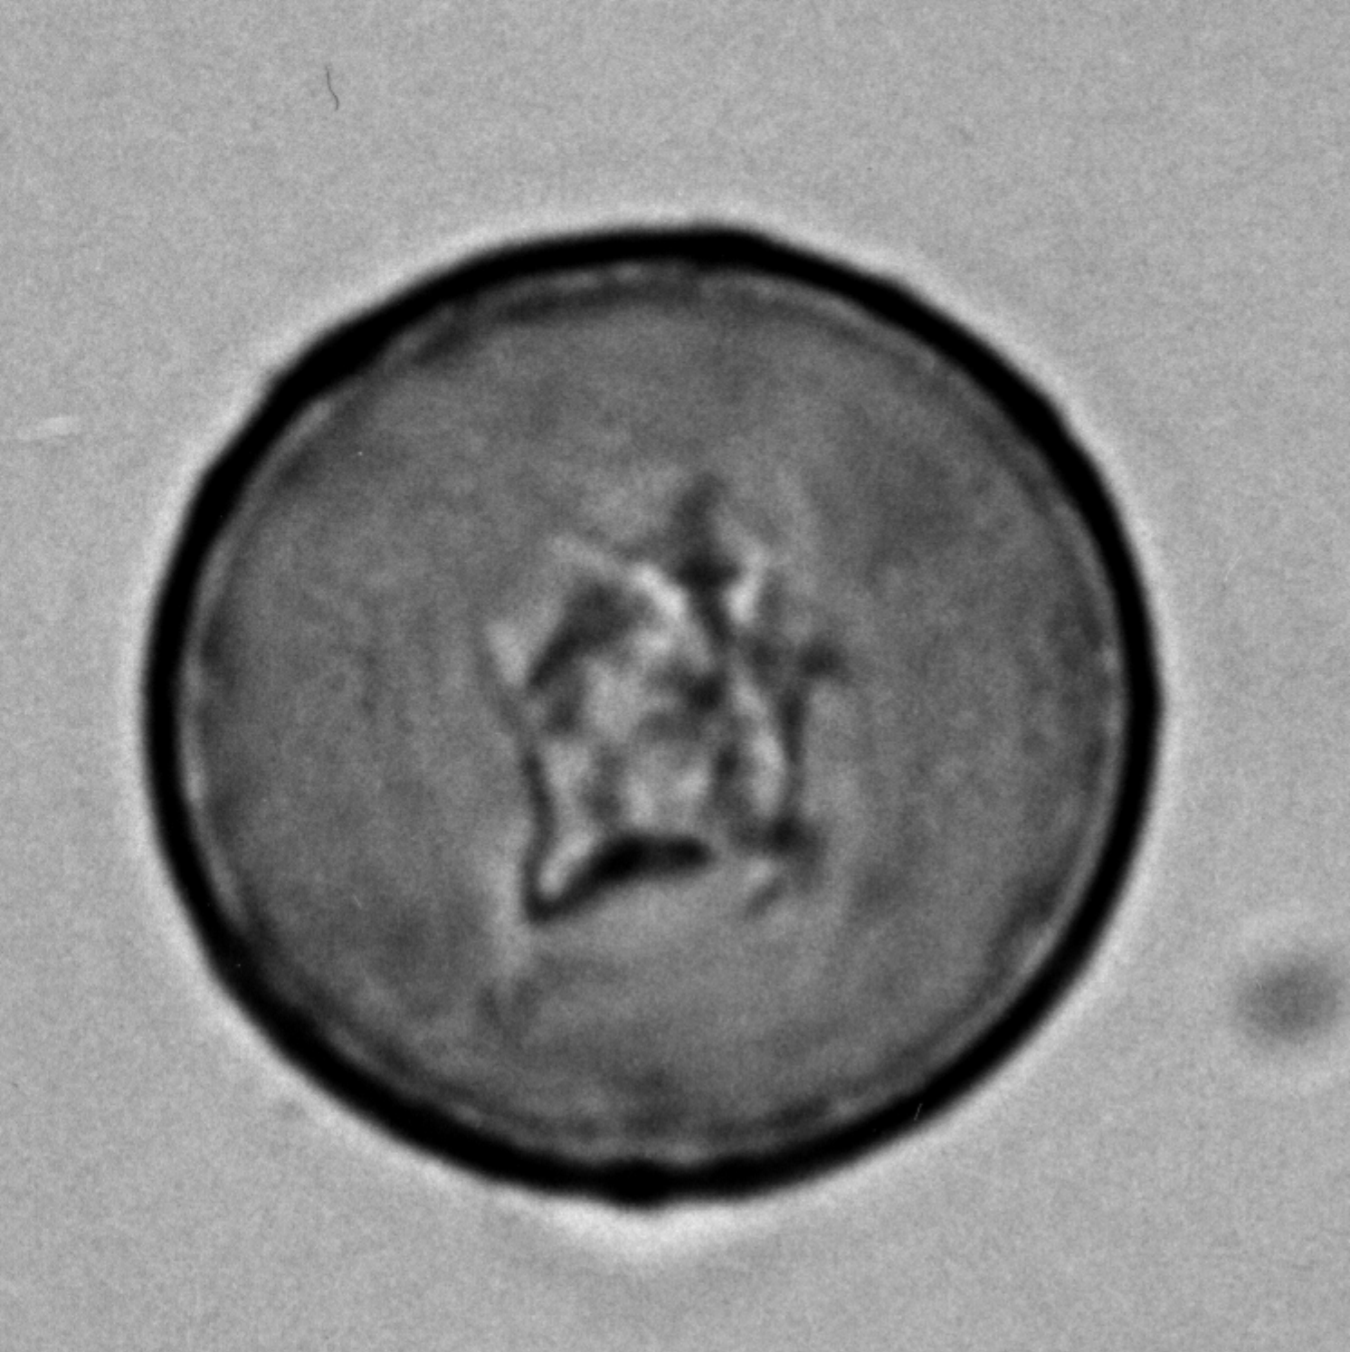
The pollen allergens are located in the walls or in the cytoplasm
Cytoplasm
R.E.
Nucleous
Plastids
Intine
Orbicule

Slide 14
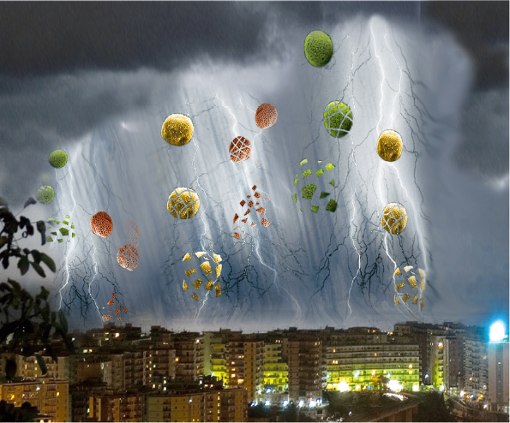
Thunderstorm related epidemics of rhinitis and asthma exacerbations
Under wet conditions or during thunderstorms pollen grains may, after rupture by osmotic shock, release part of their cytoplasmic content into the atmosphere.
D’Amato G, et al BMJ ,2005; Clin Exp Allergy, 2005; Allergy , 2007; JACI, 2 008; JIACI2, 010; ERR 2014; Clin Exp Allergy, 2016
Notes:
14
14

Slide 15
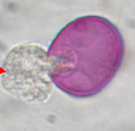

Climate changes favor production also of Airborne Small Allergen-carrying Particles
Pollen fragments
Starch granules and other cytoplasmic granules
Non-pollen plant parts (from inflorescences, leaves or Ubisch bodies)
Non-plant particulate matter (allergens transferred through physical contact or by leaching from the surface of the pollen grain to other airborne small particles).
Pollen grains fragmented and dispersed in atmosphere during Thunderstorms
D’Amato G et al Allergy, 2007; Clin Exp Allergy, 2008; JIACI, 2010;ERR , 2012;Clin Exp Allergy, 2016
Notes:
High
environmental humidity conditions can subject the pollen
particles to osmotic shock, resulting in the release of
microparticles or paucimicronic particles that may contain
allergenic proteins [28]. The presence of these paucimicronic
particles would explain the discordance occasionally observed
between the appearance of respiratory allergic symptoms in a
pollinic patient and the absence of actual pollen particles in the
atmosphere [29,30]. In the same way, through physical contact
with the pollen particles, DEPs can disrupt the former, leading
to the release of paucimicronic particles and transporting them
by air - thus facilitating their penetration of the human airways.
It should be remembered that DEPs may measure less than 10
μm in diameter, and many are even less than 0.1 μm in size;
as a result, they can easily penetrate the airways and even
reach the lower respiratory tract [31,32]. In vitro studies have
shown that Lol p 1 and Bet v 1, which are the prevalent or
majority allergens of Lolium (a gramineous species) and birch,
respectively, bind to DEPs thanks to the absorptive capacity
resulting from their physicochemical characteristics [33,34].
Such “affi nity” has also been demonstrated for other allergens
such as Der p 1, Fel d 1 and Can f 1 [35].
Other plant-derived allergenic particles are the so-called
Ubish bodies. These are spheroid structures that develop
with pollen exine and are found in the anthers of many plants
[36]. These structures, measuring only a few μm in diameter,
may also contain allergenic proteins [37]. Non-biological
particles in suspension, such as DEPs, act as transporters for
these structures, in the same way as for other pollen-derived
paucimicronic particles [38].

Slide 16
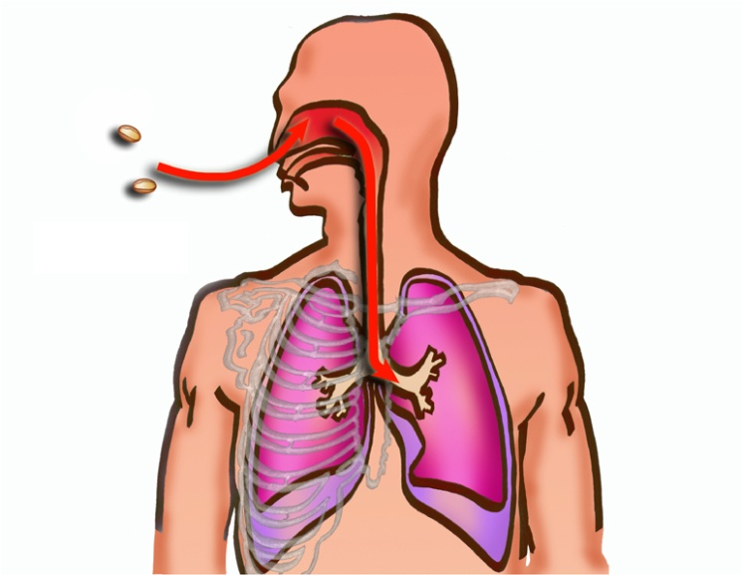



Submicronic and/or paucimicronic particles in atmosphere
Pollen grains fragmented and dispersed in atmosphere

Slide 17
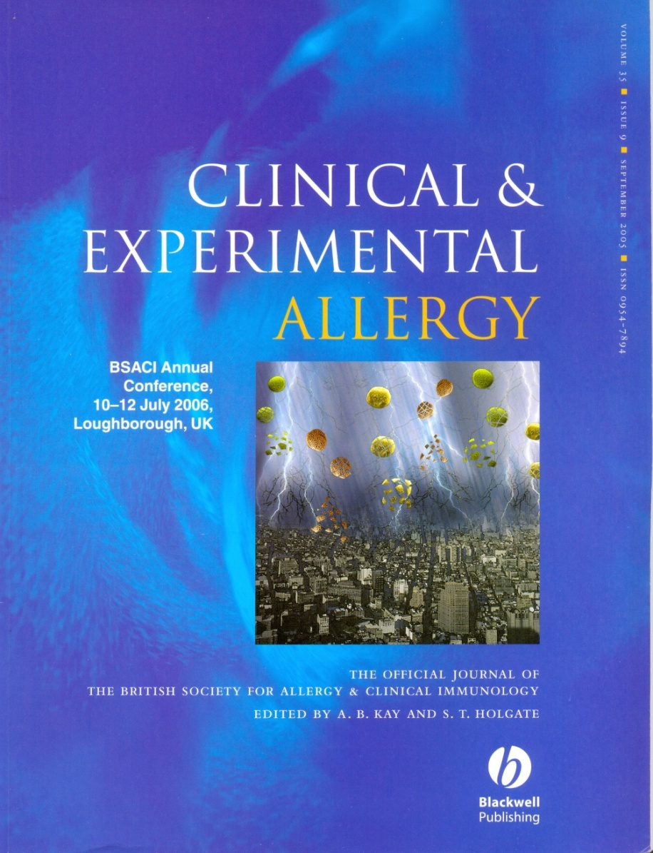
D’Amato G et al.
Environmental risk factors and allergic bronchial asthma.
Clin Exp Allergy 2005;35:1113-1124.
D’Amato G et al .
Thunderstorm related asthma: what happens and why.
Clin Exp Allergy 2016 ;(46) :390–396.

Slide 18


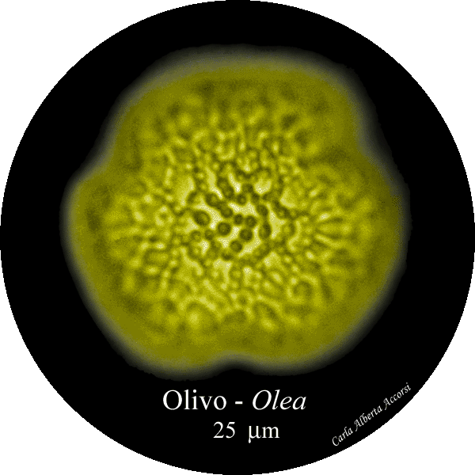
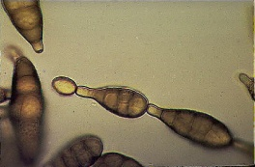
Grass pollens
Parietaria pollens
Olea pollens
Alternaria
Thunderstorm-related respiratory allergy and asthma outbreaks and relapse.
Gennaro D'Amato et al.
BMJ, 2005; Allergy, 2007; ERR, 2014; Clin Exp Allergy, 2016

Slide 19

Now rhino conjunctivitis and asthma are controlled, during Spring months, with antihistamines (Fexofenadine 120 o.d., nasal triamcinolone acetonide o.d. and inhaled fluticasone 250 mcg 2 puffs morning and 2 evening)

Slide 20
The evidence about thunderstorm related epidemics of rhinitis and asthma exacerbations
The occurrence of epidemics is closely linked to thunderstorm
The thunderstorm related epidemics are limited to late spring and summer when there are high levels of airborne pollen grains
There is a close temporal association between the arrival of the thunderstorm, a major rise in the concentration of pollen grains and the onset of epidemics
Subjects with pollen allergy, who stay indoors with window closed during thunderstorm, are not involved
There is a major risk for subjects who are not under antiasthma correct treatment, but subjects with allergic rhinitis and without previous asthma can experience severe bronchoconstriction.
D’Amato G et al . Thunderstorm related asthma: what happens and why.
Clin Exp Allergy 2016 ;(46):390–396

Slide 21
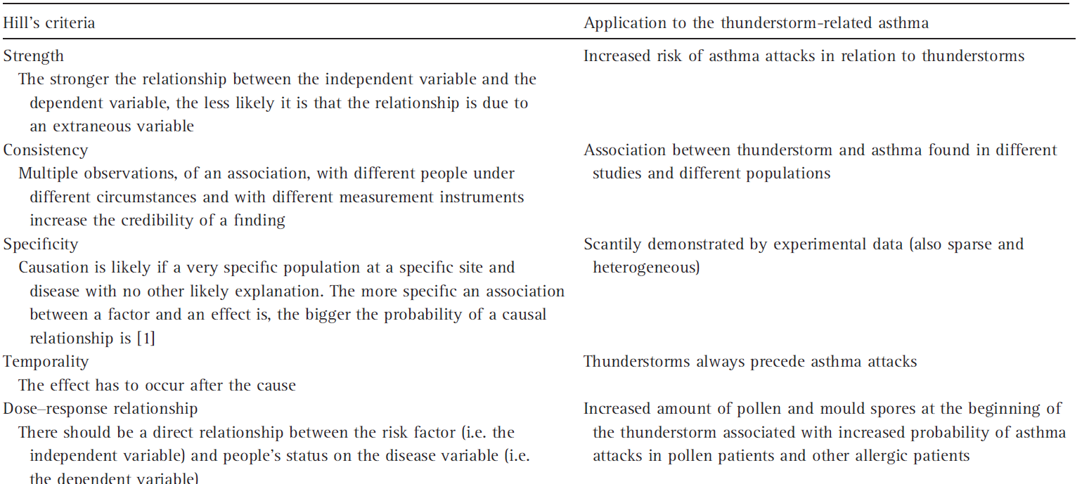
Is there a causal link between thunderstorms
and asthma attacks?
D’Amato G et al . Thunderstorm related asthma: what happens and why.
Clin Exp Allergy 2016 ;(46):390–396

Slide 22
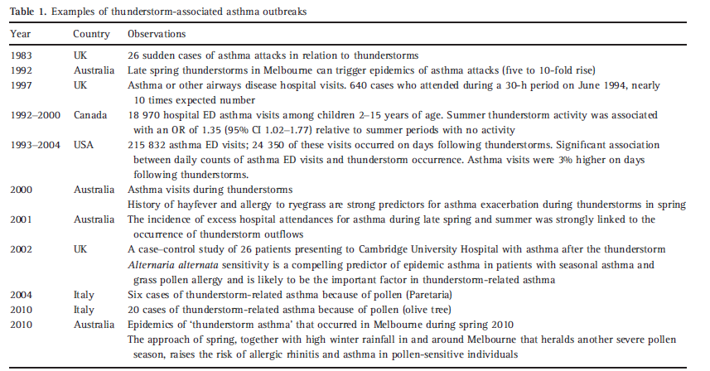
Thunderstorm - associated respiratory allergy
and /or asthma epidemics: observational evidence

Slide 23

Although thunderstorm-associated asthma outbreaks are not frequent, it is possible to observe in clinical practice, during a thunderstorm in the pollen season, single cases of patients with deterioration of allergic respiratory symptoms (nasal, such as rhinorrhea and sneezing and bronchial, such as cough and asthma).

Slide 24

Take home message:
Subjects affected by pollen allergy should be alert to the danger of being outdoors without correct treatment of rhinitis and asthma during a thunderstorm in the pollen season.

Slide 25
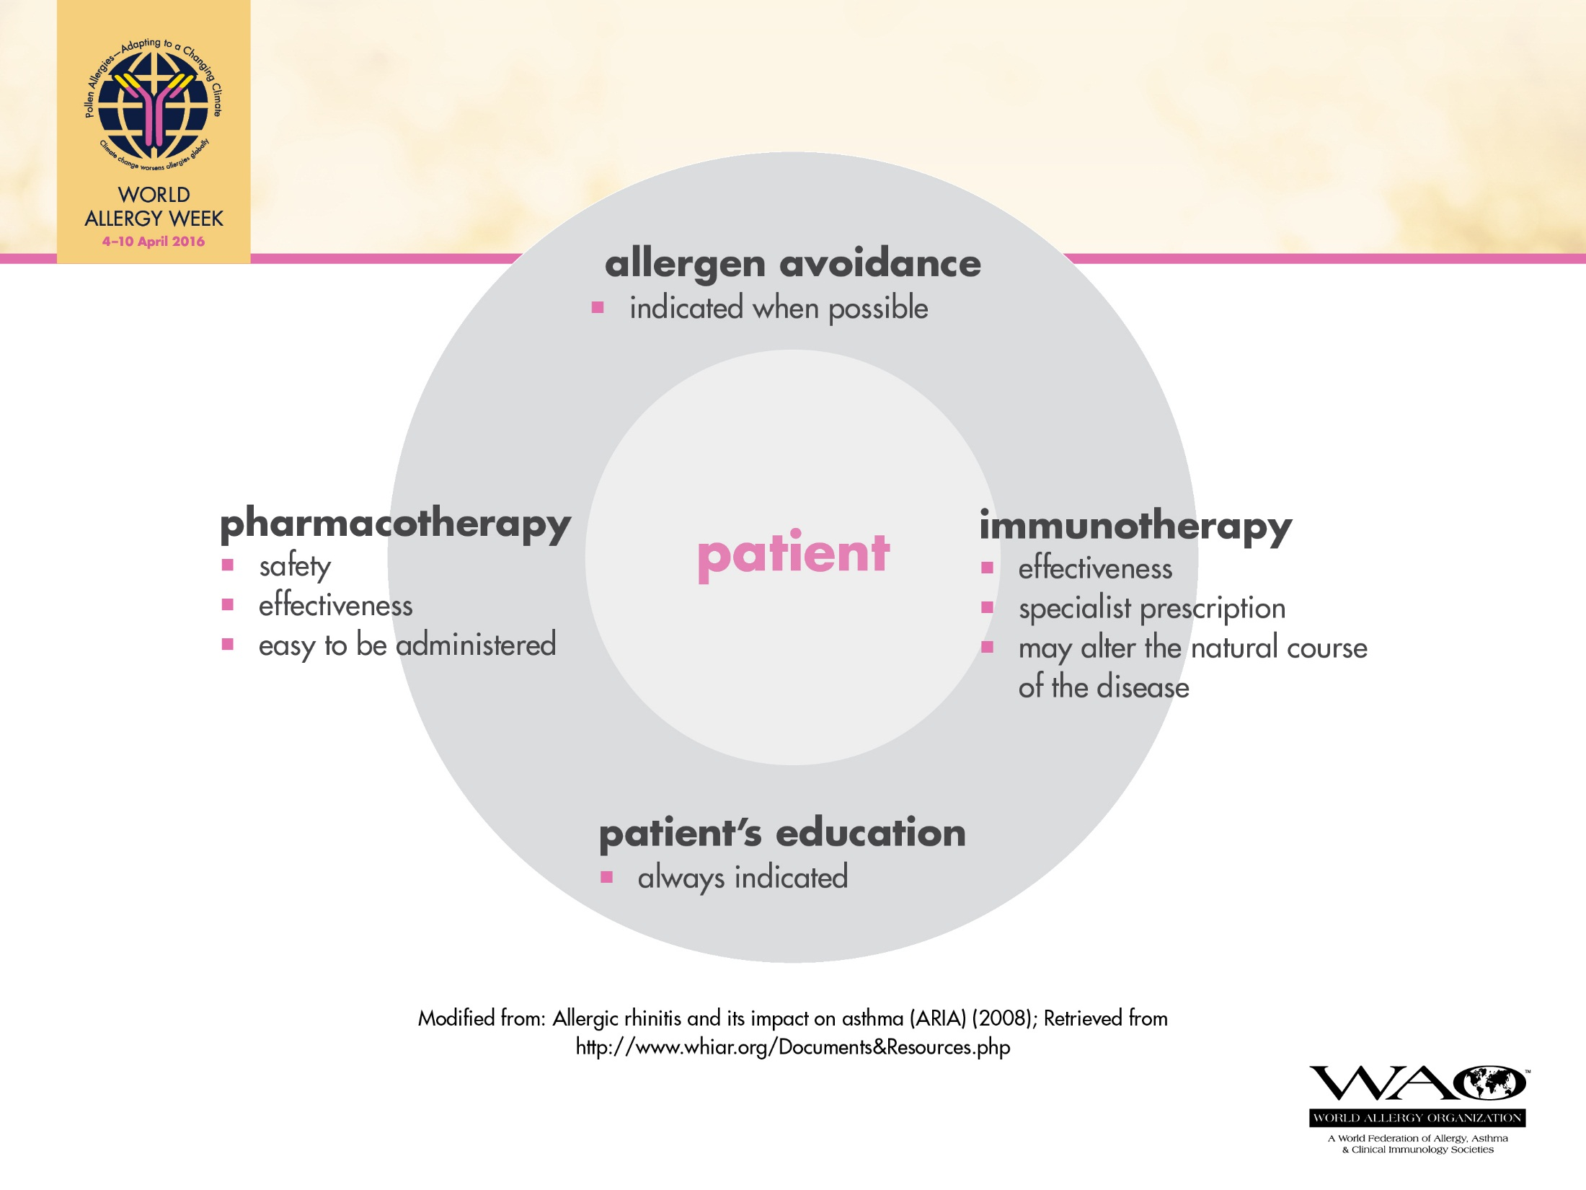

Slide 26
Clinical Case

Slide 27

Case report
This 49-yo lady has been suffering from sneezes, clear nasal secretion, nasal, oropharyngeal and ocular pruritus.
Bilateral nasal obstruction worsens when she is exposed to air pollution*. Symptoms occur frequently and in the fall they are daily. Hyposmia was noted In the past months.
Additional precipitants: mold, house dust, wind, tobacco smoke, and temperature inversions.
Laundry powder, detergents, and aerosols
invariably trigger rhinitis.
*Diesel exhaust and cellulose industry depending on wind direction

Slide 28
Past Medical history:
Two episodes of rhino sinusitis were treated with antibiotics. Cough and dyspnoea especially with pollutants.
Family History:
Her father has persistent allergic rhinitis.
Home:
She lives in a 3 bedroom apartment , well ventilated; no pets but her husband is a heavy smoker. Pillow and mattress are covered .
Prick Skin Tests: positive to D. pteronyssinus, Blomia tropicalis and Dog

Slide 29
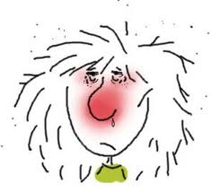
Diagnosis
Persistent Allergic Rhino conjunctivitis, moderate/severe (ARIA 2008)
Mild Asthma

Slide 30
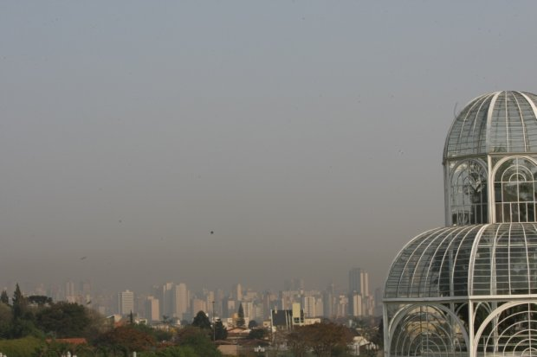

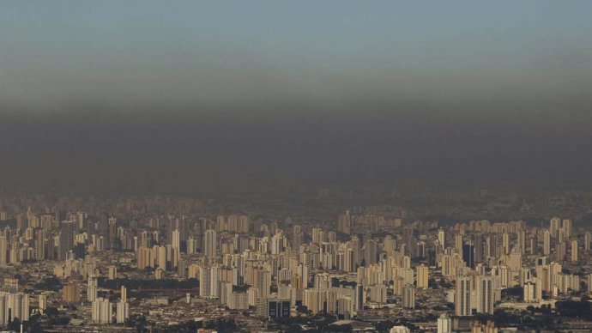
Curitiba

Slide 31
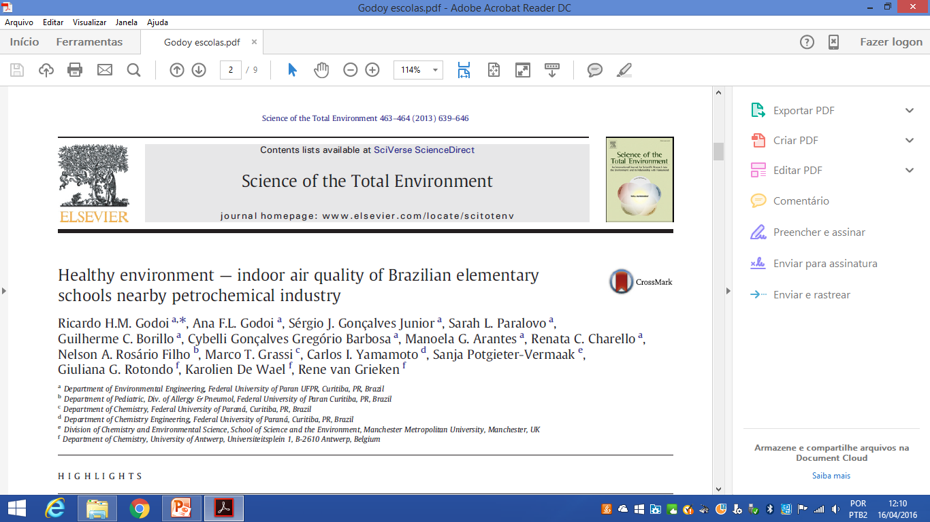
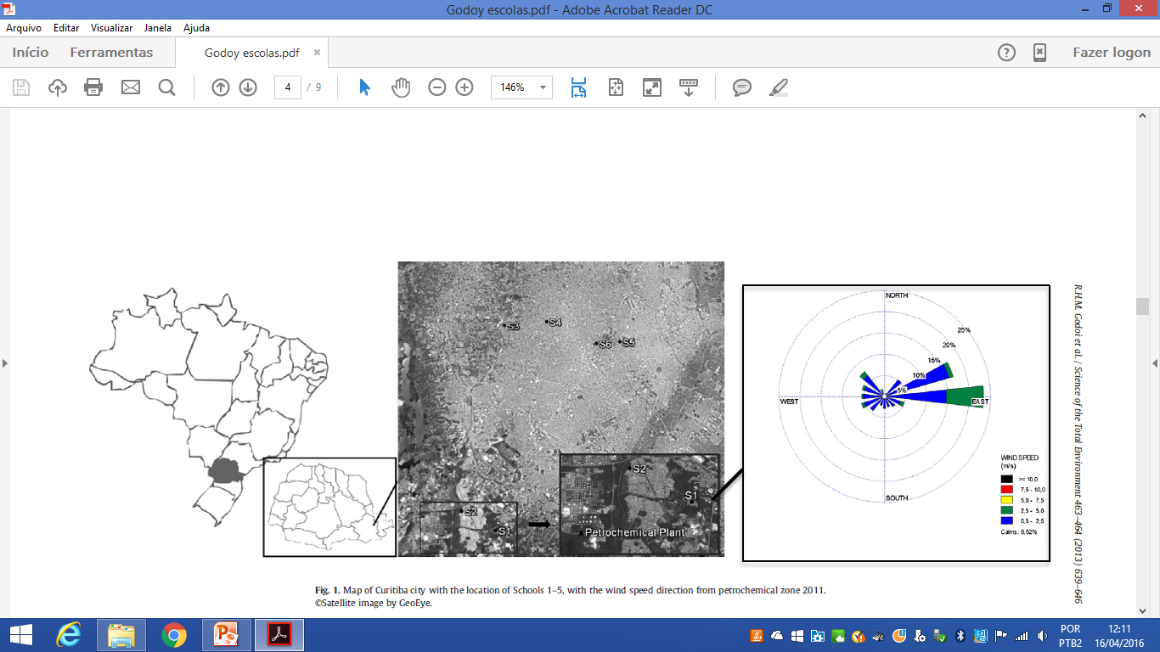

Slide 32


Our Aim
Pollution nearby industrial zones relation to indoor air
inside classrooms.
Notes:
Two sampling in three schools in two different periods, spring and winter. Suburban near a petrochemical plant (2) and urban.
two pupils have been randomly selected in each school to carry personal samplers,which are composed by a necklace with two passive samplers,one for SO2, NO2, HAc and HFor and another for BTEX.

Slide 33
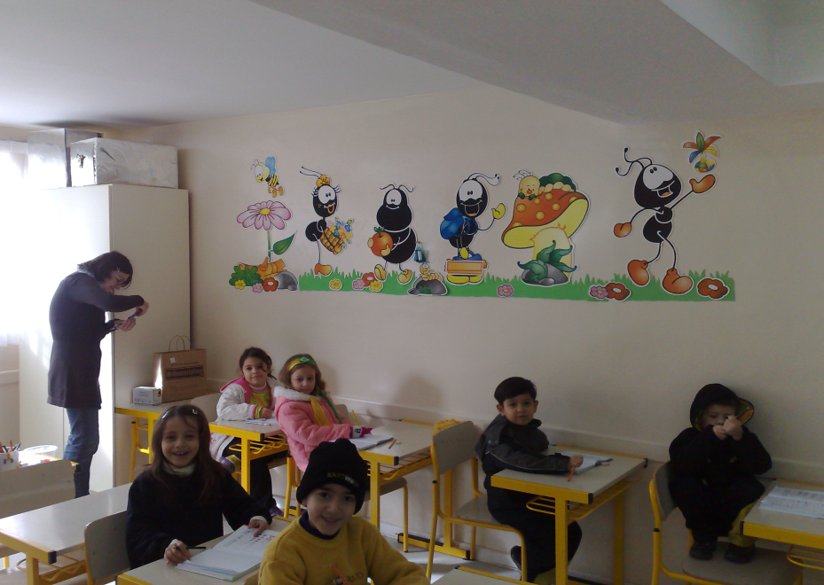

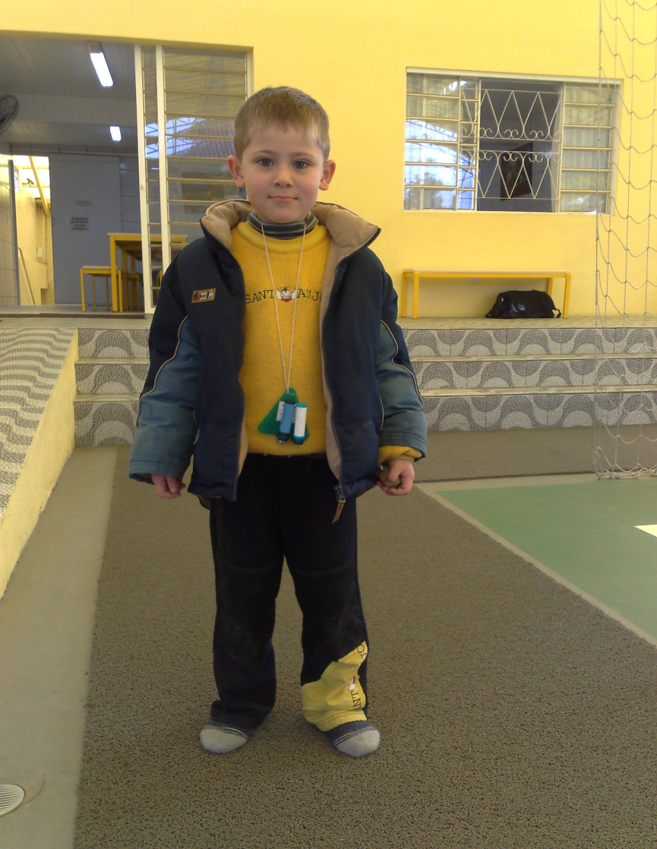
Gases
School
Home
Personal exposure
SO2, NO2, Hac, HFor and BTEX
Notes:
The VOCs that are of scientific interest for indoor and outdoor air qualities are specifically benzene, toluene, ethyl-benzene and the xylene isomers (acronym BTEX) Hac acetaldehyde, Hfor formaldehyde.
SO2, NO2, HAc, and HFor were analyzed by means of ion chromatography (dual column Dionex DX-120),
For BTEX, sample extractions were performed by using chemical desorption with 2 ml of carbon disulfide (CS2), during 1 h . Extracts were analyzed with a Varian® gas chromatograph

Slide 34

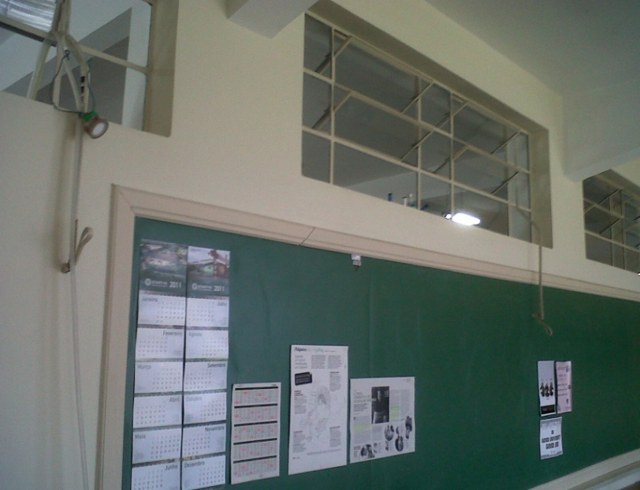
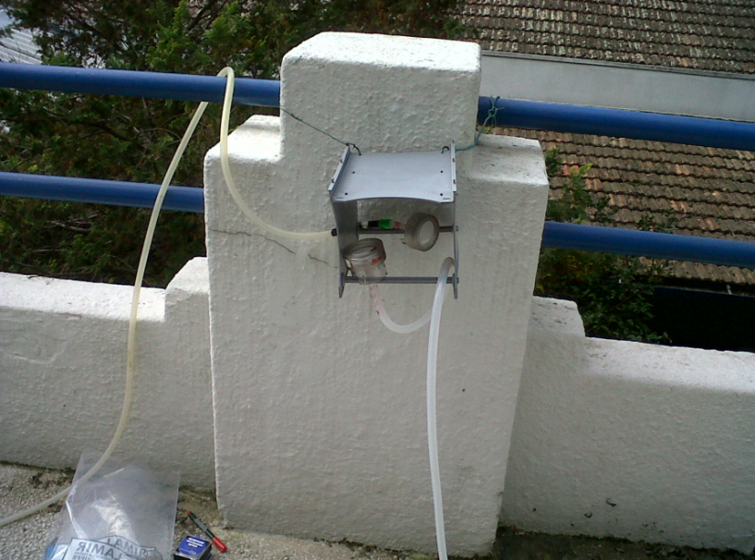
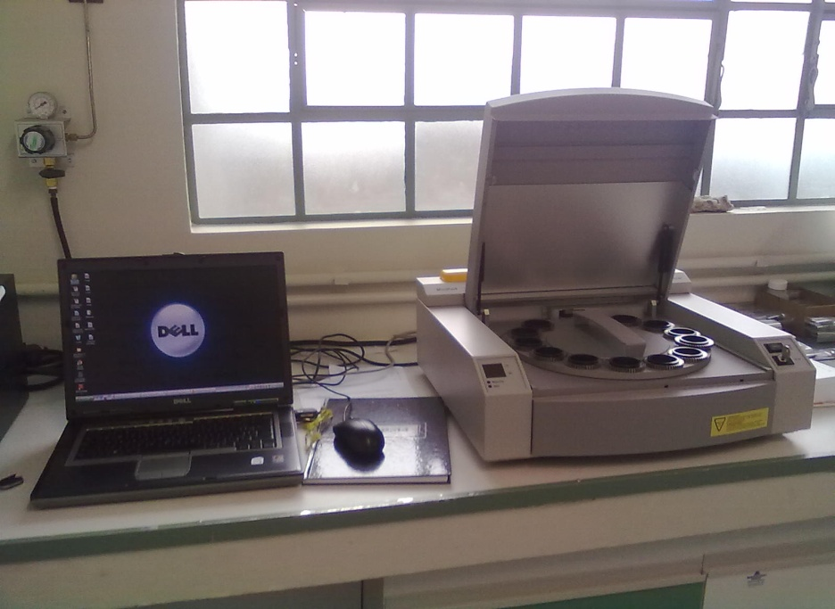
Total Bulk Particles
5-day exposure (week period of classes)
24 hours
2 weeks
Filters
Inside
Energy-Dispersive X-ray Fluorescence
Outside
Notes:
polycarbonate membranes (nucleopore) by means of impaction. The sequential sampler was exposed indoors and outdoors for periods of
24 h at a flow rate of 35 L min−1.

Slide 35
Conclusion
Children are exposed to high pollutant concentrations, mainly in the suburban area (proximity to industrial plants); the schools in urban area revealed high exposure to particulate matter (motor vehicles emission)
Industrial zones contributed significantly to reduce air quality; outdoor sources have a high influence in houses and schools indoor air quality.
These pollutants may be one of the sources causing / potentiating respiratory diseases in some schoolchildren.

Slide 36
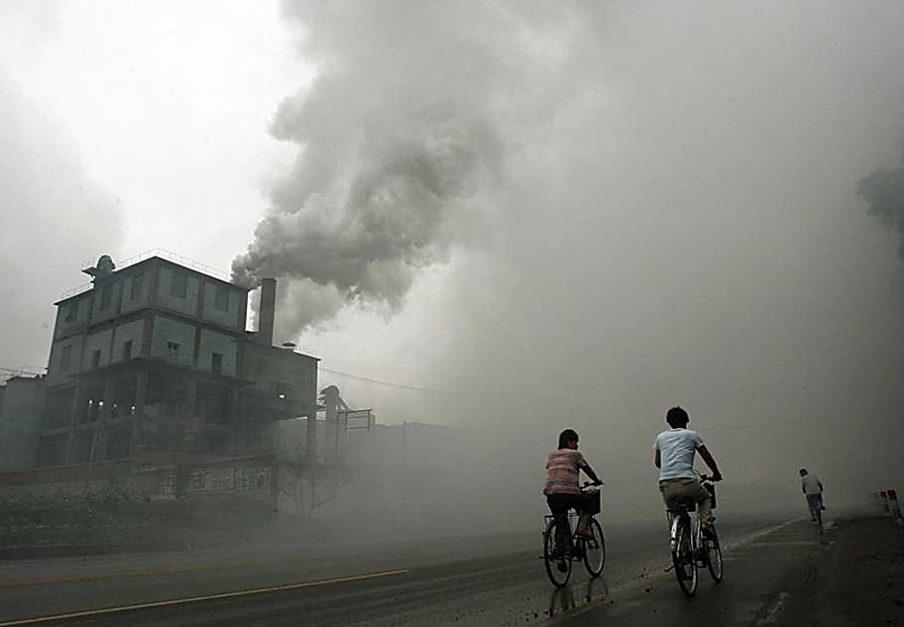
Take Home Message
Allergic diseases can be aggravated by indoor pollutants.
Outdoor sources have high influence in indoor air quality of houses and schools .
Dr. Nelson Rosário

Slide 37
Treatment
Education
Environmental control
Medication
Immunotherapy.

Slide 38
Clinical Case

Slide 39
CLINICAL CASE
Martin:
30 year old man
Followed in our Department because of sneezing, itchy nose and eyes, rhinorrhea and obstruction, ongoing for more than a decade
The patient refers increase of symptoms in the last two years coinciding with moving from small village to a new home in the city center of Bilbao
The apartment is a first floor, over a pizzeria and in front of a garden square.
Symptoms occur mainly in autumn as well as May and June

Slide 40
CLINICAL CASE
Youngest of three brothers, all suffering allergic rhinitis
Both parents alive, non-allergic
Non-smoker
No relevant past medical history
He works as a bus-driver
No pets at home
He practices regularly sports: soccer 7 and paddle.

Slide 41
CLINICAL CASE
Initially, he complained of symptoms during autumn, mainly indoors, that improved when leaving home. Symptoms were more intense on rainy days
Very occasionally, he developed wheezing and shortness of breath, controlled with SABA
In spring, symptoms were restricted to sunny days in May and June
His work or leisure activities were not affected

Slide 42
CLINICAL CASE
Inhalant allergen SPT:
  D pteronyssinus 6x7 mm
  Grass mix 8x9 mm
  Weeds, negative
  Molds, negative
  Cockroach, negative
  Tree mix, negative
  Pet danders, negative
  Storage mites, negative
FeNO: 23 ppb
Baseline FEV₁ within limits

Slide 43
CLINICAL CASE
Total IgE 215 kU/l
Serum sIgE:
  D pteronyssinus 48 kU/l
  Phleum pratensis 23 kU/l
  Cynodon dactylon 4 kU/l

Slide 44
CLINICAL CASE
Allergen avoidance measures for mites, pollen and raw rice
Nasal lavage
Non-sedating 2nd generation antihistamine once daily
Intranasal corticosteroid 1 application twice a day
Inhaled salbutamol on demand

Slide 45
CLINICAL CASE
Six years later he re-consulted because in the last two years symptoms became worse
In spring they are more severe, affecting nose and eyes, impairing his everyday life, often accompanied by wheezing, and not controlled by oral antihistamines. The patient was reluctant to use intranasal corticosteroids and abandoned this treatment after a short course. For four years the patient controlled symptoms with antihistamines
He also reports sneezing in his building doorway area on hot days, all year round. He thinks it is because of the products used by the cleaner of the property

Slide 46
CLINICAL CASE
In vivo and in vitro allergy tests were repeated, with similar results as 5 years ago
The patient himself went to another property managed by the same company and using the same cleaning products, but experienced no symptoms
The patient was advised to use again the intranasal corticosteroid together with the antihistamine, for a period of three months and a new appointment was given for re-evaluation

Slide 47
CLINICAL CASE
The patient delayed the appointment because he was getting married in August
Upon arrival from the honeymoon, he spontaneously came to the outpatient clinic because his symptoms restarted when he returned home
He also reported that, immediately after his marriage, when leaving the city hall, experienced acute rhino conjunctivitis, despite he had been perfectly well while inside
Symptoms remained for a couple of hours and ceased spontaneously during the banquet

Slide 48
CLINICAL CASE
After accurate anamnesis, the patient recognized that the day that he returned from the honeymoon he was sitting in the pizzeria below his apartment. He suffered nasal congestion but he thought it was a cold due to the air-conditioning of the plane. In other pizzerias he had visited he did not experience worsening of his rhinitis
He was told to ask the owner of the pizzeria if they were using something different to other pizzerias. He found out that in that pizzeria, rice flour was mixed with wheat flour in the dough to improve the texture of the pizza base
At that moment he realized that after the wedding, plenty of rice had been thrown to the couple

Slide 49





CLINICAL CASE

Slide 50
CLINICAL CASE
Although the patient tolerates the intake of cooked rice, extended allergological work-up showed positive SPT to rice (7x9 mm) and a sIgE of 14 kU/l.
A controlled challenge test handling of rice flour was performed, and nasal symptoms were triggered after 7 minutes.

Slide 51
CLINICAL CASE
Actual Diagnosis:
  Moderate persistent allergic rhinitis
  Mild intermittent asthma
  Sensitization to house dust mites and grass pollen
  Rice-flour induced allergic rhinitis

Slide 52
CLINICAL CASE
Allergen avoidance measures for mites, pollen and raw rice
Nasal lavage
Non-sedating 2nd generation antihistamine once daily
Intranasal corticosteroid 1 application twice a day
Inhaled salbutamol on demand

Slide 53
How airway allergies impair quality of life: aggravating role of pollution

Slide 54
Outline
Discuss survey data showing the burden of allergic rhinitis
Discuss the impact of treatment on quality of life
Discuss the effect of pollution on allergic rhinitis

Slide 55
Adults Diagnosed with Nasal Allergies: Household Screening
Not diagnosed, 86%
Diagnosed, 14%
QA. Including yourself, how many persons, aged 18 and older, live in this household (even if they are not there right now)?
QB. Have any of these persons been diagnosed as having hay fever, rhinitis, or nasal allergies?
QC. How many persons, 18 or older, in this household have been diagnosed with hay fever, rhinitis or nasal allergies? N=61,655 adults in 31,470 households
.
From Allergies in America. A telephone survey conducted in 2500 adults with allergic rhinitis. Healthstar
Communications, Inc., in partnership with Shulman, Ronca and Bucuvalas, Inc. Allergies in America: A landmark survey on nasal allergy sufferers. Executive summary. Florham Park, NJ: Altana Pharma US, Inc., 2006. Accessed May 2016.
Meltzer E. O. et al Allergy Asthma Proc 33:S113–S141, 2012; doi: 10.2500/aap.2012.33.3603

Slide 56
1 in 7 Children Has Been Diagnosed With Nasal Allergies
Not diagnosed
86%
Diagnosed
14%
From allergies in America. A telephone survey conducted in 2500 adults with allergic rhinitis. Healthstar
Communications, Inc., in partnership with Shulman, Ronca and Bucuvalas, Inc. Allergies in America: A landmark survey on nasal allergy sufferers. Executive summary. Florham Park, NJ: Altana Pharma US, Inc., 2006. Accessed May 2016.
Meltzer E. O. et al Allergy Asthma Proc 33:S113–S141, 2012; doi: 10.2500/aap.2012.33.3603
Notes:
How many persons under age 18 live in this household (even if they are not there right now)?
Have any of these persons under age 18 been diagnosed by a medical professional as having hay fever, allergic rhinitis, or nasal allergies?
How many persons under age 18 in this household have been diagnosed by a medical professional as having hay fever, allergic rhinitis, or nasal allergies?
N = 7,504 adults queried in 33,522 households.

Slide 57
Seasonal or Persistent Allergies in Adults
Throughout the year
56%
Not sure
1%
Seasonal
43%
Q12. Would you describe your nasal allergies as seasonal or do they occur throughout the year? N=2,500
From allergies in America. A telephone survey conducted in 2500 adults with allergic rhinitis. Healthstar
Communications, Inc., in partnership with Shulman, Ronca and Bucuvalas, Inc. Allergies in America: A landmark survey on nasal allergy sufferers. Executive summary. Florham Park, NJ: Altana Pharma US, Inc., 2006. Accessed May 2016.
Meltzer E. O. et al Allergy Asthma Proc 33:S113–S141, 2012; doi: 10.2500/aap.2012.33.3603

Slide 58
Prevalence of Seasonal Versus Perennial Allergies in Children
From allergies in America. A telephone survey conducted in 2500 adults with allergic rhinitis. Healthstar
Communications, Inc., in partnership with Shulman, Ronca and Bucuvalas, Inc. Allergies in America: A landmark survey on nasal allergy sufferers. Executive summary. Florham Park, NJ: Altana Pharma US, Inc., 2006. Accessed May 2016.
Meltzer E. O. et al Allergy Asthma Proc 33:S113–S141, 2012; doi: 10.2500/aap.2012.33.3603
Notes:
Would you describe your nasal allergies as seasonal, or do they occur throughout the year?
Unweighted N = 407.

Slide 59
Time of Year for Nasal Allergy Symptoms in Children
From allergies in America. A telephone survey conducted in 2500 adults with allergic rhinitis. Healthstar
Communications, Inc., in partnership with Shulman, Ronca and Bucuvalas, Inc. Allergies in America: A landmark survey on nasal allergy sufferers. Executive summary. Florham Park, NJ: Altana Pharma US, Inc., 2006. Accessed May 2016.
Notes:
During what times of the year are your nasal allergies the worst?
Base: Worse at certain times.
Unweighted N = 350.

Slide 60
Outdoor Allergies Symptoms
Are More Bothersome in Children
Same
52%
Not sure
1%
Inside
3%
Outside
44%
From allergies in America. A telephone survey conducted in 2500 adults with allergic rhinitis. Healthstar
Communications, Inc., in partnership with Shulman, Ronca and Bucuvalas, Inc. Allergies in America: A landmark survey on nasal allergy sufferers. Executive summary. Florham Park, NJ: Altana Pharma US, Inc., 2006. Accessed May 2016.
Notes:
Are your nasal allergies worse when you are outdoors or inside, or is it about the same?
Unweighted N = 407.

Slide 61
Most Bothersome Symptoms of Nasal Allergies
From allergies in America. A telephone survey conducted in 2500 adults with allergic rhinitis. Healthstar
Communications, Inc., in partnership with Shulman, Ronca and Bucuvalas, Inc. Allergies in America: A landmark survey on nasal allergy sufferers. Executive summary. Florham Park, NJ: Altana Pharma US, Inc., 2006. Accessed May 2016.
Meltzer E. O. et al, Allergy Asthma Proc 33:S113–S141, 2012; doi: 10.2500/aap.2012.33.3603
Notes:
Which of these symptoms was the most bothersome to your [AGE]?
Base: Had bothersome symptoms.
N = 438.
Red, itching eyes: 8%
Repeated sneezing: 7%
Postnasal drip: 7%
Watering eyes: 5%
Itching: 4%
Ear pain: 3%
Facial pain: 2%
Not sure: 2%

Slide 62
Degree of Discomfort from Allergies
Can't Tolerate
38%
Not sure
1%
Can Ignore
6%
Can Tolerate
55%
Q17. In general, when you have a nasal allergy attack would you say that your discomfort is usually something you can ignore, you can’t ignore it, but you can tolerate it, or you can’t tolerate it without relief? N=2,500
From allergies in America. A telephone survey conducted in 2500 adults with allergic rhinitis. Healthstar
Communications, Inc., in partnership with Shulman, Ronca and Bucuvalas, Inc. Allergies in America: A landmark survey on nasal allergy sufferers. Executive summary. Florham Park, NJ: Altana Pharma US, Inc., 2006. Accessed May 2016.
Meltzer E. O. et al Allergy Asthma Proc 33:S113–S141, 2012; doi: 10.2500/aap.2012.33.3603

Slide 63
Degree of Discomfort During Nasal
Allergy Attack: Parents and Practitioners
ENT specialists
26%
71%
Can't tolerate
Can't ignore
Family physicians
27%
70%
Allergists
55%
41%
Pediatricians
38%
56%
Parents
33%
57%
0
20
40
60
80
100
Category, %
ENT = Ear, nose, and throat.
From allergies in America. A telephone survey conducted in 2500 adults with allergic rhinitis. Healthstar
Communications, Inc., in partnership with Shulman, Ronca and Bucuvalas, Inc. Allergies in America: A landmark survey on nasal allergy sufferers. Executive summary. Florham Park, NJ: Altana Pharma US, Inc., 2006. Accessed May 2016.
Allergy Asthma Proc 33:S113–S141, 2012; doi: 10.2500/aap.2012.33.3603
Notes:
Practitioners: In general, would you say that patients’ (aged 4 to 17) discomfort during a nasal allergy attack is usually: Something they can ignore; something they can’t ignore, but they can tolerate it; or something they can’t tolerate without relief? N = 501.
Parents: In general, when your child has a nasal allergy attack, would you say that (his/her) discomfort is usually: Something (he/she) can ignore; something (he/she) can’t ignore, but (he/she) can tolerate it; or something (he/she) can’t tolerate without relief?
N = 500.

Slide 64
Symptoms During Worst Month
Q30. During allergy season, how often do you feel (ITEM) – frequently, sometimes, rarely or never? N=2,500
From allergies in America. A telephone survey conducted in 2500 adults with allergic rhinitis. Healthstar
Communications, Inc., in partnership with Shulman, Ronca and Bucuvalas, Inc. Allergies in America: A landmark survey on nasal allergy sufferers. Executive summary. Florham Park, NJ: Altana Pharma US, Inc., 2006. Accessed May 2016.
Meltzer E. O. et al Allergy Asthma Proc 33:S113–S141, 2012; doi: 10.2500/aap.2012.33.3603

Slide 65
Fewer Parents View Their Children’s Overall Feelings of Well-Being to Be Positive (Past 4 Weeks)
From allergies in America. A telephone survey conducted in 2500 adults with allergic rhinitis. Healthstar
Communications, Inc., in partnership with Shulman, Ronca and Bucuvalas, Inc. Allergies in America: A landmark survey on nasal allergy sufferers. Executive summary. Florham Park, NJ: Altana Pharma US, Inc., 2006. Accessed May 2016.
Meltzer E. O. et al Allergy Asthma Proc 33:S113–S141, 2012; doi: 10.2500/aap.2012.33.3603
Notes:
During the past 4 weeks how often has your [AGE] been [ITEM]
—all of the time, most of the time, a good bit of the time, some of the time, little of the time, or none of the time?

Slide 66
Children’s Emotional Status Affected by Nasal Allergy Symptoms
From allergies in America. A telephone survey conducted in 2500 adults with allergic rhinitis. Healthstar
Communications, Inc., in partnership with Shulman, Ronca and Bucuvalas, Inc. Allergies in America: A landmark survey on nasal allergy sufferers. Executive summary. Florham Park, NJ: Altana Pharma US, Inc., 2006. Accessed May 2016.
Meltzer E. O. et al Allergy Asthma Proc 33:S113–S141, 2012; doi: 10.2500/aap.2012.33.3603
Notes:
During allergy season, how often do you feel [ITEM]
—frequently, sometimes, rarely, or never?
Open-ended question.
Unweighted N = 407.

Slide 67
Children’s Social Life Is Disrupted by Nasal Allergy Symptoms
Allergy N = 493
No allergy N = 432
Sleeping
40%
7%
Organized sports or exercising
10%
33%
Outdoor activities
7%
31%
Going out/Playing with friends
6%
29%
Having pets
27%
4%
Doing well in school
26%
8%
Doing things with family
5%
22%
School activities
4%
17%
Indoor activities
12%
4%
0
10
20
30
40
50
Respondents, %
From allergies in America. A telephone survey conducted in 2500 adults with allergic rhinitis. Healthstar
Communications, Inc., in partnership with Shulman, Ronca and Bucuvalas, Inc. Allergies in America: A landmark survey on nasal allergy sufferers. Executive summary. Florham Park, NJ: Altana Pharma US, Inc., 2006. Accessed May 2016.
Allergy Asthma Proc 33:S113–S141, 2012; doi: 10.2500/aap.2012.33.3603
Notes:
How much do you feel your [AGE]’s allergies/health limit what (he/she) can do in the following areas—a lot, some, only a little, or not at all?
Organized sports or exercising; doing well in school; and school activities. Excludes responses regarding 4- and 5-year-olds.
Numbers reflect pooled answer of a lot and some.
Open-ended question.

Slide 68
Nasal Allergies Interfere With Sleep
Allergy
Difficulty in
getting to sleep
32%
12%
No allergy
Waking up during
the night
26%
8%
Lack of a good
night’s sleep
29%
12%
0
10
20
30
40
50
Respondents, %
From allergies in America. A telephone survey conducted in 2500 adults with allergic rhinitis. Healthstar
Communications, Inc., in partnership with Shulman, Ronca and Bucuvalas, Inc. Allergies in America: A landmark survey on nasal allergy sufferers. Executive summary. Florham Park, NJ: Altana Pharma US, Inc., 2006. Accessed May 2016.
Meltzer E. O. et al Allergy Asthma Proc 33:S113–S141, 2012; doi: 10.2500/aap.2012.33.3603
Notes:
How troubled has your [AGE] been by each of these symptoms during the last week as a result of his/her nasal symptoms—
not troubled, hardly troubled, somewhat troubled, moderately troubled, quite a bit troubled, very troubled, or extremely troubled?

Slide 69
Work Interference from Nasal Allergies
Q22a. Have you missed work in the past 12 months due to your nasal allergies?
Q23a. Aside from actually missing work, have your nasal allergy symptoms in the past 12 months interfered with your performance at work? Base: Employed full time N=1,315
From allergies in America. A telephone survey conducted in 2500 adults with allergic rhinitis. Healthstar
Communications, Inc., in partnership with Shulman, Ronca and Bucuvalas, Inc. Allergies in America: A landmark survey on nasal allergy sufferers. Executive summary. Florham Park, NJ: Altana Pharma US, Inc., 2006. Accessed May 2016.
Meltzer E. O. et al Allergy Asthma Proc 33:S113–S141, 2012; doi: 10.2500/aap.2012.33.3603

Slide 70
Productivity and Allergies
Mean Productivity
Q24. Thinking about your productivity on a scale of 0 to 100, where 100 means 100% productivity, where would your rank your productivity on days when you don’t have nasal allergy symptoms?
Q25. Where would you rank your productivity on the same scale of 0 to 100 … when your nasal allergies are at their worst? Base: Employed full time N=1,315
From allergies in America. A telephone survey conducted in 2500 adults with allergic rhinitis. Healthstar
Communications, Inc., in partnership with Shulman, Ronca and Bucuvalas, Inc. Allergies in America: A landmark survey on nasal allergy sufferers. Executive summary. Florham Park, NJ: Altana Pharma US, Inc., 2006. Accessed May 2016.
Meltzer E. O. et al Allergy Asthma Proc 33:S113–S141, 2012; doi: 10.2500/aap.2012.33.3603

Slide 71
Children’s Productivity Suffers When Nasal Allergy Symptoms Are at Their Worst
100
97
80
30% decrease
68
60
Patient’s productivity
40
20
0
No symptoms
n = 486
Symptoms at worst
n = 487
From allergies in America. A telephone survey conducted in 2500 adults with allergic rhinitis. Healthstar
Communications, Inc., in partnership with Shulman, Ronca and Bucuvalas, Inc. Allergies in America: A landmark survey on nasal allergy sufferers. Executive summary. Florham Park, NJ: Altana Pharma US, Inc., 2006. Accessed May 2016.
Notes:
Thinking about your [AGE]’s ability to do things (he/she) wants to do—on a scale of 0 to 100, where 100 means 100% able . . .
Where would you rank (his/her) ability on days when (he/she) doesn’t have nasal allergy symptoms?
Where would you rank your [AGE]’s ability on the same scale of 0 to 100 when (his/her) nasal allergies are at their worst?

Slide 72
Productivity when Nasal Allergies are at Their Worst
Q10. Thinking about productivity at work on a scale from 0 to 100, where 100 means 100% productivity, where would you rank the productivity of persons with allergic rhinitis, when their nasal allergies are at their worst? N=400
PQ25. Where would you rank your productivity on the same scale of 0 to 100 … when your nasal allergies are at their worst? Base: Employed full time N=1,315
From allergies in America. A telephone survey conducted in 2500 adults with allergic rhinitis. Healthstar
Communications, Inc., in partnership with Shulman, Ronca and Bucuvalas, Inc. Allergies in America: A landmark survey on nasal allergy sufferers. Executive summary. Florham Park, NJ: Altana Pharma US, Inc., 2006. Accessed May 2016.

Slide 73
Opinions About Nasal Allergies
Q44. Now I am going to read you a series of statements. As I read each statement, please tell me whether you agree strongly, agree somewhat, disagree somewhat or disagree strongly with the statement. N=400
PQ110. Now I am going to read you a series of statements. As I read each statement , please tell me whether you agree strongly, agree somewhat, disagree somewhat or disagree strongly with the statement N=2,500
From allergies in America. A telephone survey conducted in 2500 adults with allergic rhinitis. Healthstar
Communications, Inc., in partnership with Shulman, Ronca and Bucuvalas, Inc. Allergies in America: A landmark survey on nasal allergy sufferers. Executive summary. Florham Park, NJ: Altana Pharma US, Inc., 2006. Accessed May 2016.

Slide 74
Allergic Triggers: All AILA Countries
Q24. What things usually trigger or make your nasal allergy symptoms worse? N= 1088

Slide 75
Activity Limitation
Q31. How much do you feel that your allergies limit what you can do in the following areas? Do you feel your allergies restrict you a lot, some, only a little or not at all in…? N = 1088 *Excludes Mexico N=783.

Slide 76
Recent Allergy Interference: All AILA Countries
Q34. How troubled have you been by each of these symptoms during the last week as a result of your nasal symptoms? On a scale of 1 to 7, where 1 means not at all troubled and 7 means extremely troubled, how much trouble have nasal allergies caused in…? N = 1088

Slide 77
Patient Feelings During Allergy Season: Symptoms Experienced Frequently
Q32. During allergy season, how often did you feel (ITEM) – frequently, sometimes, rarely, or never? N=1088

Slide 78
Impact of Nasal Allergies on Daily Life
85% of subjects
Subjects (%)
Symptoms did not impact daily life
Slight
Some
Moderate
Large
Not sure
Extent of interference with daily life
Adapted from allergies in America. A telephone survey conducted in 2500 adults with allergic rhinitis. Healthstar
Communications, Inc., in partnership with Shulman, Ronca and Bucuvalas, Inc. Allergies in America: A landmark survey on nasal allergy sufferers. Executive summary. Florham Park, NJ: Altana Pharma US, Inc., 2006. Accessed May 2016.
Notes:
The magnitude of impact of allergic rhinitis on patients daily life, obtained from the respondents included in the Allergies in America survey, are displayed on the current slide. Almost all patients with allergic rhinitis surveyed stated that the condition had an impact on their life during allergy season. By contrast, only a minority said the condition did not impact their daily life.
Study Design:
Allergies in America is the largest and most comprehensive national survey of patient and health provider perspectives concerning allergic rhinitis.
A national probability sample of 2,500 adults, aged 18 and older, who had been diagnosed with allergic rhinitis, and who had nasal allergy symptoms or had taken prescription medicine for the allergies in the past 12 months, were interviewed by telephone about their condition and treatment.
This national sample of patients with nasal allergies was obtained by systematically screening a national sample of 31,470 households in the United States to identify nasal allergy sufferers. Individual screening was conducted with a randomly selected patient (if more than one) in the household to confirm that they had been diagnosed with nasal allergies and suffered from them or been treated for them in the past 12 months.
A parallel survey was conducted among 400 healthcare practitioners, including a national sample of 300 doctors in direct patient care in outpatient settings --- including 100 in Adult Primary Care specialties, 100 in Allergy, and 100 in Otolaryngology, as well as 50 Nurse Practitioners and 50 Physician Assistants --- were interviewed as part of the survey.

Slide 79
Impairment Frequency With Allergic Rhinitis
Daily activities
Work production
Incidence of Impairment (%)
Missed work
Reduced classroom productivity
Missed
classroom time
Frequency (%)
Gregory C, et al. Am J Manag Care. 1999;5(4):485-96.
Notes:
The reported incidence of impairment in patients with allergic rhinitis are
depicted in the current slide. These data show that nearly all patients included in
this survey reported that allergic rhinitis had, at one time or another, caused
impairment in daily activities, work productivity and reduced classroom
productivity (children respondents). These data suggest that allergic rhinitis, if
untreated can impact daily physical functioning and work output.
Study Design:
Study Commissioned by Lovelace Health System, Albuquerque, NM.
526 patients with AR as a diagnosis in the database were monitored throughout the allergy season by using written and telephone surveys, symptom diaries, and encounter data.
Measurable outcomes were established for provider and patient behavior.
Patient outcomes were derived from a preventive behavior index and administrative data reporting.

Slide 80
Fatigue in Patients With Allergic Rhinitis
*
*
Units
Allergies
Controls
Allergies
Controls
Allergies
Controls
GENERAL FATIGUE
MENTAL FATIGUE
PHYSICAL FATIGUE
*P < 0.05 comparing fall ragweed season versus winter season
Marshall P. Psychosomatic Medicine. 2002;64:684–691.
Notes:
The fatigue level of patients with allergic rhinitis versus healthy controls are shown on the current slide. During ragweed season, allergic patients reported higher levels of general fatigue and mental fatigue, but not physical fatigue, as well as reduced motivation.
Study Design:
This study evaluated the effect of symptomatic allergic rhinitis on both fatigue level and mood.
Symptomatic ragweed allergic rhinitis patients on no medications and healthy control subjects completed the Multi-Dimensional Fatigue Inventory and the Positive Affect-Negative Affect mood rating scales in an in-out-in ragweed season.
A series of repeated measures, two-way, univariate analysis of variance (ANOVA) was run to assess the differences between groups and seasons on each dependent variable.

Slide 81
Comparison of Quality of Life Between Allergic Rhinitis and Asthma
Bousquet J, et al. J Allergy Clin Immunol. 1994;94:182-188.
Bousquet J, et al. Am J Respir Crit Care Med. 1994;149:371-375.
Notes:
17
5
The comparison of quality of life between allergic rhinitis and asthma are
depicted on the current slide. These data show that the mean quality of life
scores for physical and social functioning, energy levels and mental health was
similar between patients with asthma and patients with allergic rhinitis.
Study Design:
Asthma study:
A study in 252 patients with asthma with variable FEV1 (25-131% predicted) using the SF-36 health status questionnaire was conducted.
This questionnaire is based on 36 items selected to represent nine health concepts (physical, social, and role functioning, mental health, health perceptions, energy or fatigue, pain and general health).
Allergic rhinitis study:
Cross-sectional study in 111 patients with moderate to severe perennial allergic rhinitis and 116 health subjects was conducted to assess the validity of a general quality of life scale (SF-36 questionnaire).

Slide 82
Comparison of Quality of Life Between Allergic Rhinitis and Asthma
General health perception
Role limitations-physical
Role limitations-emotional
Pain
Change in health
Bousquet J, et al. J Allergy Clin Immunol. 1994;94:182-188.
Bousquet J, et al. Am J Respir Crit Care Med. 1994;149:371-375.
Notes:
The comparison of quality of life between allergic rhinitis and asthma are
depicted on the current slide. These data show that the mean quality of life
scores was similar between patients with asthma and patients with allergic
rhinitis.
Study Design:
Asthma study:
A study in 252 patients with asthma with variable FEV1 (25-131% predicted) using the SF-36 health status questionnaire was conducted.
This questionnaire is based on 36 items selected to represent nine health concepts (physical, social, and role functioning, mental health, health perceptions, energy or fatigue, pain and general health).
Allergic rhinitis study:
Cross-sectional study in 111 patients with moderate to severe perennial allergic rhinitis and 116 health subjects was conducted to assess the validity of a general quality of life scale (SF-36 questionnaire).

Slide 83
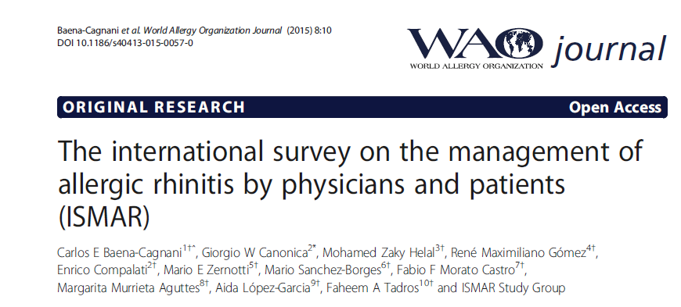
This was an international, multicenter, cross-sectional study conducted in adults or children (≥6 years) suffering from rhinitis confirmed by physician's diagnosis for at least one year.
It was found that clinical history was the selected tool to diagnose and categorize AR patients (97.1%), with less than half of patients undergoing allergy testing.
51% of patients incriminated pollution as cause of symptoms and about 80% climate changes
World Allergy Organization Journal, 2015, 8:10

Slide 84
Ann Allergy Asthma Immunol. 1999;83(4):311-317

Slide 85
Ann Allergy Asthma Immunol. 1999;83(4):311-317

Slide 86
Ann Allergy Asthma Immunol. 1999;83(4):311-317

Slide 87
Int Arch Allergy Immunol 2005;136:148–154
(DOI:10.1159/000083322)

Slide 88
Int Arch Allergy Immunol 2005;136:148–154
(DOI:10.1159/000083322)

Slide 89
Clin Exp Allergy. 2000;30(6):891-899.

Slide 90
Clin Exp Allergy. 2000;30(6):891-899.

Slide 91
Clin Exp Allergy. 2000;30(6):891-899.

Slide 92
Otolaryngol Head Neck Surg. 2003;129(1):16-23.

Slide 93
Clin Exp Allergy. 2000;30(6):891-899.

Slide 94
Ann Allergy Asthma Immunol. 2000;84(5):533-538.

Slide 95
Ann Allergy Asthma Immunol. 2000;84(5):533-538.

Slide 96
Sedating Antihistamines Impair Learning in Pediatric Patients
Mean Learning Scores in Children 10-12 Years of Age (N=73)
60
56
52
n. s.
Composite learning score (%)
48
*
†
44
40
Healthy
controls
Loratadine
10 mL syrup (10 mg)
Placebo
Diphenhydramine
25 mg
*P=0.007 vs healthy controls.
†P=0.002 vs healthy controls.
Vuurman et al. Ann Allergy. 1993;71:121.

Slide 97
Improvements in Rhino conjunctivitis Quality of Life Questionnaire (RQLQ) Scores
Peak Pollen Season
Total difference .55
*
*
Mean RQLQ Scores
*
*
*
*
*
*
Activities
Sleep
Non-Nose/
Eye Symptoms
Practical
Problems
Nasal
Symptoms
Eye
Symptoms
Emotional
Total
*P<0.05.
Ädelroth E et al. J Allergy Clin Immunol. 2000;106:253-259.
Notes:
The principle efficacy outcomes, fewer nasal and ocular symptoms, as well as the additional outcomes, reduction in rescue medication, and reduced absenteeism and contacts with healthcare professionals, translated into clinically meaningful improvements in quality of life.
Quality of life was assessed using the Rhinoconjunctivitis Quality of Life Questionnaire (RQLQ).
Statistically significant improvements over placebo were observed in all domains of the RQLQ.
Clinically meaningful differences over placebo, defined as >0.5 units difference, were reached in total score and in the domains of “activities,” “nasal symptoms,” “non-nose/eye symptoms,” and “practical problems.”

Slide 98
Significant and Clinically Meaningful
Improvement* in Disease-Specific Quality of Life
Health Outcomes Endpoint—Least Square Mean Change
From Baseline in Overall RQLQ Score
Placebo (n=144)
FFNS 110 mcg (n=144)
Least Square Mean Change From Baseline in Overall RQLQ Score
† Significant and clinically meaningful treatment difference
vs placebo: -0.60 (P<0.001).
†
* Minimally important difference in RQLQ is defined as an absolute difference of ≥0.5 in mean change from baseline over placebo.
Baseline RQLQ score for both treatment groups was 3.9.
In adult and adolescent patients with perennial allergic rhinitis, improvements in RQLQ scores were not statistically significant compared with placebo.
Kaiser HB. J Allergy Clin Immunol 2007;119:1430-7
Notes:
Results are from a well-controlled, randomized, double-blind, parallel-group, multicenter, 2-week SAR study in adult and adolescent patients ≥12 years prospectively designed to evaluate the efficacy of FFNS 110 mcg once daily compared with vehicle placebo during the US ragweed season.
Rhinoconjunctivitis Quality of Life Questionnaire (RQLQ) assessed the impact of allergic rhinitis treatment on 28 items in 7 domains (nasal symptoms, eye symptoms, non-nose/eye symptoms, activities, sleep, practical problems, and emotional).
Least square mean, also known as “adjusted” mean, is an analytic method that increases the statistical rigor of endpoint evaluations where variability caused by factors (eg, baseline values, disease history, age, sex, investigator center, etc) are likely to have an impact on the outcome measure evaluated.
Baseline RQLQ scores for FFNS and placebo were both 3.9.
The least square mean treatment difference was -0.60 (P<0.001).
Statistically significant improvement and minimally important difference (MID; absolute difference of at least 0.5 over placebo) were achieved in the overall RQLQ score.

Slide 99
Real-World Effectiveness of QNASL® (beclomethasone dipropionate) Nasal Aerosol in Patients With PAR:
The BALANCE Study
Objective
To evaluate “real-world” effectiveness of QNASL 320 µg/d from patient-reported rhinitis control
Study Design
Post-marketing prospective, observational, single arm, open-label registry study
Enrolled study participants aged ≥12 years of age who had a diagnosis of PAR for at least one year
Primary Outcome Assessment
The primary outcome assessment was the RCAT, a patient-reported questionnaire validated in patients ≥12 years of age with PAR
ClinicalTrials.gov
Notes:
Real-World Effectiveness of QNASL® (beclomethasone dipropionate) Nasal Aerosol in Patients With PAR: The BALANCE Study
Objective
To evaluate “real-world” effectiveness of QNASL 320 µg/d from patient-reported rhinitis control
Study design
Post-marketing prospective, observational, single arm, open-label registry study was initiated to investigate the value of QNASL from the patient’s perspective under naturalistic condition
Enrolled study participants aged ≥12 years of age who had a diagnosis of PAR for at least one year were enrolled at allergy, otolaryngology, and primary care clinics
QNASL was to be taken at the dose of 320 µg/d administered as two nasal aerosol sprays in each nostril
Concomitant therapy
Any therapy for PAR beyond 90 days before study enrollment was allowed
Previous use of any pressurized metered-dose inhaler INS product (including QNASL or ciclesonide nasal aerosol) within 90 days preceding enrollment in the present study was not permitted
There was no restriction on the use of concomitant medications
Primary outcome assessment (RCAT)
A patient-reported questionnaire that was developed in accordance with the FDA Patient-Reported Outcomes guidance
Validated in patients ≥12 years of age with SAR and PAR and has satisfactory psychometric properties and found suitable for assessing control of AR
Reference:
Data
ClinicalTrials.gov

Slide 100
Rhinitis Control Assessment Test (RCAT)
By answering the 6 questions below, you can help your doctor determine how well your allergic rhinitis (AR) symptoms are being controlled. After completing the questionnaire, add up the numbers associated with your answers.
DURING THE PAST WEEK
How often did you have nasal congestion?
  How often did you sneeze?
How often did you have watery eyes?
To what extent did your nasal or other allergy symptoms interfere with your sleep?
How often did you avoid any activities (for example, visiting a house with a dog or cat, gardening) because of your nasal or other allergy symptoms?
How well were your nasal or other allergy symptoms controlled?
5
NEVER
4
RARELY
3
SOMETIMES
2
OFTEN
1
EXTREMELY OFTEN
5
NEVER
4
RARELY
3
SOMETIMES
2
OFTEN
1
EXTREMELY OFTEN
5
NEVER
4
RARELY
3
SOMETIMES
2
OFTEN
1
EXTREMELY OFTEN
5
4
3
2
1
NOT AT ALL
A LITTLE
SOMEWHAT
A LOT
ALL THE TIME
5
NEVER
4
RARELY
3
SOMETIMES
2
OFTEN
1
EXTREMELY OFTEN
5
4
3
2
1
COMPLETELY
VERY
SOMEWHAT
A LITTLE
NOT AT ALL
TOTAL SCORE
Meltzer et al. J Allergy Clin Immunol. 2013;131(2):379-386.
Notes:
Rhinitis Control Assessment Test (RCAT)
The RCAT is a brief, validated, patient-completed test used to assess symptom control in patients with allergic rhinitis (AR)
Consists of the following 6 questions scored on a 5-point scale (an answer of “never,” “rarely,” “sometimes,” “often,” and “extremely often” can be chosen [with scores ranging from 5 to 1, respectively] and scores for the answers are added after the questionnaire is completed)
How often did you have nasal congestion?
How often did you sneeze?
How often did you have watery eyes?
To what extent did your nasal or other allergy symptoms interfere with your sleep?
How often did you avoid any activities (for example, visiting a house with a dog or cat, gardening) because of your nasal or other allergy symptoms?
How well were your nasal or other allergy symptoms controlled?
Test scores can range from 6 to 30, with higher scores indicating better symptom control
The RCAT can help identify patients whose AR symptoms might warrant a change in management strategy, referral to an allergy specialist, or both
How the RCAT can be used
The RCAT can be a useful tool in research and clinical practice when used in patients with AR:
To monitor a patient’s perception of AR control
To gauge the success of therapies
To detect deterioration of symptom control
The authors of the validation study publication concluded that a score of 21 or less (RCAT score range, 6–30) might be useful in identifying allergic rhinitis patients who are experiencing symptom control problems
Reference:
Meltzer et al. J Allergy Clin Immunol. 2013;131(2):379-386.

Slide 101
Mean RCAT Score from Baseline to One Month
The primary outcome assessment was the RCAT, a patient-reported questionnaire validated in patients ≥12 years of age with PAR¹
A score of ≤21 may be useful in identifying patients who are experiencing control problems²
The RCAT can be used to gauge success of therapies and detect changes in symptoms over time—a change in RCAT score of ≥3 points is considered clinically meaningful (MID = minimal important difference)²
RCAT, Rhinitis Control Assessment Test; PAR, perennial allergic rhinitis.
1. ClinicalTrials.gov
2. Meltzer et al. J Allergy Clin Immunol. 2013;131(2):379-386.
Notes:
1
2. Meltzer et al. J Allergy Clin Immunol. 2013;131(2):379-386.

Slide 102
Pollution: Epidemiologic Evidence
Upper airway inflammation correlating with endotoxin and β1-3-glucan exposure has also been demonstrated in sanitation workers exposed to organic waste
Population studies have also demonstrated structural changes in the nasal epithelium in subjects exposed to high or prolonged ozone levels
A longitudinal study in reunified Germany suggested that improvement in air quality might account for a decrease in respiratory disease including rhinosinusitis
JM Pinto, Clin Allergy Immunol. 2007;20:25-49

Slide 103
Epidemiologic Evidence
A large study from Brazil comparing children from polluted and non-polluted areas demonstrated an increased incidence of rhinosinusitis (12 versus 8%) and rhinitis (7 versus 4%) in the exposed group
Mail carriers have an increased prevalence of chronic rhinosinusitis as compared to controls, with smoking being an additional negative factor
Sanitation workers exposed to pollutants demonstrated significant sinonasal symptoms as well as increases in nasal inflammation
Coal workers with pneumoconiosis had highest level of sinus inflammation, followed by coal workers without and then controls
JM Pinto, Clin Allergy Immunol. 2007;20:25-49

Slide 104
Effects of Pollutants on the Nose
Release of mediators with acute and chronic inflammatory effects
Immunotoxic effects of pollutants
Diesel exhaust particles enhance sensitization to allergen and related inflammation
Lastly, direct toxic effects on sinonasal epithelium
JM Pinto, Clin Allergy Immunol. 2007;20:25-49
Notes:
Cigarette smoke, nicotine, capsaicin, ether, & formaldehyde
Release of neuropeptides (Substance P) from the nasal mucosa with resultant inflammation
Cigarette smoke inhibits neutral endopeptidase, an enzyme involved in the degradation of neuropeptides in lung tissue, possibly leading to increased or chronic inflammation
Immunotoxic effects of pollutants
Compromised phagocytic ability possibly leading to chronic infection or inflammation
Diesel paricles enhance sensitization to allergen and related inflammation
Lastly, direct toxic effects on the sinonasal epithelium represent another mechanism

Slide 105
Particulates and Allergic Rhinitis
Adjuvant for allergen sensitization
Enhances airway inflammation
Effects on oxidative stress and alters antioxidant defense
  Susceptibility based on genetic polymorphisms in GSTT1 and GSTM1 for asthma
A Nel. Science 6 May 2005:308 ( 5723): 804 - 806
Notes:
Inflammation, cytokine, and chemokine releas
Production of white blood cells,
Oxygen free-radical production
Endotoxin-mediated cellular and tissue responses
Stimulation of irritant receptors
Covalent modification of key cellular enzymes (5, 9). Best characterized in humans are the effects of PM on airway inflammation (10).
In human and animal studies, inhalation of particles elicits
Proinflammatory effects
Cytokine production
Enhancement of allergic responses in the upper and lower airways
A number of mechanisms have been proposed to explain the adverse health impact of PM (5). Effects of PM that have experimental support are inflammation, cytokine [HN7] and chemokine [HN8] release, production of white blood cells, oxygen free-radical production in the lungs, endotoxin-mediated cellular and tissue responses, stimulation of irritant receptors, and covalent modification of key cellular enzymes (5, 9). Best characterized in humans are the effects of PM on airway inflammation (10). In human and animal studies, inhalation of particles elicits proinflammatory effects, cytokine production, and enhancement of allergic responses in the upper and lower airways (9-11). PM exposure is likely linked to inflammation through the generation of reactive oxygen species [HN9] and oxidative stress [HN10] (9, 12-14).
Although there is still debate about which particle components are responsible for producing reactive oxygen species, there is accumulating evidence that pro-oxidative organic hydrocarbons, such as polycyclic aromatic hydrocarbons and quinones, and transition metals, such as copper, vanadium, chromium, nickel, cobalt, and iron, play a role (15, 16). The particle provides a template for electron transfer to molecular oxygen in these reduction and oxidation (redox) cycling events (7). In addition, target cells, such as airway epithelial cells and macrophages, generate reactive oxygen species in response to particle uptake by biologically catalyzed redox reactions that occur in the cell membrane and mitochondria (9, 13, 15). The second figure shows mitochondrial damage to a macrophage caused by ultrafine particles.
Reactive oxygen species can damage cellular proteins, lipids, membranes, and DNA. To defend against this damage, cells use up their stores of a key antioxidant, glutathione [HN11]. The glutathione depletion can induce a state of cellular stress, called oxidative stress, that triggers an increase in the production of antioxidant enzymes through activation of a transcription factor Nrf2 (17). Failure to overcome oxidative stress leads to the activation of additional intracellular signaling cascades that regulate the expression of cytokine and chemokine genes (14, 16). These products are produced locally in target tissues as well as systemically, and lead to widespread proinflammatory effects remote from the site of damage.
Toxic particles. The effect of ultrafine particles (UFP) in a macrophage cell line. (Left) An untreated macrophage with healthy mitochondria (M). (Right) The same cell type treated with ambient ultrafine particles, collected in the Los Angeles basin. The enlarged images show that the untreated cell has healthy mitochondria with cristae, whereas the treated cell has damaged mitochondria that lack cristae. The vacuolar structures in the treated cell each represent a mitochondrion with included particles (P). Whether the particles gain access to and then damage the mitochondria or gain access to already damaged mitochondria is unknown. [Modified from (15)] Some individuals may be more prone to the development of inflammation, asthma, and allergic responses, because of mutations in the genes involved in the induction of the antioxidant defense (18). Other conditions that predispose to PM susceptibility include old age, preexisting chronic heart and lung disease, and diabetes mellitus, all of which are associated with oxidative stress and inflammation.

Slide 106
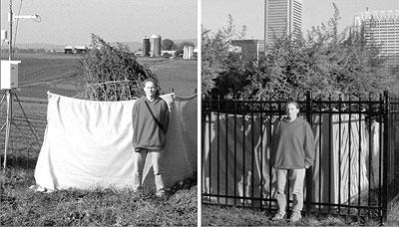
Global Warming Affects
Ragweed Growth
Wall Street Journal 5/03/07, from data from L. Ziska
Notes:
The answer may be yes. Ziska’s group at the USDA has shown that warming and elevated CO2 affects ragweed growth. Ragweed grown in Baltimore, an urban heat island, grows much better than a control plant in rural Maryland.

Slide 107
Climate Change and Allergic Rhinitis
Environmental changes affect plant biology
These effects are complex and involve heat island effects in the inner city, pollution, and elevated CO₂
In urban environments, ragweed growth, pollen counts, and allergenicity are increased
These effects may represent increasing clinical challenges in the future
Notes:
In summary, environmental changes affect plant biology. These effects are complex and involve heat island effects in the inner city, pollution, and elevated CO_{2.}
In urban environments, ragweed growth, pollen counts, and allergenicity are increased.
These effects may represent increasing clinical challenges in the future.

Slide 108
Preconceptional, prenatal and postnatal exposure to outdoor and indoor environmental factors on allergic diseases/symptoms in preschool children
They found that preconceptional, prenatal, and postnatal exposure to outdoor industrial and traffic air pollutants were significantly associated with increase in the risk of childhood asthma, and also positively associated with allergic rhinitis and eczema. However, we cannot distinguish the effect of outdoor air pollutants and exposure windows because of their high correlations. New furniture was associated with eczema and allergic rhinitis during postnatal exposure, but redecoration associated with asthma and eczema during prenatal exposure. Indoor visible mold/damp stains was significant for eczema during prenatal exposure and asthma during postnatal exposure respectively, but window condensation was significant for all childhood allergic diseases during both prenatal and postnatal exposures. Allergic symptoms in children were found to be associated with exposure to indoor factors only.
Conclusions: Associations between outdoor air pollutants and indoor environmental factors and childhood allergic diseases/symptoms were divergent and related to the timing of exposure
Qihong Deng, Chan Lu, Cuiyun Ou, Lv Chen, Hong Yuan Chemosphere 152 (2016)459e467

Slide 109
“A nationwide cross-sectional survey was conducted in 6- to 7-year-old children. The prevalence of allergic diseases was assessed by using questionnaires.
For a 100 ppb increase in the mean daily CO level during the first year of life, the adjusted odds ratio for lifetime allergic rhinitis was 1.10 (95% confidence interval, 1.03–1.19).
Higher exposure to CO during infancy increased the risk of development of allergic rhinitis.’’
Association of carbon monoxide levels with allergic diseases in children
Jihyun Kim, et al Allergy Asthma Proc 37:e1–e7, 2016; doi: 10.2500/aap.2016.37.3918

Slide 110
The aim of the study was to investigate the association between the frequency of truck traffic and allergic rhinitis symptoms, rhinoconjunctivitis and hayfever among 13 to 14 year old school children in Ekurhuleni Metropolitan Municipality, South Africa. In a cross-sectional study design, 3468 completed the International Study of Asthma and Allergies in Childhood (ISAAC) Phase I questionnaire.
The prevalence of self-reported rhinitis ever, current rhinitis, rhinoconjunctivitis and hayfever was 52, 40, 21 and 37 % respectively.
Rhinitis ever, current rhinitis and current rhinoconjunctivitis were significantly associated with the frequency of trucks passing near residences almost all day on weekdays, (OR 1.46 95 % CI: 1.16 − 1.84), (OR 1.60 95 % CI: 1.24–2.02) and (OR 1.42 95 % CI: 1.09–1.84) respectively.
The study shows a high prevalence of allergic rhinitis symptoms amongst children. The results support the hypothesis that traffic related pollution plays a role in the prevalence of allergic rhinitis symptoms in children residing in the area.
Allergic rhinitis, rhino conjunctivitis and hay fever symptoms among children are
associated with frequency of truck traffic near residences: a cross sectional study
Shirinde et al. Environmental Health (2015) 14:84

Slide 111
This longitudinal study examined whether traffic-related air pollution (TRAP) is associated with the prevalence of asthma, allergic rhinitis and aeroallergen sensitization in two German cohorts followed from birth to 10 years.
Questionnaire-derived annual reports of doctor diagnosed asthma and allergic rhinitis, as well as eye and nose symptoms, were collected from 6,604 children. Aeroallergen sensitization was assessed for 3,655 children who provided blood samples. Associations between these health outcomes and nitrogen dioxide (NO2), particles with aerodynamic diameters less than 2:5 g=m3 (PM2:5) mass, PM2:5 absorbance and ozone, individually estimated for each child at the birth, six and 10 year home addresses.
This study did not find consistent evidence that TRAP increases the prevalence of childhood asthma, allergic rhinitis or aeroallergen sensitization in later childhood using data from birth cohort participants followed for 10 years in three locations in Germany.
A longitudinal analysis of associations between traffic-related air pollution with
asthma, allergies and sensitization in the GINIplus and LISAplus birth cohorts
Fuertes et al. (2013), PeerJ, DOI 10.7717/peerj.193

Slide 112
Childhood allergic rhinitis, traffic-related air pollution, and variability in the GSTP1, TNF, TLR2, and TLR4 genes: Results from the TAG Study
Associations between traffic-related air pollution (TRAP) and allergic rhinitis remain inconsistent, possibly because of unexplored gene-environment interactions.
The generally null effect of TRAP on allergic rhinitis and aeroallergen sensitization was not modified by the studied variants in the GSTP1, TNF, TLR2, or TLR4 genes. Children carrying a minor rs1800629 (TNF) or rs1927911 (TLR4) allele may be at a higher risk of allergic rhinitis.
Fuertes et al J Allergy Clin Immunol 2013;132:342-52

Slide 113
Ambient air pollution and allergic diseases in children
The reactive oxidative species produced in response to air pollutants can overwhelm the redox system and damage the cell wall, lipids, proteins, and DNA, leading to airway inflammation and hyperactivity.
Pollutants may also cause harmful effects via epigenetic mechanisms, which control the expression of genes without changing the DNA sequence itself.
Byoung-Ju Kim, MD, PhD, Soo-Jong Hong, MD, PhD
Korean J Pediatr 2012;55(6):185-192

Slide 114
Indoor mildew odor in old housing was associated with adult allergic symptoms, asthma, chronic bronchitis, vision, sleep and self-rated health: USA NHANES, 2005–2006
Data was retrieved from the United States National Health and Nutrition Examination Surveys, 2005–2006, including the available information on demographics, housing characteristics, self-reported health conditions and urinary concentrations of environmental chemicals.
Of all American adults (n= 4979), 744 (15.1 %) reported indoor mildew odor or musty smell in their households. People who reported indoor mildew odor or musty smell also reported poorer self-rated health, sleep complaints, chronic bronchitis, asthma attack, itchy rash, sneezing and poor vision.
Ivy Shiue: Environ Sci Pollut Res (2015) 22:14234–14240

Slide 115
Respiratory and Allergic Health Effects of Dampness, Mold, and Dampness‑Related Agents: A Review of the Epidemiologic Evidence
Mark J. Mendell et al Environ Health Perspect 119:748–756 (2011)
Evident dampness or mold had consistent positive associations with multiple allergic and respiratory effects. Measured microbiologic agents in dust had limited suggestive associations, including both positive and negative associations for some agents.
Thus, prevention and remediation of indoor dampness and mold are likely to reduce health risks, but current evidence does not support measuring specific indoor microbiologic factors to guide health-protective actions.
Mark J. Mendell et al Environ Health Perspect 119:748–756 (2011)

Slide 116
Allergic sensitization, rhinitis, and tobacco smoke exposure in U.S. children and adolescents
Cross-sectional study in 2714 children and adolescents aged 6 to 19 in the National Health and Nutrition Examination Survey (NHANES), 2005–2006. About half of the population (54%) had detectable levels of IgE specific to at least 1 of the tested allergens, and 25% reported a history of rhinitis.
After multivariate adjustment, an increased prevalence rate ratio (PRR) of self-reported rhinitis was seen in individuals in the highest cotinine tertile among active smokers (PRR, 1.73; 95% confidence interval [CI], 1.23 to 2.43), with a significant trend between increasing cotinine levels in individuals exposed to either secondhand smoke or active smoking (p = 0.05 for both analyses). Significantly less food allergen sensitization was observed in participants in the highest cotinine tertile of secondhand smoke (PRR, 0.61; 95% CI, 0.43 to 0.85).
Tobacco smoke exposure was associated with increased prevalence of rhinitis symptoms, but decreased prevalence of allergic sensitization. The results highlight the complex relationship between tobacco exposure and sinonasal pathology.
Shargorodsky et al Int Forum Allergy Rhinol. 2015;5:471–476.

Slide 117
Cigarette Smoke
Cigarette smoke alters dendritic cell function
  Tsoumakidou – AJRCCM 175: 919-925, 2007
Second hand smoke increased respiratory symptoms; Hong Kong
  Ho - Ann Epidemiol 17:126-131, 2007
Smoking reduces effectiveness of corticosteroids, but not montelukast
Lazarus – AJRCCM 175: 783-790, 2007

Slide 118
Impact of environmental tobacco smoke and active tobacco smoking on the development and outcomes of asthma and rhinitis
The harmful effect of tobacco smoking is not only on asthma but also on rhinitis playing a role in disease outcomes.
Tobacco exposure can influence innate immunity diminishing innate production of antigen presenting cells cytokines, as well as an impaired response to toll-like receptor ligands.
Tobacco smoking has been also found among the factors inducing nasal obstruction and decreased mucociliary clearance in nonallergic rhinitis.
Carlos E. Baena-Cagnania, R. Maximiliano Gomez, Rodrigo Baena-Cagnani and G. Walter Canonica
Current Opinion in Allergy and Clinical Immunology 2009, 9:136–140

Slide 119
Association of Indoor Air Pollution with Rhinitis Symptoms, Atopy and Nitric Oxide Levels in Exhaled Air
Self reported exposure to the use of woodstoves, candles or gas cookers was not significantly associated with an increased risk of rhinitis symptoms or atopy, nor increased Fe NO .
Hersoug et al Int Arch Allergy Immunol 2010;153:403–412

Slide 120
Toxic Mold Syndrome
The Institute of Medicine report on damp spaces and health reported “insufficient evidence was found to determine an association between mycotoxin exposure and a number of other reported health effects, including gastrointestinal problems fatigue, neuro-psychiatric symptoms an skin problems
The same conclusion of the World Health Organization panel on mold and dampness

Slide 121
Particulate matter modifies the association between airborne pollen and daily medical consultations for pollinosis in Tokyo
Ambient PM2.5 and SPM (suspended particulate matter) modify the effect of pollen on daily new cases of pollinosis.
The cumulative effect of pollen was larger with higher levels of PM2.5 and SPM.
Particulate pollutants may act as an adjuvant to promote pollinosis symptoms.
Konishi et al Science of the Total Environment 499 (2014) 125–132

Slide 122
The Influence of Environmental Exposure to Formaldehyde in Nasal Mucosa of Medical Students during Cadaver Dissection
This observational non-comparative study consisted of a group of 41 medical students who had signed up for a cadaver dissection course as part of their gross anatomy teaching at the school of medicine Chiba University in Japan.
During such dissection course, the students were exposed to variable levels of environmental formaldehyde routinely employed for the preservation the cadavers. Olfactory abnormalities were observed in 32% subjects and increased nasal mucosal hypersensitivity to histamine was observed in 41% during and immediately after completion of the course.
These subjects had evidence of preexisting allergic rhinitis. 15% of other students with no prior evidence of allergic rhinitis also exhibited formaldehyde associated clinical symptoms during the dissecting course. However, the symptoms disappeared upon completion of the course in all subjects studied.
Hisamitsu et al Allergology International Vol 60, No3, 2011

Slide 123
The relationship between exposure to microbial volatile organic compound and allergy prevalence in single-family homes
Microbial volatile organic compounds (MVOCs) are a type of VOCs produced by microorganisms. Exposure to 1-octen-3-ol, one of the known MVOCs, has been reported to reduce nasal patency and increase nasal lavage myeloperoxidase, eosinophil cationic proteins, and lysozymes in both experimental and field studies.
In this study, 624 inhabitants of 182 detached houses in six regions of Japan, air samples were collected using diffusive samplers, and the concentrations of eight selected MVOCs were analyzed .
Among the 609 subjects, a significant association between 1-octen-3-ol (per log10 unit) and allergic rhinitis odds ratio (OR): 4.10, 95% confidence interval (CI): 1.71 to 9.80 and conjunctivitis (OR: 3.54, CI: 1.17 to 10.7) was found after adjusting or age, sex, tobacco, wall-to-wall carpeting, signs of dampness, history of treatment for hay fever, and other potentially relevant environmental factors.
The levels of MVOCs and airborne fungi were only weakly correlated. These results are consistent with previous studies that have associated higher levels of 1-octen-3-ol exposure with increased irritation of nasal and ocular mucosae.
Araki et al Science of the Total Environment 423 (2012) 18–26

Slide 124
Efficacy and Safety of Once Daily Fluticasone Furoate
Nasal Spray for Treatment of Irritant (Non-allergic) Rhinitis
Pongsakorn Tantilipikorn et al The Open Respiratory Medicine Journal, 2010, 4, 92-99

Slide 125
Environmental pollutants and allergic rhinitis
MANAGEMENT OF ENVIRONMENTAL RELATED CHRONIC RHINITIS
The treatment strategy for chronic rhinitis secondary to environmental irritants is similar to the management of other types of chronic rhinitis. It is important to note that the patient may have concomitant allergic and nonallergic rhinitis; thus, treating allergic disease may help the patient’s symptoms, while the treatment plan may also need to include the identification and avoidance of other nonallergic triggers. Once the possible triggers are identified, the most effective way to limit symptoms is avoidance.
Higgins and Reh; Johns Hopkins Sinus Center
Curr Opin Otolaryngol Head Neck Surg 2012, 20:209–214

Slide 126
Does air pollution really cause allergy?
There is robust evidence that air pollutants can exacerbate response to allergens to which persons already sensitized. However, it remains unclear whether exposure to ambient air pollutants can promote primary development of atopy.
Epigenetic changes are a plausible explanation for the effect of environmental agents on molecular modification of atopy, and perhaps more plausible than environmentally induced changes in DNA sequence, or the impact of a single nucleotide polymorphisms on gene–environment interactions relevant to atopy.
While it is likely that multiple factors such as exposure pattern and duration, exposure during specific windows of susceptibility and non-inheritance of biological responses and genetic risk factors simultaneously impact development of atopy, epigenetic modulation will prove to be a central mechanism enhancing environmental modulation of atopy.
D. B. Peden Clinical & Experimental Allergy, 45 : 3–5, 2014

Slide 127
Advertisements Impact the Physiological Efficacy of a Branded Drug

Slide 128
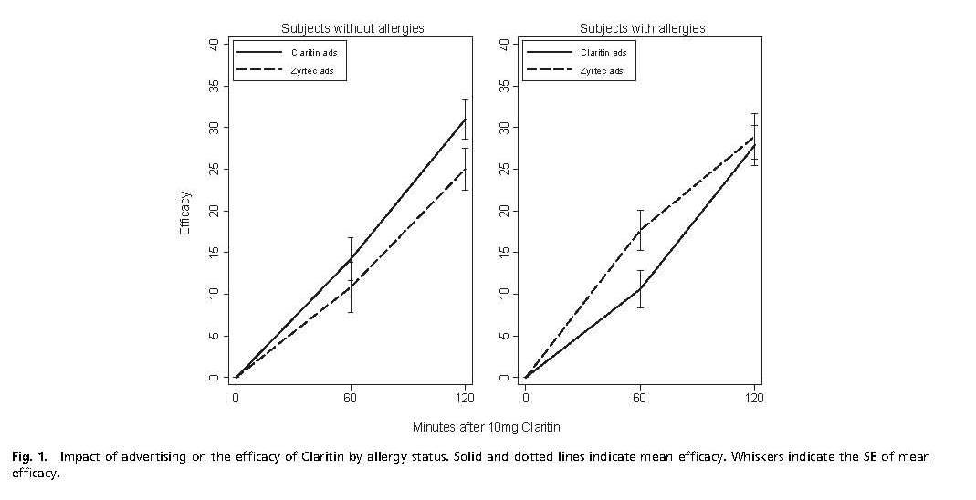

Slide 129
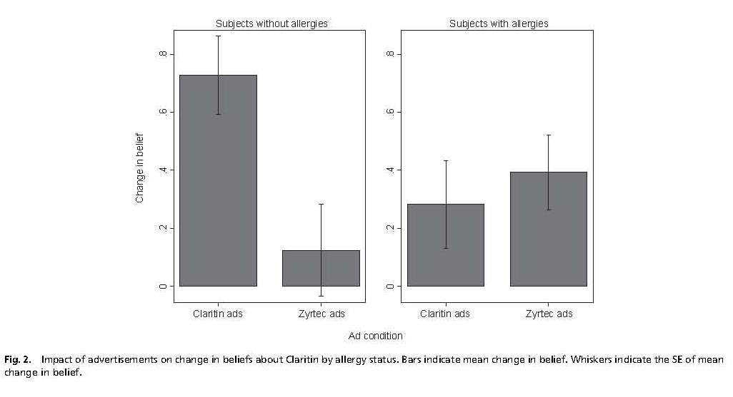

Slide 130
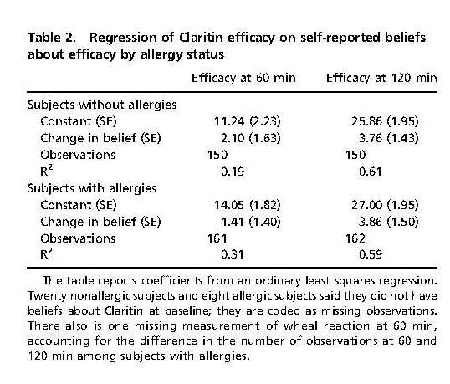

Slide 131
Conclusions
Allergic rhinitis adversely affects suffers’ quality of life
Treatment of allergic rhinitis with oral H1 antihistamines and intranasal steroids improves quality of life
Indoor and outdoor pollution worsens the symptoms of allergic rhinitis and may modify the disease.

