Slide 1
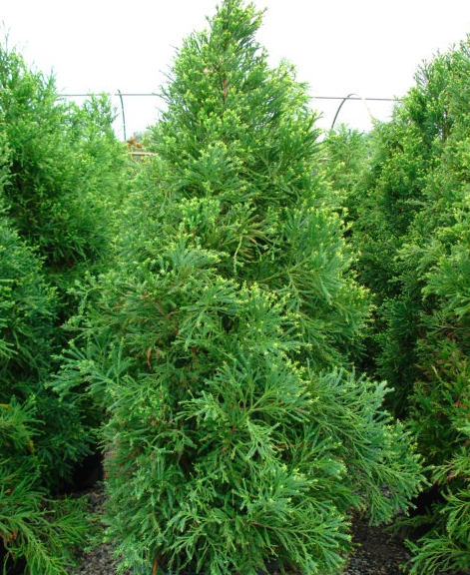
Prevalence and Burden of Allergic Rhinitis and Pollution

Slide 2
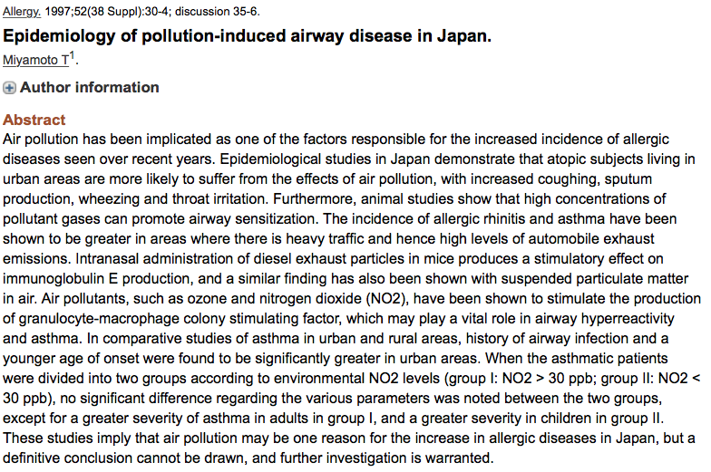
Epidemiology of pollution-induced airway disease in Japan
When the asthmatic patients were divided into 2 groups according to environmental NO2 levels (group l: NO2 >30 ppb; group II: NO2 < 30 ppb)
No significant difference regarding the various parameters was noted between the 2 groups, except for a greater severity of asthma in adults in group l, and a greater severity in children in group II.
These studies imply that air pollution may be one reason for the increase in allergic diseases in Japan, but a definitive conclusion cannot be drawn, and further investigation is warranted.
SALEV.FEX.16.07.0165
Miyamoto T: Allergy 1997;52(38 Suppl): 30-4; discussion 35-6

Slide 3

Trabant, East Germany
SALEV.FEX.16.07.0165

Slide 4
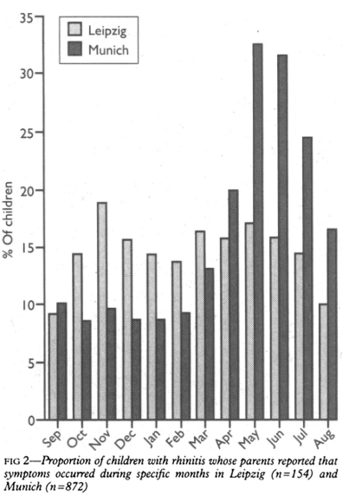
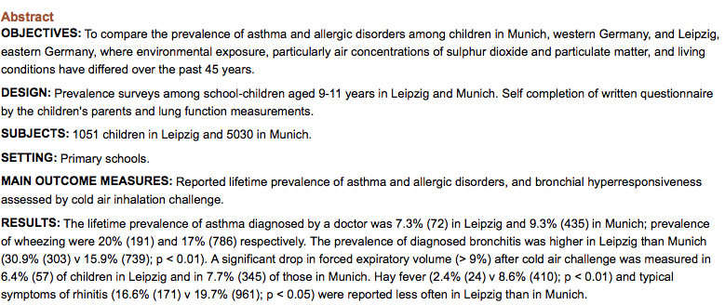
Prevalence of asthma & allergic disorders among children in united Germany: a descriptive comparison
Conclusions:
No significant differences were seen in the lifetime prevalence of asthma, wheezing, and bronchial hyper responsiveness between children in Leipzig and Munich.
The lifetime prevalence of bronchitis was higher in Leipzig than in Munich.
The lower prevalence rates of allergic disorders in Leipzig could point toward etiological factors that are associated with Western lifestyle and living conditions.
SALEV.FEX.16.07.0165
Von Mutius E / Fritzsch C / Weiland SK / et al: BMJ 1992 Dec 5;305(6866):1395-9

Slide 5
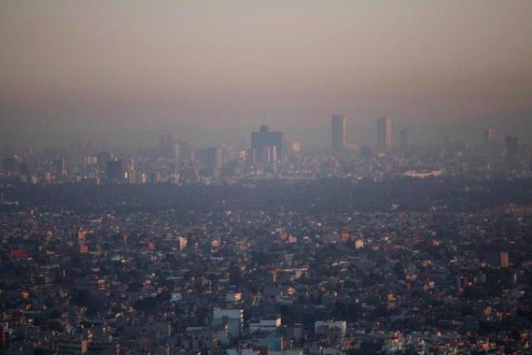
Mexico City
SALEV.FEX.16.07.0165

Slide 6

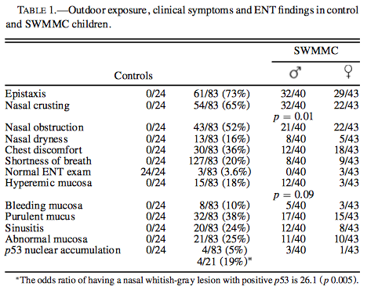
The 3 most important nasal complaints were: epistaxis, nasal crusting, and nasal obstruction.
The ENT most important findings were a hyperemic mucosa.
SALEV.FEX.16.07.0165

Slide 7
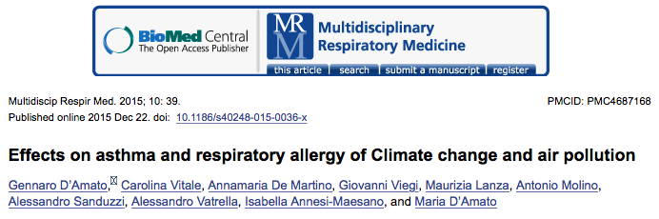
The role of air pollution in the severity of rhinitis
Role of air pollution in occurrence of rhinitis or sensitization
Role of pollutants in allergenicity of pollens
Mechanistic studies
Role or air pollution in symptom severity
SALEV.FEX.16.07.0165

Slide 8
The role of air pollution in the severity of rhinitis
Prevalence of rhinitis
SALEV.FEX.16.07.0165

Slide 9
The role of air pollution in the severity of rhinitis
Prevalence of rhinitis
Outdoor air pollution
Indoor air pollution
Tobacco smoking
SALEV.FEX.16.07.0165

Slide 10
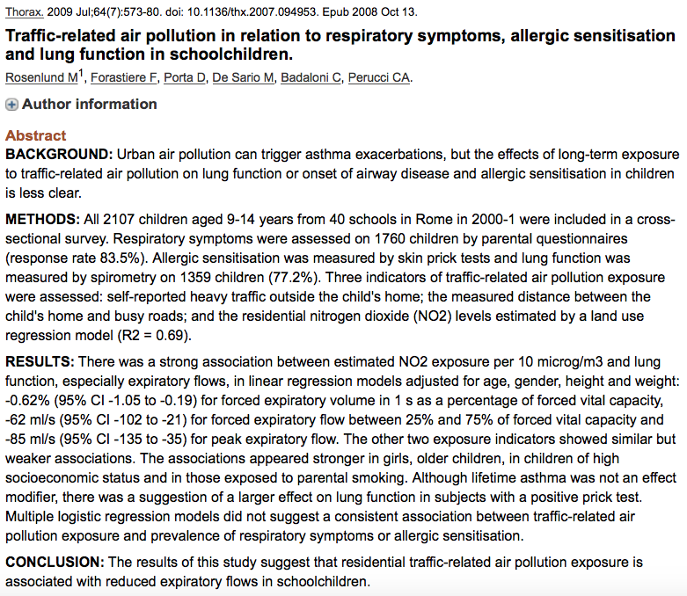
Traffic-related air pollution in relation to respiratory symptoms, allergic sensitisation and lung function in schoolchildren
Conclusion:
The results of this study suggest that residential traffic-related air pollution exposure is associated with reduced expiratory flows in schoolchildren
SALEV.FEX.16.07.0165
Rosenlund M / Forastiere F / Porta D / et al: Thorax 2009 Jul;64(7):573-80. doi 10.1136/thx.2007 .094953. Epub 2008 Oct 13

Slide 11
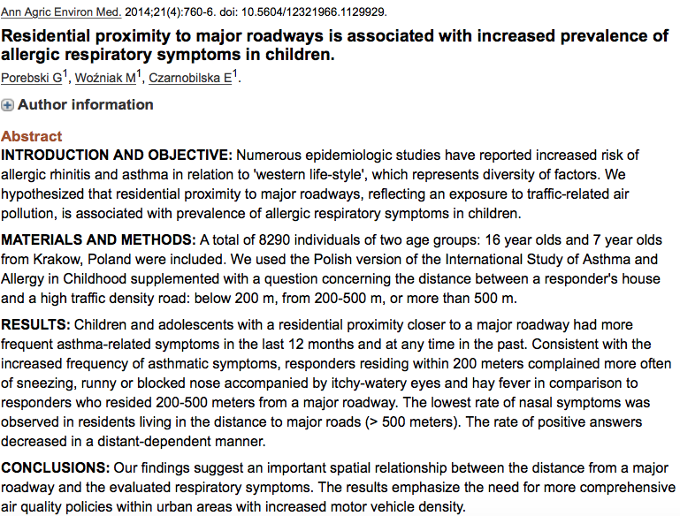
Residential proximity to major roadways is associated with increased prevalence of allergic respiratory symptoms in children
Conclusions:
Findings suggest an important spatial relationship between the distance from a major roadway and the evaluated respiratory symptoms.
The results emphasize the need far more comprehensive air quality policies within urban areas with increased motor vehicle density
SALEV.FEX.16.07.0165
Porebski G / Wozniak M / Czarnobilska E: Ann Agric Environ Med. 2014;21(4):760-6. doi 10.5604/12321966.1129929

Slide 12
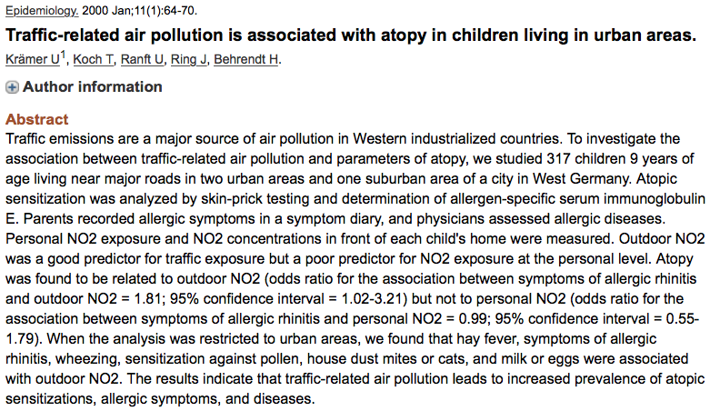
Traffic-related air pollution is associated with atopy in children living in urban areas
The results indicate that traffic-related air pollution leads to increased prevalence of atopic sensitizations, allergic symptoms, and diseases.
Kramer U / Koch T / Ranft U / et al: Epidemiology. 2000 Jan;11(1):64-70

Slide 13
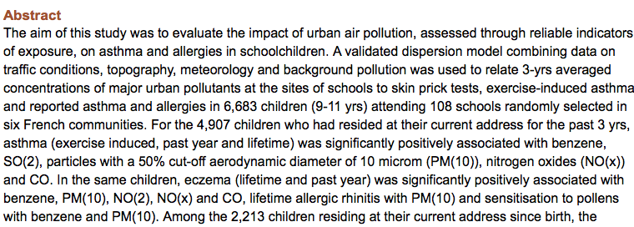
Long-term exposure to close-proximity air pollution and asthma and allergies in urban children
Among the 2,213 children residing at their current address since birth, the associations persisted for lifetime asthma with benzene (adjusted OR per interquartile range (95% Cl) 1 .3 (1.0-1.9) and PM (10) (1.4 (1.0-2O), and for sensitization to pollens with volatile organic compounds 1.3 (1.0-1.9) and PM (1O)1.2 (1.0-1 .9).
Accurately modelled urban air pollution as associated with some measures of childhood asthma and allergies.
Penard-Morand C / Raherison C / Charpin / et al: Eur Respir J. 2010 Jul;36(1):33-40. doi: 10.1183/09031936.001161109. Epub 2010 Jan 14

Slide 14
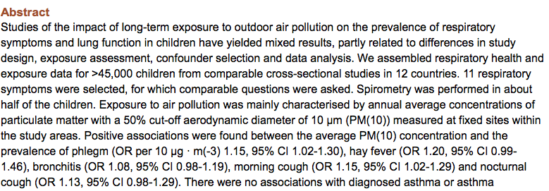
PM10, and children’s respiratory symptoms and lung function in the PATY study
There were no associations with diagnosed asthma or asthma symptoms. PM(10) was not associated with lung function across all studies combined.
This study adds to the evidence that long-term exposure to outdoor air pollution characterized by the concentration of PM (10), is associated with increased respiratory symptoms.
Hoek G / Pattenden S / Willers S/ et al: Eur Respir J. 2012 Sep;40(3):538-47. doi: 10.1183/09031936.00002611. Epub 2012 Apr 20

Slide 15
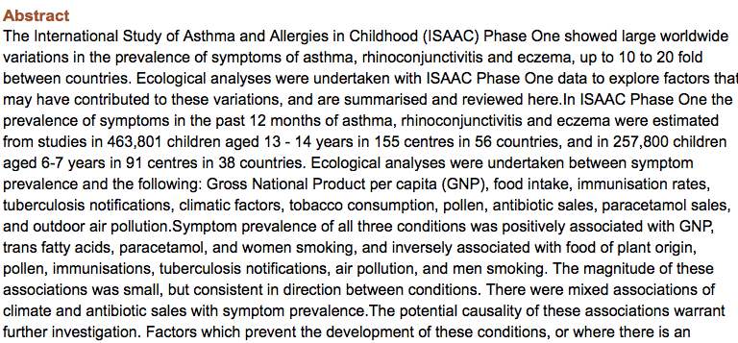
Which population level environment factors are associated with asthma, rhino conjunctivitis and eczema? Review of the ecological analyses of ISAAC Phase One
Factors which prevent the development of these conditions, or where there is an absence of a positive correlation at a population level may be as important from the policy viewpoint as a focus on the positive risk factors.
Interactions based on small associations may have the potential for a large public health benefit.
Asher MI / Stewart AW / Mallol J/ et al: Respir Res. 2010 Jan 21;11:8. doi: 10.1186/1465-9921-11-8

Slide 16
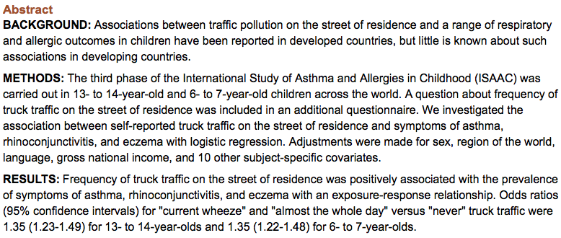
Self-reported truck traffic on the street of residence and symptoms of asthma and allergic disease: a global relationship in ISSAC phase 3
Conclusions:
Higher exposure to self-reported truck traffic on the street of residence is associated with increased reports at symptoms of asthma, rhinitis, and eczema in many locations in the world.
These findings require further investigation in view of increasing exposure of the world's children to traffic.
Brunekreef B / Stewart AW / Anderson HR/ et al: Environ Health Prospect. 2009 Nov;117(11):1791-8. doi: 10.1289/ehp.0800467. Epub 2009 Jul 20

Slide 17
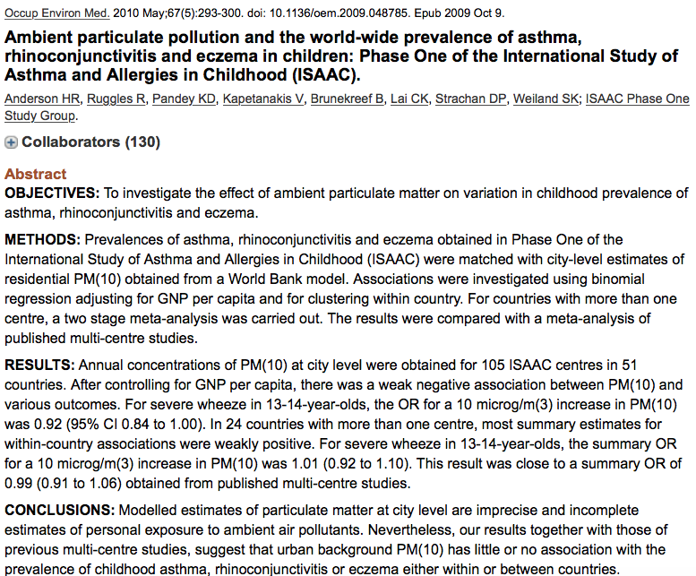
Ambient particulate pollution and the world-wide prevalence of asthma, rhino conjunctivitis and eczema in children: Phase One of the International Study of Asthma and Allergies in Childhood (ISAAC)
Conclusions:
Modeled estimates of particulate matter at city level are imprecise and incomplete estimates of personal exposure to ambient air pollutants.
Nevertheless, these results together with those of previous multicentre studies, suggest that urban background PM (10) has little or no association with the prevalence of childhood asthma, rhino conjunctivitis or eczema either within or between countries.
Anderson HR / Ruggles R / Pandey KD/ et al: Occup Environ Med 2010 May;67(5):293-300. doi 10.1136/oem.2009.048785. Epub 2009 Oct 9

Slide 18
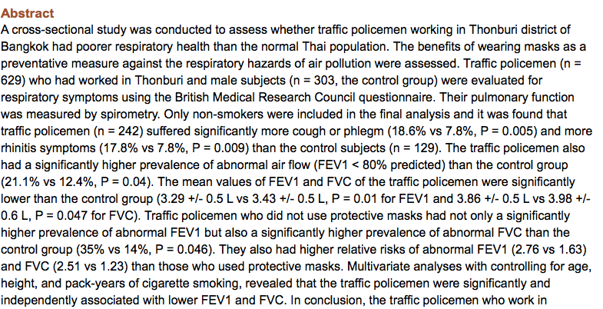
Respiratory symptoms and pulmonary function of traffic policemen in Thonburi
The traffic policemen who work in Thonburi have more cough and rhinitis symptoms and lower FEV1 and FVC than the normal Thai population.
Traffic policemen '’who do not use protective masks have higher relative risks of abnormal FEV1 and FVC than those who use them.
Wongsurakiat P / Maranetra KN / Nana A/ et al: J Med Assoc Thai 1999 May;82(5):435-43

Slide 19
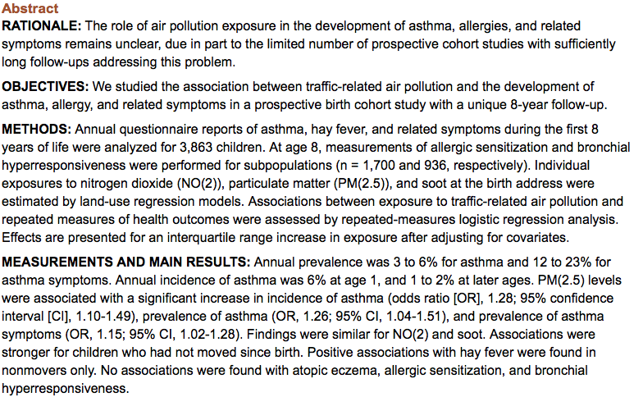
Traffic-related air pollution and the development of asthma and allergies during the first 8 years of life
Conclusion:
Exposure to traffic related air pollution may cause asthma in children
Gehring U/ Wijga AH / Brauer M / et al: Am J Respir Crit Care Med 2010 Mar 15;181(6):596-603. doi: 10.1164/rccm.200906-0858OC. Epub 2009 Dec 3

Slide 20
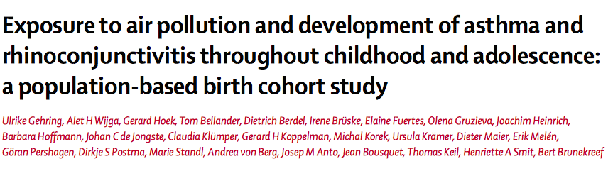
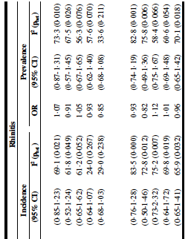
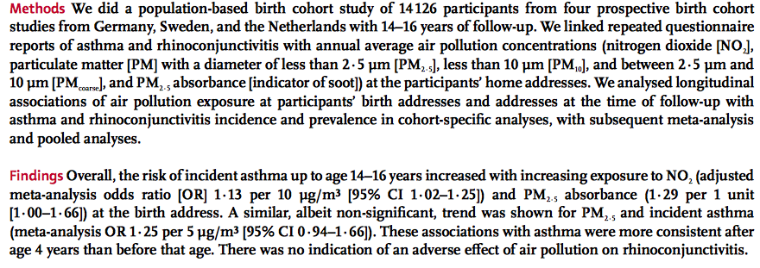

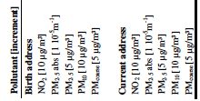

Slide 21
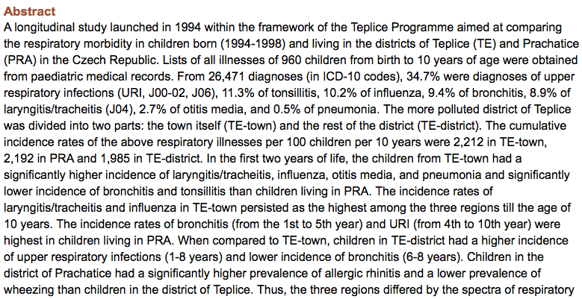
Differences between the spectra of respiratory illnesses in children living in urban and rural environments
The 3 regions differed by the spectra of respiratory illnesses rather than by overall morbidity and, hypothetically, the effects of air pollution were obscured by differences in the degree of urbanization.
Dostal M / Prucha M / Rychlikova E / et al: Cent Eur J Public Health 2014 Mar;22(1):3-11

Slide 22
The role of air pollution in the severity of rhinitis
Prevalence of rhinitis
Outdoor air pollution
Indoor air pollution
Tobacco smoking

Slide 23
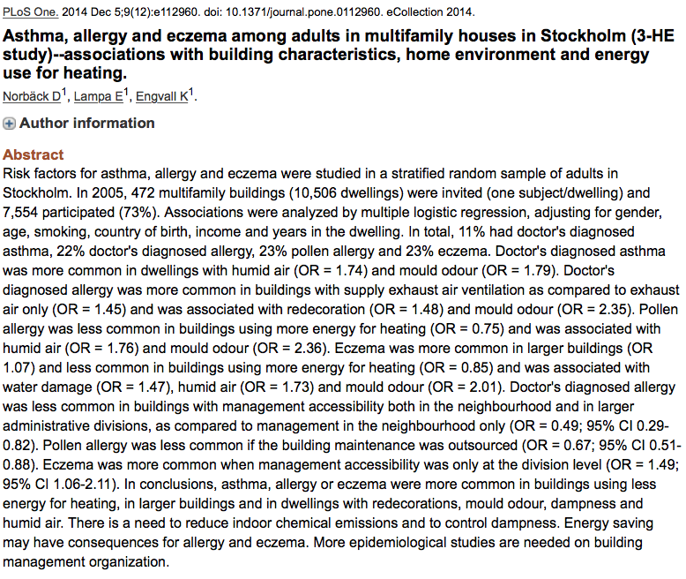
Asthma, allergy and eczema among adults in multifamily houses in Stockholm (3-HE study) – associations with building characteristics, home environment and energy use for heating
Conclusions:
Asthma, allergy or eczema were more common in buildings using less energy for heating, in larger buildings and in dwellings with redecorations, mould odor, dampness and humid air.
There is a need :
  To reduce indoor chemical emissions & to control dampness and humid air
  To reduce indoor chemical emissions and to control dampness.
Energy saving may have consequences for allergy and eczema.
More epidemiological studies are needed on building management organization.
Norback D / Lampa E / Engvall K: PLoS One 2014 Dec 5;9(12):e112960. doi: 10.1371/journal.pone.0112960. eCollection 2014

Slide 24
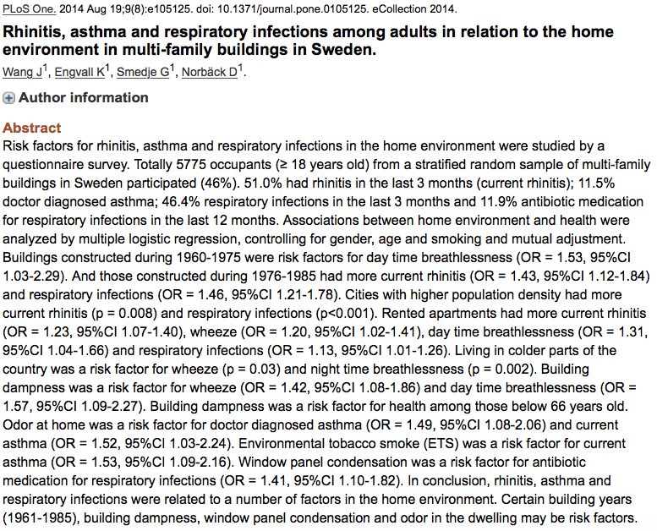
Rhinitis, asthma and respiratory infections among adults in relation to a number of factors in the home environment
Rhinitis, asthma and respiratory infections were related to a number of factors in the home environment.
Certain building years (1961-1985), building dampness, window panel condensation and odor in the dwelling may be risk factors.
Wang J / Smedje G / Engvall K / et al: PLoS One 2014 Aug 19;9(8):e105125. doi: 10.1371/journal.pone.0105125. eCollection 2014

Slide 25
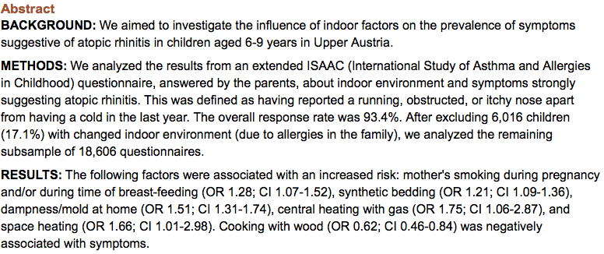
Symptoms suggestive of atopic rhinitis in children aged 6-9 years and the indoor environment
Conclusions:
The indoor environment plays a role in the symptoms of atopic rhinitis in children.
However, the population-attributable risks were not particularly high; they were between -2.7% and 9% for the various exposures considered in this study.
Zacharasiewicz A / Zidek T/ Haidinger G/ et al: Allergy 2000 Oct;55(10):945-50

Slide 26
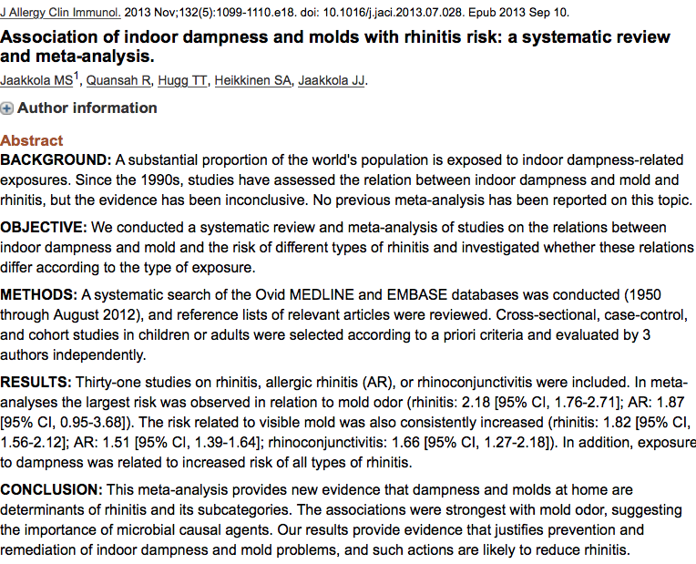
Association of indoor dampness and molds with rhinitis risk: a systematic review and meta-analysis
Conclusions:
This meta-analysis provides new evidence that dampness and molds at home are determinants of rhinitis and its subcategories.
The associations were strongest with mold odor, suggesting the importance of microbial causal agents.
The results provide evidence that justifies prevention & remediation of indoor dampness & mold problems, & such actions are likely to reduce rhinitis.
Jaakkola MS / Quansah R/ Hugg TT/ et al: J Allergy Clin Immunol 2013 Nov;132(5):1099-1110.e18. doi: 10.1016/j.jaci2013.07.028 Epub 2013 Sep 10

Slide 27
The role of air pollution in the severity of rhinitis
Prevalence of rhinitis
Outdoor air pollution
Indoor air pollution
Tobacco smoking

Slide 28
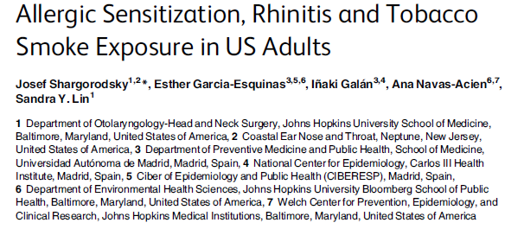
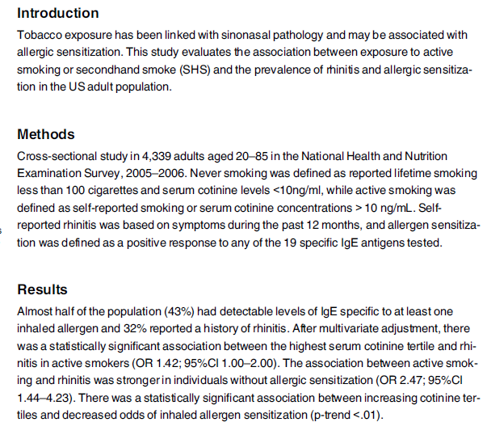
Allergic sensitization, rhinitis and tobacco smoke exposure
in US adults
Tobacco smoke exposure was associated with increased prevalence of rhinitis symptoms, but not with allergic sensitization independent of allergic sensitization.

Slide 29
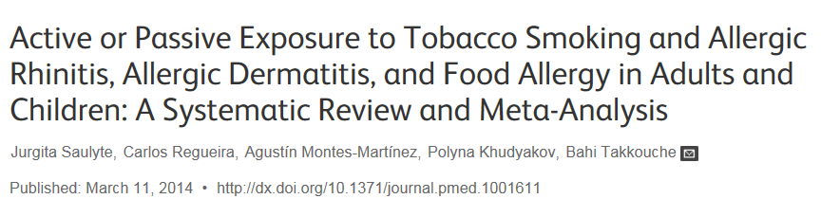
Active or passive exposure to tobacco smoking and allergic rhinitis, allergic dermatitis and food allergy in adults & children: A systematic Review and Meta-Analysis
BACKGROUND:
Systematically review on the association between sinusitis and second hand smoke (SHS) exposure.
RESULTS:
The initial search yielded 116 abstracts, of which 19 articles were included. Thirteen (68.4%) of the 19 articles showed a statistically significant association between sinusitis and SHS. Seven (36.8%) studies specifically evaluated chronic rhino sinusitis (CRS) with 5 (71.4%) CRS studies demonstrating a significant association between CRS and SHS. Seventeen articles were case-control studies (Level 3b). For characterizing sinusitis, 6 (31.6%) studies included computed tomography (CT) or endoscopy in the diagnostic criteria, with 5 of these studies following rhino sinusitis taskforce guidelines. For determining presence of SHS, all studies used questionnaires and 2 (10.5%) studies also reported serum or urine cotinine levels.
Conclusions:
Very modest associations between smoking and some allergic diseases among adults.
Among children and adolescents, both active and passive exposure to SHS were associated with a modest increased risk for allergic diseases, and passive smoking was associated with an increased risk for food allergy.
Additional studies with detailed measurement of exposure and better case definition are needed to further explore the role of smoking in allergic diseases.

Slide 30
The role of air pollution in the severity of rhinitis
Severity of rhinitis
Outdoor air pollution
Indoor air pollution
Tobacco smoking

Slide 31
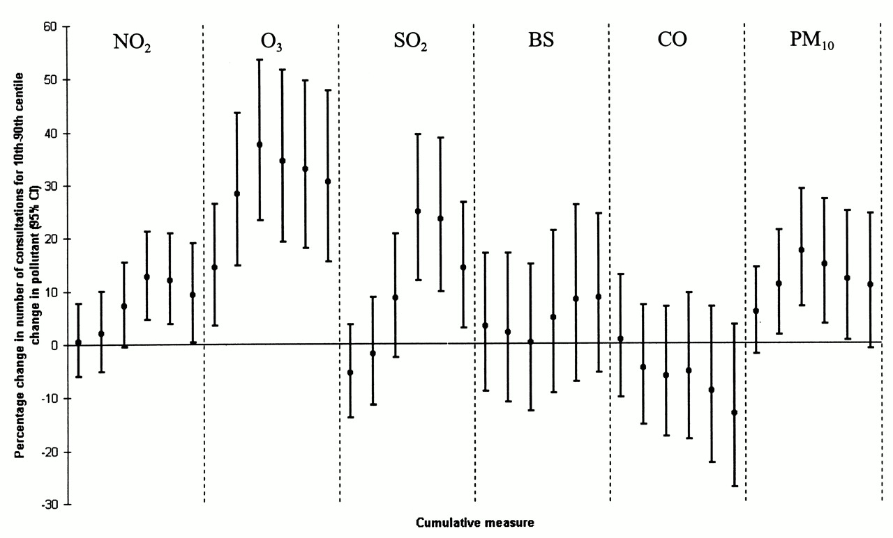
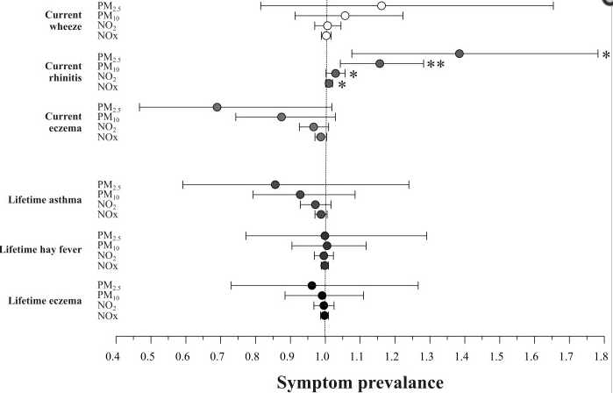
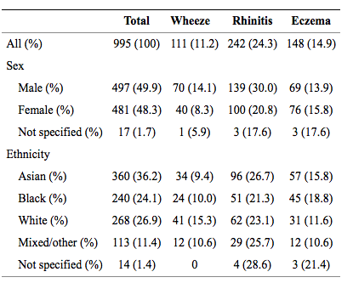
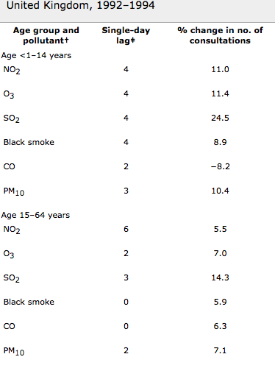
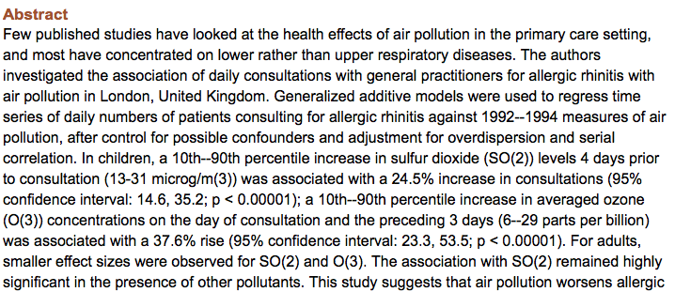
Association between air pollution and daily consultations with general practitioners for allergic rhinitis in London, UK
This study suggests that air pollution worsens allergic rhinitis symptoms, leading to substantial increase in consultations.
SO(2) and O(3) seem particularly responsible, and both seem to contribute independently.
Hajat S / Haines A / Atkinson RW / et al: Am J Epidemiol 2001 Apr 1;153(7):704-14

Slide 32
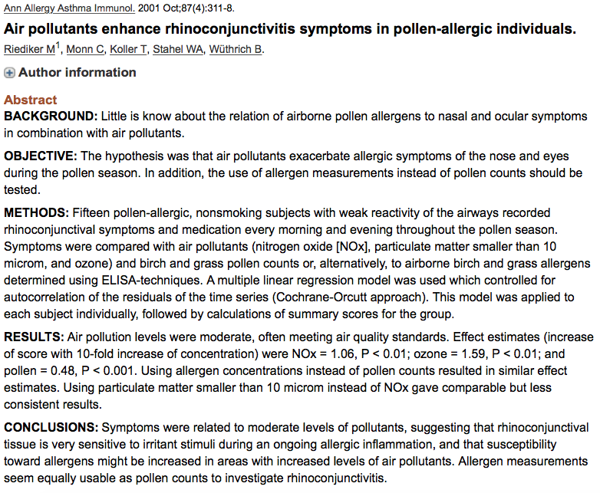
Air pollutants enhance rhino conjunctivitis symptoms in pollen-allergic individuals
Conclusions:
Symptoms were related to moderate level of pollutants, suggesting that rhino-conjunctival tissue is very sensitive to irritant stimuli during an ongoing allergic inflammation, and that susceptibility toward allergens might be increased in areas with increased levels of air pollutants.
Allergens measurements seem equally usable as pollen counts to investigate rhino conjunctivitis.
Riediker M / Monn C / Koller T / et al: Ann Allergy Asthma Immunol 2001 Oct;87(4):311-8

Slide 33
The role of air pollution in the severity of rhinitis
Search: Role of air pollution in symptoms of rhinitis
  Short term exposure
  Long-term exposure
Exclusion:
Role of air pollution in occurrence of rhinitis or
sensitization
Role of pollutants in allergenicity of pollens
Mechanistic studies

Slide 34
The role of air pollution in the severity of rhinitis
Search:
  Role of air pollution in symptoms of rhinitis
Medline search
  2010-current
  « pollution » [OR] « pollutants » [AND] « rhinitis »
    282 abstracts reviewed

Slide 35
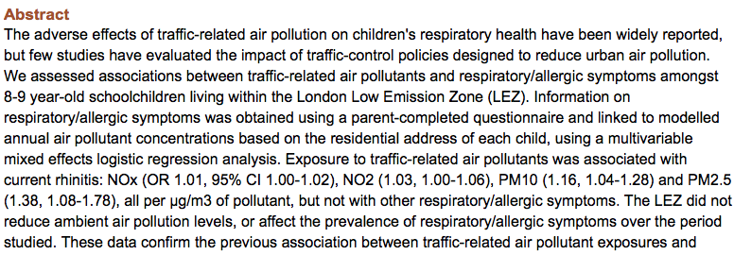
Effects of air pollution and the introduction of the London low emission zone on the prevalence of respiratory and allergic symptoms in schoolchildren in east London:
A sequential cross-sectional study
Data confirm the previous association between traffic-related air pollutant exposures and symptoms of current rhinitis.
Importantly, the London LEZ has not significantly improved air quality within the city, or the respiratory health of the resident population in its first 3 years of operation.
This highlights the need for more robust measures to reduce traffic emissions.
Wood HE / Marlin N / Mudway IS / et al: PLoS One 2015 Aug 21;10(8):e0109121. doi: 10.1371/journal.pone.0109121. eCollection 2015

Slide 36
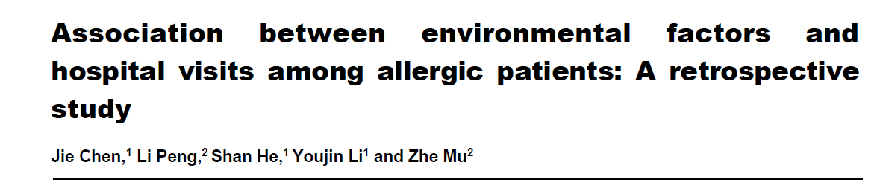
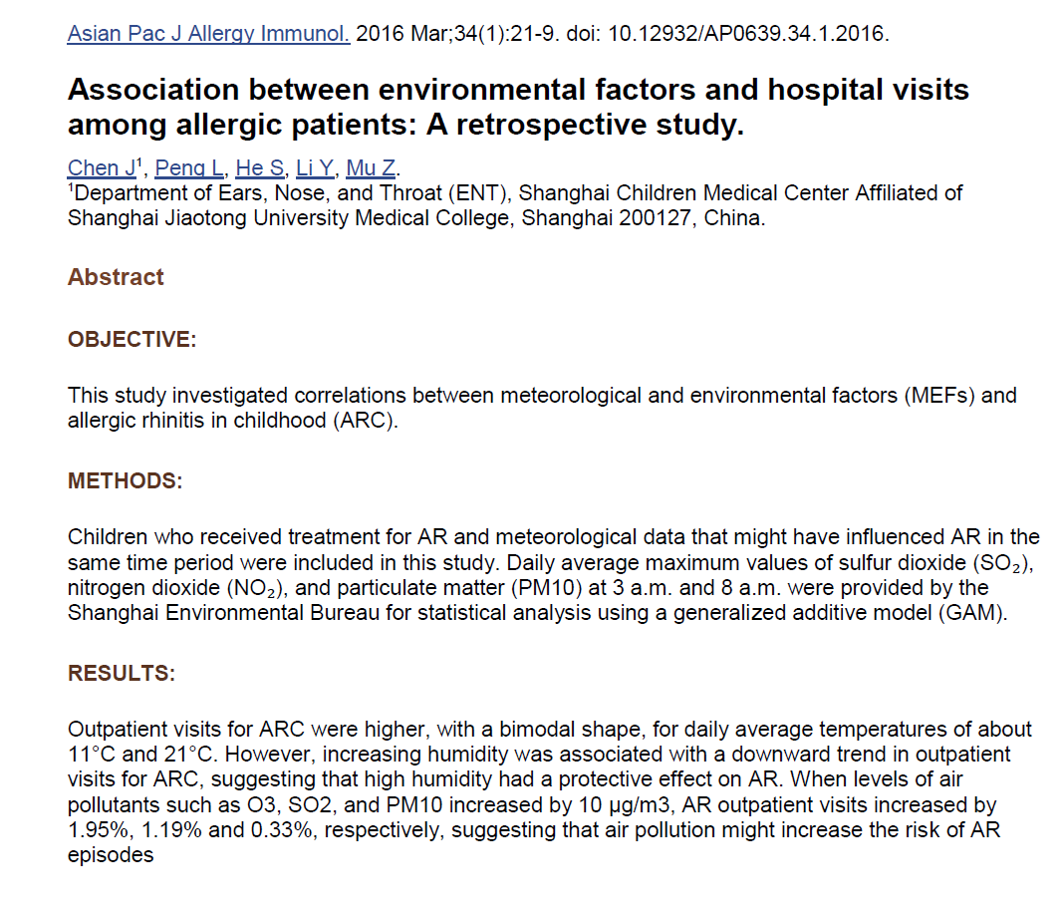
Association between environmental factors and hospital visits among allergic patients: A retrospective study
Conclusion:
Meteorological and environmental factors were significantly correlated with the incidence of Allergic Rhinitis in children.
Chen J / Peng L / He S / et al: Asian Pac J Allergy Immunol 2016 Mar;34(1):21-9. doi: 10.12932/AP0639.34.1.2016

Slide 37
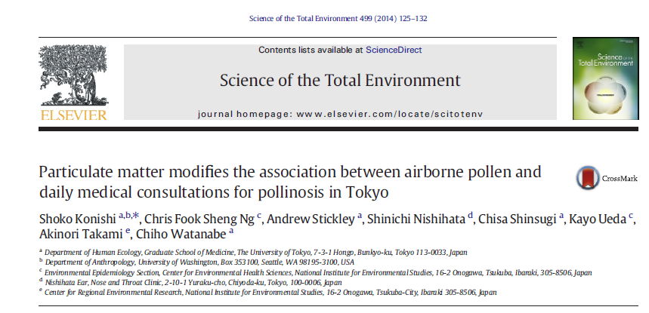
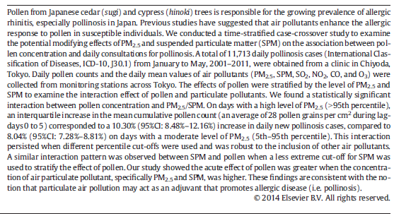
Particulate matter modifies the association between airborne pollen and daily medical consultations for pollinosis in Tokyo
The acute effect of pollen was greater when the concentration of air particulate pollutant, specifically PM2.5 and SPM, was higher.

Slide 38
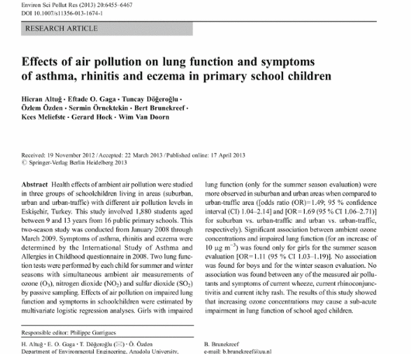
Effects of air pollution on lung function and symptoms of asthma, rhinitis and eczema in primary school children
The results of this study showed that increasing ozone concentrations may cause a sub-acute impairment in lung function of school aged children.

Slide 39
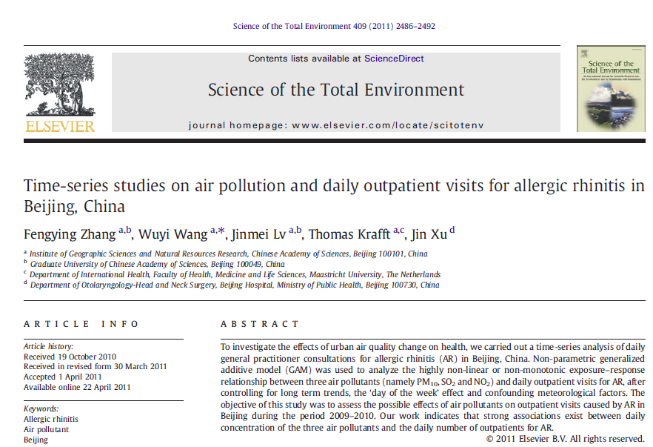
Time-series on air pollution and daily outpatient visits for allergic rhinitis in Beijing, China
This work indicates that strong associations exist between daily concentration of the three air pollutants and the daily number of outpatients for AR.

Slide 40
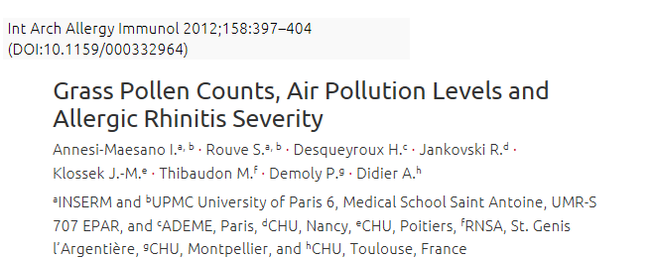
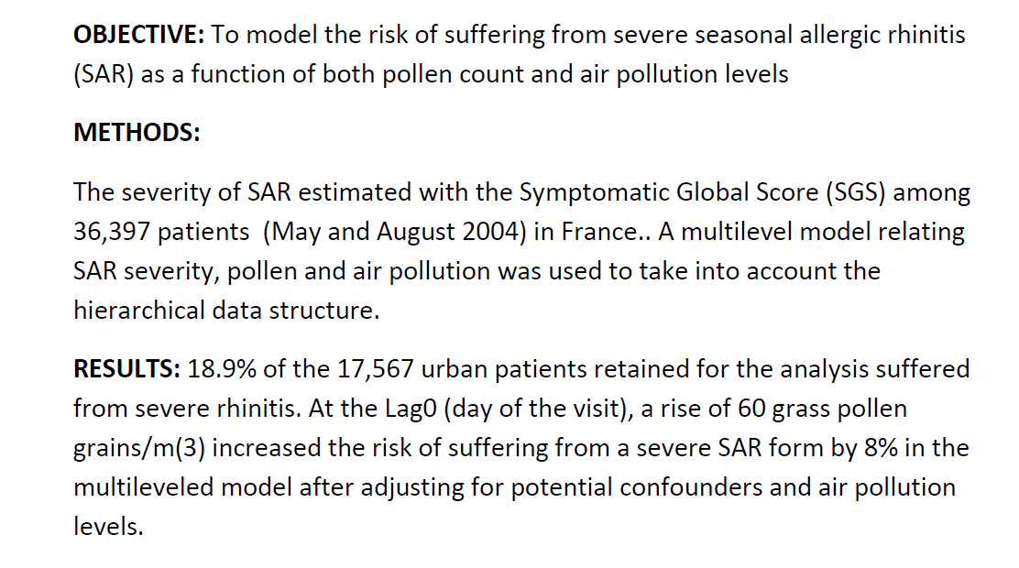
Grass pollen counts, air pollution level and allergic rhinitis severity
Conclusions:
Grass pollen count aggravated SAR in terms of symptoms in this nationwide sample.
These findings confirm the need for proper treatment and preventive measures in SAR patients sensitized to grass pollen.

Slide 41
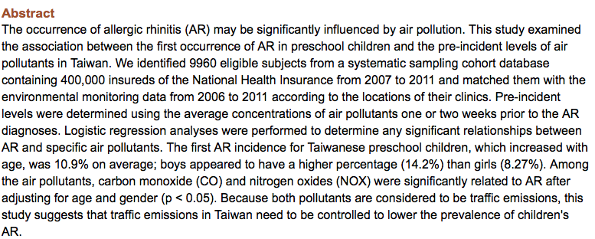
Association between the first occurrence of allergic rhinitis in preschool children and air pollution in Taiwan
Because both pollutants are considered to be traffic emissions, this study suggests that traffic emissions in Taiwan need to be controlled to lower the prevalence of children’s Allergic Rhinitis.
Chung HY / Hsieh CJ / Tseng CC / et al. Int J Environ Res Public Health 2016 Feb 27;13(3) pii: E268.doi: 10.3390/ijerph13030268

Slide 42
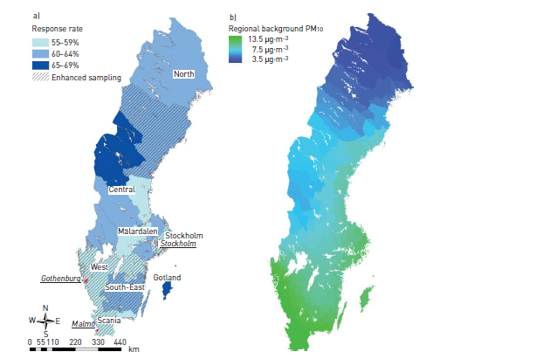
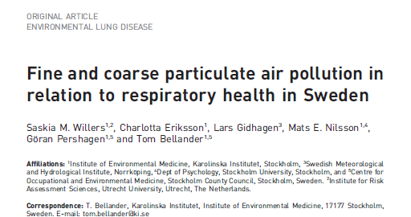
Fine and coarse particulate air pollution in relation to respiratory health in Sweden
Health effects may be associated with residential levels of air pollution. It is difficult to disentangle effects of long-term exposure to locally generated and long-range transported pollutants, as well as to exhaust emissions and wear particles from road traffic. We aimed to investigate effects of exposure to particulate matter fractions on respiratory health in the Swedish adults
Methods: Nationwide environmental health survey performed in 2007 (25,851 adults aged 18-80 years).
Individual exposure to particulate matter at residential addresses was estimated by dispersion modelling of regional, urban and local sources.
Associations analysed using multiple logistic regression, adjusting for individual and contextual confounding.
Results: Exposure to locally generated wear particles showed associations for blocked nose or hay fever, chest tightness or cough, and restricted activity days with odds ratios of 1.5-2 per 10-μg·m(-3) increase. Associations were also seen for locally generated combustion particles, which disappeared following adjustment for exposure to wear particles.
Conclusion:
Data indicate that long-term exposure to locally generated road wear particles increases
the risk of respiratory symptoms in adults
Map of Sweden showing study regions and main cities (underlined), response rates, and areas in which enhanced participant sampling in the Swedish Environmental Survey of 2007 took place.
Map of Sweden showing modelled regional background particulate matter <10 μm aerodynamic diameter range (PM₁₀) (long-range transport) particle concentration.

Slide 43
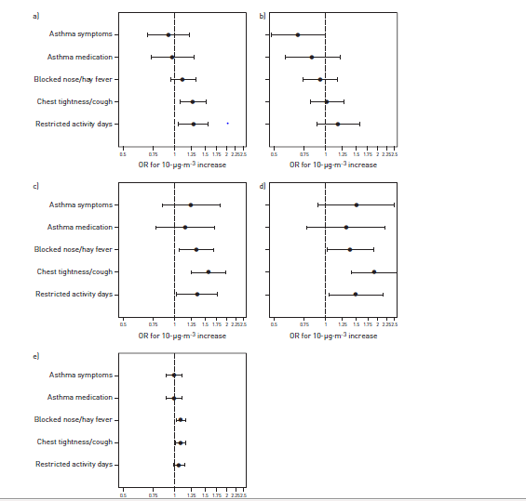
Adjusted associations between different particulate matter (PM) fractions and self-reported current respiratory health outcomes in the Swedish Environmental Survey of 2007.
Total particulate matter <10 μm aerodynamic diameter range (PM10),
long-range transport particles,
locally generated PM10,
locally generated wear particles
locally generated combustion particles.
Data are presented as odds ratios and error bars represent 95% confidence intervals.
Saskia M. Willers et al. Eur Respir J 2013;42:924-934
Notes:
Adjusted associations between different particulate matter (PM) fractions and self-reported current respiratory health outcomes in the Swedish Environmental Survey of 2007. One-pollutant models adjusted for the individual confounders sex, age, educational level, smoking, passive smoking, mould and moisture exposure in the home and country of birth, and the contextual confounders proportion of highly educated and unemployed people in the municipality. a) Total particulate matter <10 μm aerodynamic diameter range (PM₁₀), b) long-range transport particles, c) locally generated PM₁₀, d) locally generated wear particles and e) locally generated combustion particles. Data are presented as odds ratios and error bars represent 95% confidence intervals.

Slide 44
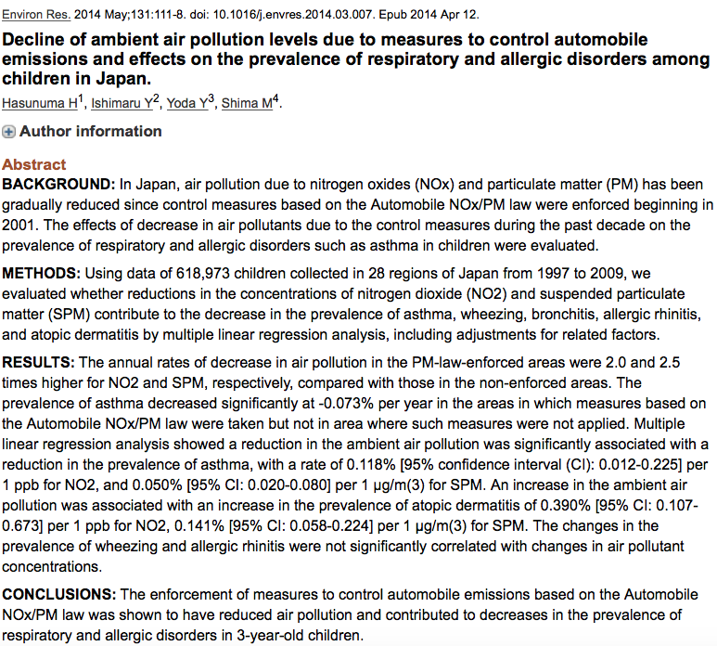
Decline of ambient air pollution levels due to measures to control automobile emissions and effects on the prevalence of respiratory and allergic disorders among children on Japan
Conclusion:
The enforcement of measures to control automobile emissions based on the Automobile NOxPM law was shown to have reduced air pollution and contributed to decreases in the prevalence of respiratory and allergic disorders in 3-year-old children.
Hasunuma H / Ishimaru Y / Yoda Y / et al: Environ Res 2014 May;131:111-8, doi: 10.1016/j.envres.2014.03.007. Epub 2014 Apr 12

Slide 45
The role of air pollution in the severity of rhinitis
Severity of rhinitis
Outdoor air pollution
Indoor air pollution
Tobacco smoking

Slide 46
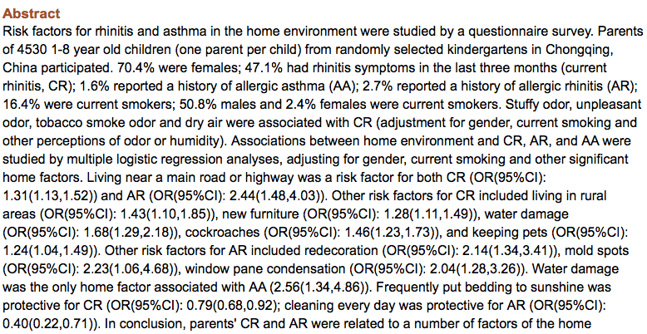
Rhinitis symptoms and asthma among parents of preschool children in relation to the home environment in Chongqing, China
Conclusion:
Parent’s Current Rhinitis and Allergic Rhinitis were related to a number of factors of the home environment.
Wang J / Li B / Yu W / et al: PLoS One 2014 Apr 14;9(4):e94731. doi: 10.1371/journal.pone.0094731. eCollection 2014

Slide 47
The role of air pollution in the severity of rhinitis
Severity of rhinitis
Outdoor air pollution
Indoor air pollution
Tobacco smoking

Slide 48

Pilot study assessing the impact of smoking on nasal-specific quality of life
Bousquet PJ / Fabbro-Peray P / Janin N / et al: Allergy 2004 Sep;59(9):1015-6

Slide 49

Effect of smoking on symptoms of allergic rhinitis
Conclusion:
In the present study, which was performed with a large number of untreated patients with a diagnosis of Allergic Rhinitis, smoking was found not to alter nasal symptoms or nasal specific quality of life.
Bousquet PJ / Cropet C / Klossel JM / et al: Ann Allergy Asthma Immunol 2009 Sep;103(3):195-200. doi: 10.1016/S1081-1206(10)60181-0

Slide 50
Conclusions
There is robust evidence that air pollutants can exacerbate response to allergens to which persons already sensitized.
However, it remains unclear whether exposure to ambient air pollutants can promote primary development of atopy.
Larger sample size studies are urgently need to confirm findings and improve control measures.
Different study design could be used for this type of studies.

Slide 51

Triggers and aggravating factors for allergic rhinitis
(indoor and outdoor)

Slide 52

International Study of Asthma
& Allergies in Childhood (ISAAC III)
Asthma
Allergic Rhinoconjunctivitis

Slide 53



Pawa
Pawankar R et al, 2009

Slide 54
ASIAN SURVEY : Impact of AR on Asthma in Child’s Quality of Life
A great deal and Quite a lot A little bit
Total disrupted:
Ability to get a good night’s sleep
85%
Participation in leisure & sports . . .
82%
Concentration at work/ school
83%
Ability to enjoy social activities
63%
Most patients (73%) had pre-existing AR when diagnosed with asthma.
most troublesome symptom was wheezing (17%) and coughing (17%).
Erkka V and Pawankar R, 2007

Slide 55
A few global facts and figures for two common allergic diseases, asthma and rhinitis:
Country | Year costs calculated | Population (2010) | Disease | Direct costs* | Indirect costs** | Total costs estimated
Australia | 2007 | 23 million | All allergies | A$1.1 billion | A$8.3 billion | A$9.4 billion
Finland | 2005 | 5.3 million | All allergies | €468 million | €51.7 million | €519.7 million
South Korea | 2005 | 50 million | Asthma Allergic Rhinitis |  |  | US $1.78 billion US $266 million
Israel |  | 7.5 million | Asthma |  |  | US $250 million
Mexico | 2007 | 103 million | Asthma |  |  | US $35 million
USA | 2007 2005 | 310.2 million | Asthma Allergic Rhinitis | US $14.7 billion US $11.2 billion | US $5 billion Up to US $9.7 billion | US $19.7 billion Up to $20.9 billion
* Direct costs: Expenditure on medications and health care provision
** Indirect costs: Cost to society from loss of work, social support, loss of taxation income, home modifications, lower
productivity at work, etc.
Member Societies Survey Reports in: Pawankar R, Canonica GW, Holgate ST, Lockey RF. WAO White Book on Allergy (World Allergy Organization, 2011), pp 153-226.

Slide 56
Definition of Air Pollutants
Primary – pollutants directly emitted into the atmosphere (eg. SO₂, some NO_{x} species, CO, PM)
Secondary – pollutants that form in the air as a result of chemical reactions with other pollutants and gases (eg. Ozone, NO₂, some particulates)
*PM=particulate matter; SO2=sulfur dioxide; CO=carbon
Monoxide; NO2=nitrogen dioxide; NOx=nitrogen oxides

Slide 57
Gaseous Pollutants
NO_{x}
SO₂
Ozone
CO
CO₂
SVOC (semi-volatile organic compounds include aldehydes, dioxins, benzene, 1,3-butadiene)

Slide 58
Particulate Matter (PM)
Coarse PM (2.5-10 um)
- regulatory standard = PM₁₀
Fine PM (0.1 – 2.5 um)
- regulatory standard = PM_{2.5}
Ultrafine PM (<0.1 um)
- not regulated

Slide 59
Outdoor pollutants
Sources
- industrial
- commercial
- mobile
- urban
- regional
- agricultural
- natural
Products
- SO₂, O₃⁻, NO_{x}, CO, PM, SVOC
*PM=particulate matter; SO2=sulfur dioxide; CO=carbon
Monoxide; NO2=nitrogen dioxide; NOx=nitrogen oxides

Slide 60
Indoor pollutants
Sources
- cooking
- combustion
- particle resuspension
- building materials
- air conditioning/cleaning
- consumer products
- smoking
- heating
- biologic agents
Products
- NO_{x}, CO, CO₂, SVOCs (semi-volatile organic compounds include aldehydes, dioxins, benzene, 1,3-butadiene, ozone (O₃⁻), bacteria,
mold-byproducts, endotoxin

Slide 61



Factors associated with epigenetic effects
Pollutants (humans)
Cigarette Smoking^{1,2}
Diesel exhaust particles^{3,4}
Organic pollutants (pesticides / industrial chemicals) ^{5,6}
Microbial exposure (in utero)
Animals - (IFNγ) allergy preventive ⁷
Humans – (FOXP3) allergy protective ⁸
Dietary factors (folate)
animals: maternal folate promotes asthma phenotype
humans: less clear¹⁰⁻¹² – no change to recommendations
Brand et al. JACI 2011
Scaub et al. JACI 2009
Hollingworth et al. JCI 2008
Whitrow et al. Am J Epidem 2009
Haberg et al. JACI 2011
Magdelijns et al. Pediatrics 2011

Slide 62
Gestational and early life exposures to ambient NO2 are risk factors for childhood respiratory diseases.
3358 preschool children who did not alter residences after birth from a cross-sectional study in 2011-2012 in Shanghai, China.
Parents reported children's respiratory health history, home environment, and family lifestyle behaviors.
Daily concentrations of sulphur dioxide (SO2), nitrogen dioxide (NO2), and particulate matter with an aerodynamic diameter ≤10μm (PM10) during the child's total lifetime (2006-2012) for each district where the children lived.
RESULTS:
Exposure to NO2 in the first year of life was significantly associated with asthma.
Exposure to NO2 during gestation, the 1-3 years, and over total lifetime was all associated with increased odds of allergic rhinitis.
No significant association with exposures to SO2 and PM10
Liu W1 et al. Environ Int. 2016

Slide 63
Preconceptional, prenatal and postnatal exposure
to outdoor and indoor environmental factors on allergic diseases/symptoms in preschool children.
Children's lifetime incidence of allergic diseases and current prevalence of allergic symptoms and exposure to indoor new furniture/redecoration and mold/dampness was surveyed by a questionnaire.
Exposure to outdoor air pollutants was estimated by the concentrations measured at air quality monitoring stations.
Multiple logistic regression model was used to evaluate the associations between outdoor air pollutants and indoor environmental factors and allergic diseases (asthma, allergic rhinitis, and eczema) and symptoms (wheezing, night cough, and rhinitis-like).
Preconceptional, prenatal, and postnatal exposure to outdoor industrial and traffic air pollutants were significantly associated with increase in the risk of childhood asthma, and also positively associated with allergic rhinitis and eczema
Allergic symptoms in children were found to be associated with exposure to indoor factors only.
Deng Q et al. Chemosphere 2016

Slide 66
The frequency of asthma treatment during the past 12 months showed a significant increase (p<0.05) with exposure to in the complex source zones.
The frequency of allergic rhinitis treatment during the past 12 months increased significantly with exposure to Black Carbon (p<0.001), SO₂^{(p<0.05), NO}₂^{(p<0.01) for all subjects.}

Slide 67
Risk factors for asthma, allergy and eczema were studied in a stratified random sample of adults in Stockholm.
In 2005, 472 multifamily buildings (10,506 dwellings) were invited (one subject/dwelling) and 7,554 participated (73%).
Associations were analyzed by multiple logistic regression, adjusting for gender, age, smoking, country of birth, income and years in the dwelling.
11% doctor-diagnosed asthma, 22% doctor-diagnosed allergy, 23% pollen allergy.
Doctor’s diagnosed asthma more in dwellings with humid air and mould odour.
Doctor’s diagnosed allergy was more common in buildings with supply exhaust air ventilation and was associated with redecoration and mould odour
Pollen allergy was less common in buildings using more energy for heating and was associated with humid air and mould odour.
In conclusion, asthma, allergy or eczema were more common in buildings using less energy for heating, in larger buildings and in dwellings with redecorations, mould odour, dampness and humid air.

Slide 68
Association between environmental factors and hospital visits among allergic patients: A retrospective study
Children who received treatment for AR and meteorological data that might have influenced AR in the same time period were included in this study.
Daily average maximum values of sulfur dioxide (SO₂), nitrogen dioxide (NO₂), and particulate matter (PM10) at 3 a.m. and 8 a.m. were provided by the Shanghai Environmental Bureau for statistical analysis using a generalized additive model (GAM).
Outpatient visits for ARC were higher, with a bimodal shape, for daily average temperatures of about 11°C and 21°C.
Increasing humidity was associated with a downward trend in outpatient visits for ARC.
When levels of air pollutants such as O3, SO2, and PM10 increased by 10 μg/m3, AR outpatient visits increased by 1.95%, 1.19% and 0.33%, respectively.
Chen J et al Asian Pac J Allergy Immunol, 2016; Thailand

Slide 70
^{NO and NO}2 are two main air pollutants that are positively associated with respiratory diseases, followed by PM10^{, PM}2.5^{, O}3^{, CO, and SO}2.
Young outpatients (age 0–15 years) are most sensitive to changing air pollution and meteorology factors, followed by the eldest (age §66 years) and age 16–65 years of outpatients.
Outpatients most sensitive to air pollution and meteorology factors are patients with allergic rhinitis, asthma, and pneumonia diseases.
In the context of sex difference to air pollution and meteorological factors, male outpatients are more sensitive than female outpatients in the 16–65 age groups, while female outpatients are more sensitive than male outpatient sin the young 0–15 age groups and in the oldest age groups.

Slide 71
The first 2-year home environment and onset, remission of asthmatic and allergic symptoms
Information on the home environment (perceptions of odors and indicators of pollution sources) and children's health (wheeze, rhinitis and eczema) was collected for the first 2 years of life and the last year (before answering the questionnaire) from one of the parents or another guardian of the child.
Associations between the home environment the first 2 years of life and new onset and remission of childhood symptoms were analyzed by multiple logistic regression.
Home environment factors reported for the first 2 years were consistently positively associated with new onset of symptoms and negatively associated with remission of symptoms.
Visible, moldy odor, air dryness, stuffy odor and parental smoking were associated with new onset of symptoms and negatively associated with the remission of symptoms.
Lin Z et al Sci Total Environ. 2016

Slide 72
Children were differently exposed to poor air quality in classrooms, with almost 30% being highly exposed according to available standards. After adjusting for confounders, past year rhinoconjunctivitis was significantly associated with high levels of formaldehyde in classrooms.
An increased prevalence of past year asthma was found in the classrooms with high levels of PM2.5, acrolein and NO2 as compared with others.
The relationship was observed mostly for allergic asthma as defined using SPT. A significant positive correlation was found between EIA and the levels of PM2.5 and acrolein in the same week.
Air quality in classrooms was poor, varied significantly among schools
and cities, and was related to an increased prevalence of clinical manifestations of asthma and rhinitis in schoolchildren.

Slide 73
Children's respiratory health and oxidative potential of PM2.5: the PIAMA birth cohort study.
For 3701 participants of a prospective birth cohort, annual average concentrations of OP (assessed by spin resonance (OP(ESR)) and dithiothreitol assay (OP(DTT)), PM with an aerodynamic diameter of less than 2.5 µm (PM2.5) mass, NO2, and PM2.5 constituents at the home addresses at birth and at all follow-up addresses were estimated by land-use regression.
Repeated questionnaire reports of asthma and hay fever until age 14 years, and measurements of allergic sensitisation, lung function and fractional exhaled nitric oxide at age 12 years were linked with air pollution concentrations.
Asthma incidence, prevalence of asthma symptoms and rhinitis were positively associated with OP(DTT). These associations persisted after adjustment for most co-pollutants.
Forced expiratory volume in 1s and forced vital capacity were negatively associated with OP(DTT).
These associations were sensitive to adjustment for NO2.
Yang A et al. Occup Environ Med. 2016

Slide 74
Allergens, air pollutants, and childhood allergic diseases.
Of the 2861 kindergarten children, 12.6% of the children had asthma, 30.0% had allergic rhinitis (AR), and 14.4% had atopic dermatitis (AD).
Mite sensitization significantly increased the risk of AD, AR, and asthma. Exposure to PM10, PM(2.5), CO, and O(3) was associated with asthma.
PM(2.5) may have increased the risk of AR.
Mite sensitization showed a synergistic effect with PM(2.5) on the development of asthma (p < 0.001). Moreover, mite allergens may modify the effect of air pollutants on allergic diseases.
Dust mites and PM(2.5) play an important role on the risk of asthma and AR. Exposure to PM(2.5) and mite allergens had a synergistic effect on the development of asthma. Avoiding co-exposure to allergens and air pollutants is important.
Wang J et al. Int J Hyg Environ Health. 2016

Slide 75
Asthma and Air Pollution
Air pollution has been associated with:
  Increased bronchial hyperresponsiveness
  Increased airway inflammation
  Decreased lung function
  Increased hospital admissions and ER visits
  Enhancing airway inflammation induced by allergen
  exposure
  Priming of the airways to allergic responses
Molfino, Lancet, 1991; Peden, AJRCCM, 1995
Takizawa R, Pawankar R, Clin Exp Allergy 2002
ER: Emergency Room

Slide 76
Epidemiologic Studies Of Pollution And Aeroallergens On Causing Asthma
Many studies have investigated the effects of automobile related pollutants in heavily traveled expressways on causing asthma symptoms in allergic children
High vehicle traffic is associated with asthma symptoms in children with known allergen sensitization
Janssen NA, et.al. Environ Health Perspect 2003;111:1512-18.
Venn AJ, et.al. Am J Respir Crit Care Med 2001;164:2177-80.
Wyler C, et.al. Epidemiology 2000;11:450-6.
Nicolai T, et.al. Eur Respir J 2003:21:956-63.

Slide 77
Epidemiologic Studies Of Pollution And Aeroallergens On Asthma Exacerbation
Ozone and fungal spores have been demonstrated to be cofactors in increasing asthma symptoms and SABA use
Ozone, NO₂ and SO₂ individually or in combination may enhance airway response to inhaled allergens
Delfino RJ, et.al. Am J Resp Crit Care Me 1996;154:633-41.
Delfino RJ, et.al. Environ Health Perspect 1997;105:622-35.
D’Amato G, et.al. Environ Res 2003;91:21-8.

Slide 78
Lung Function and Air Pollutants
Inhalation of 1 ppm of SO2 for 10 minutes during moderate exercise decreased FEV1 by 23% in adolescents with asthma.¹
An association between ambient ozone levels below EPA limits and asthma symptoms was found in children with asthma living in New England.²
¹Koenig JQ, et al. Environ Res 1981;25:340-8.
²Gent et al. JAMA 2003;290:1859-1867

Slide 79
ER Visits for Respiratory Complaints and Air Pollutants
Numerous studies have found an association between PM 10 levels and ER visits for asthma.
An increase of 11 µg/m3 in fine PM was associated with an 11% increase in asthma ER visits.1
Ozone and SO2 have been associated with ER visits for asthma in Mexico.2
¹Norris et al Environ Health Perspect 1999;107:489-93.
²Romieu et al Am J Epidemiol 1995;141:546-53.

Slide 80
Mechanisms Of Pollutant-Related Adverse Health Effects
PM or ozone induced airway inflammation
Oxidative stress induced by transition metals or polyaromatic hydrocarbons
Covalent modifications of intracellular proteins/enzymes
Biologic compounds (glucans, endotoxin) effect on the innate immune response and inflammation
Stimulation of the autonomic nervous system
Adjuvant effects (DEP + allergens)
Procoagulant activity of ultrafine PM
Suppression of normal defense mechanisms

Slide 81
Inflammatory Markers and Air Pollutants
Exposure to ozone results in an influx of neutrophils and alveolar macrophages into the airway.^{1,2}
IL-6, IL-8, LTB4, and thromboxane B2 are increased after exposure to ozone.
mCD14 surface expression on airway macrophages is enhanced following ozone exposure ²
PM₁₀ exposure increases allergen specific IgE production leading to increased airway inflammation.
1. Peden DB, Ann Allergy Asthma Immunol 2001;87(Suppl):12-17.
2. Arjomandi M, Am J Respir Cri Car Med 2005;172:427-32. 3. Alexis NE et al, Clin Immunol. 2004 Apr;111(1):126-31.

Slide 82
Diesel Exhaust Particulate (DEP)
The largest single source of airborne PM is diesel exhaust.
Diesel engines emit up to 100 times more exhaust particulate matter than gasoline engines.
Diesel exhaust particulates consist of a carbon core with a large surface area which permits many chemicals and metals to attach.
Most of the deleterious effects of DEP’s are due to the chemicals that are adsorbed onto their surface.

Slide 83
Effects of Diesel Exhaust on the Respiratory System
Increased Diesel exhaust PM levels have been linked to cardiorespiratory mortality.¹
Numerous studies have demonstrated an association between high air pollution levels and cough, bronchitis, asthma, and COPD.
As a strong association between high diesel exhaust levels and other airborne pollutants exists, it is difficult to determine the relative contributions of each pollutant source.
1. Samet et al NEJM 2003;343:1742-9

Slide 84
Effects of Diesel Exhaust on the Respiratory System
Physician diagnosed asthma has been reported to be more frequent among children living within 100 meters of a freeway.¹
Higher rates of allergic sensitization are found in children playing more than one hour/day near major traffic thoroughfares.²
van Vliet et al Environ Res 1997;74:122-32
2. Duhme et al Epidemiology 1996;7:578-82

Slide 85
Adjuvant Effects of Diesel Exhaust
DEP’s increase allergic inflammation when co-administered with allergens.
In rat models, intra-tracheal administration of grass pollen in conjunction with DEP’s induces inflammatory reactions in the lungs characterized as macrophage and eosinophil infiltrates.¹
Human B cells cultured with IL-4 and DEP’s show a 360% increase in IgE production.
¹Steerenberg et al Inhal Toxical 1999;11:1109-22

Slide 86

Summary of Clinical Features of Diesel Exhaust Particles
Diaz – Sanchez et al JACI 1999;104:1183-8.

Slide 87
Ozone Enhances Allergic Inflammation
Ozone causes an increased immediate and late airway response to inhaled allergen
Increased sputum eosinophils were observed in induced sputum after 6 hours
This effect was most pronounced at higher ozone exposure levels (0.16-.25 ppm)
Allergic asthma patients challenged intranasally with dust mite allergen + 0.4 ppm ozone had increased ECP and IL-8 levels after 8 hours
Bell BA, et.al. J Allergy Clin Immunol 1996;98:563-72.
Kehrl HR, et.al. J Allergy Clin Immunol 1999;104:1198-204.
Peden DB, et.al. Am J Respir Crit Care Med 1995;151:1336-45.

Slide 88
Sulfur Dioxide, Nitrogen Dioxide, Carbon Monoxide
Epidemiologic studies have demonstrated that exposure to SO₂, NO₂ and CO increase cardiopulmonary mortality, respiratory and cardiovascular hospital admissions caused by stroke (NO₂) and myocardial infarction (NO₂ and CO)

Slide 89
Interaction Between Allergen And Pollutants
Epidemiologic studies of pollution and aeroallergens on causing asthma
Epidemiologic studies of pollution and aeroallergens on the exacerbation of asthma
Experimental studies on the adjuvant effects of DEPs on specific TH₂ responses
Role of pollution and global warming on natural allergen production
Bernstein JA, et.al. J Allergy Clin Immunol 2004;114:1116-23.

Slide 90
The Potential Influence of Climate Change on Aeroallergens
Increased amount of pollen
Stronger allergenicity of pollen
Human activities
CO₂
Temperature
Increased germination rate
Altered plant/tree distribution
Earlier start to pollen season
Longer pollen season
Beggs PJ. Impacts of climate change on aeroallergens: past and future. Clin Exp Allergy 2004;34:1507-13.
Notes:
90

Slide 91
Role Of Pollution And Global Warming On Natural Allergen Production
Climate change has been demonstrated to cause ragweed plants to grow faster, flower earlier and produce greater amounts of pollen
This effect was greater in urban areas where CO₂ levels and temperatures were higher compared to rural areas
Doubling the atmospheric concentration of CO₂ in ragweed pollen production by 61%
Ziska LH, et.al. J Allergy Clin Immunol 2003;111:290-5.
Wayne P, et.al. Ann Allergy Asthma Immunol 2002;88:279-82.

Slide 92

Meteorological Conditions, Climate Change,
New Emerging Factors and Asthma.
A Statement of the World Allergy Organization
WAO Journal 2015

Slide 93



WAO Committee on Climate Change and Allergic Diseases.
Chairman: G. D’Amato
Pawankar R., Canonica GW, Holgate S T, Lockey R (Eds)
Climate Change, Migration and Allergic Respiratory Diseases
D’Amato Gennaro and Menachem Rottem
White Book of World Allergy Organization
UN Rio+ 20 pre panel on Environment & Health 2012

Slide 94


ERS EAACI Task Force on Climate Change,
Air Pollution and Respiratory Diseases (2009)

Slide 95

Endorsed by EAACI and ERS
Task force on “Climate change, air pollution and respiratory dieseases”
Chairpersons:
G.D’Amato and I.Annesi
Global warming affects start, duration and intensity of pollen season
Air pollution is associated with mortality and morbidity for respiratory and cardiovascular diseases.
PM and ozone are aggravating factors of asthma and increase the effects of airborne allergens with different mechanisms.
Living near heavy traffic roads is associated with impaired respiratory health and lung development.
Subjects living in urban areas tend to be more affected by plant-derived respiratory disorders than those living in rural area
Sep; 65(9):1073-81 Allergy, 2010

